Slide 1
Recent Progress with Atomic Layer Deposition
T.Proslier^{1,2}, J.Norem¹
J.Elam³, M.Pellin⁴, J.Zasadzinski², P.Kneisel⁵, R.Rimmer⁵, L.Cooley⁶, C.Antoine⁷
High Energy Physics, ANL
Department of Biological, Chemical and Physical Sciences, IIT
Materials Science Division, ANL
Energy System Division, ANL
J-Lab
Technical Division, FNAL
7. CEA, France
LDRD review 2009
NuFact09

Slide 2
Can the fundamental properties of SRF Materials be enhanced? AG, Appl. Phys. Lett. 88, 012511 (2006)
Higher-T_{c}SC: NbN, Nb₃Sn, etc
Multilayer coating of SC
cavities: alternating SC and
insulating layers with d < λ
Nb, Pb
Higher T_{c} thin layers provide
magnetic screening of the
bulk SC cavity (Nb, Pb)
without vortex penetration
For NbN films with d = 20 nm, the rf field can be as high as 4.2 T !
No open ends for the cavity
geometry to prevent flux leaks in the insulating layers
Insulating
layers
Fermilab Workshop 09
NuFact09

Slide 3
A Simple Test?
A Nb cavity coated by a single Nb₃Sn
layer of thickness d = 50nm and an
insulator layer in between
If the Nb cavity can withstand H_{i} = 150mT,
then the external field can be as high as
H₀ = 324mT
H_{i} = 150mT
d
Lower critical field for the Nb₃Sn layer with d = 50 nm and ξ = 3nm: H_{c1} = 1.4T is much higher than H₀
A single layer coating more than doubles the breakdown field with no vortex penetration, enabling E_{acc}∼ 100 MV/m
LDRD review 2009
Fermilab Workshop 09
NuFact09

Slide 4
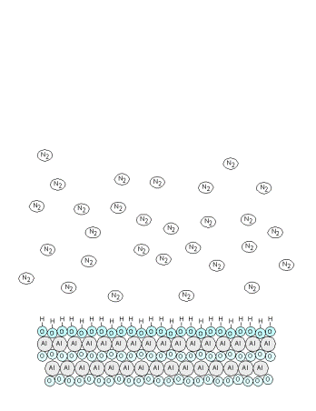

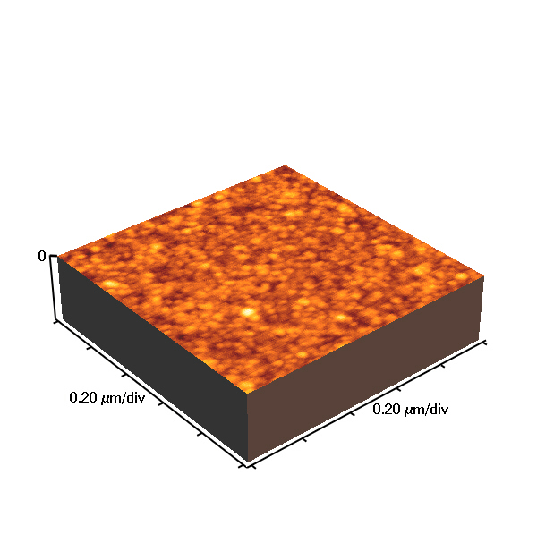
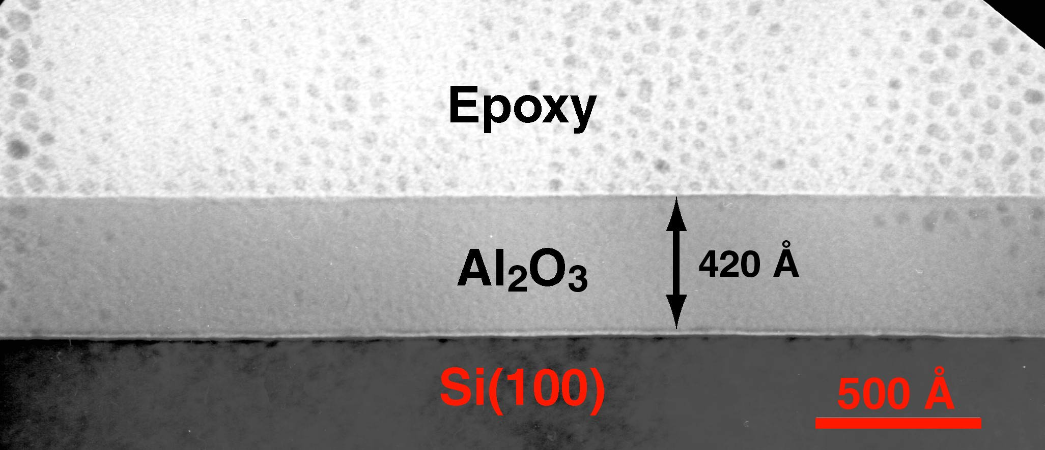

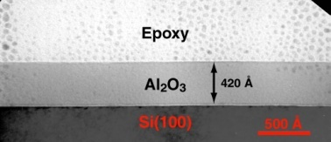
ALD Reaction Scheme
Ellipsometry
Atomic Force Microscopy
ALD involves the use of a pair of reagents.
  each reacts with the surface completely
  each will not react with itself
This setup eliminates line of site requirments
Application of this AB Scheme
  Reforms the surface
  Adds precisely 1 monolayer
Pulsed Valves allow atomic layer precision in growth
Viscous flow (~1 torr) allows rapid growth
  ~1 μm / 1-4 hours
4000
3500
No uniform line of sight requirement!
Errors do not accumulate with film thickness.
Fast! ( μm’s in 1-3 hrs )
Pinholes seem to be removed.
Bulk
3000
2500
Thickness (Å)
2000
1500
1000
500
0
Seagate, Stephen Ferro
0
500
1000
1500
2000
2500
3000
RMS Roughness = 4 Å (3000 Cycles)
ALD Films Flat, Pinhole free
AB Cycles
Flat, Pinhole-Free Film
Film growth is linear with AB Cycles
LDRD review 2009
Fermilab Workshop 09
NuFact09

Slide 5
In Situ Measurements During Al₂O₃ ALD
TMA / H₂O → Al₂O₃ + CH₄
Quartz
Crystal
Microbalance
Growth Occurs
in Discrete
Steps
Al₂O₃ Thickness (Å)
Mass
Spectrometer
Reaction Product
CH₄ Observed
CH₄ Signal (AU)
Fermilab Workshop 09
NuFact09

Slide 6
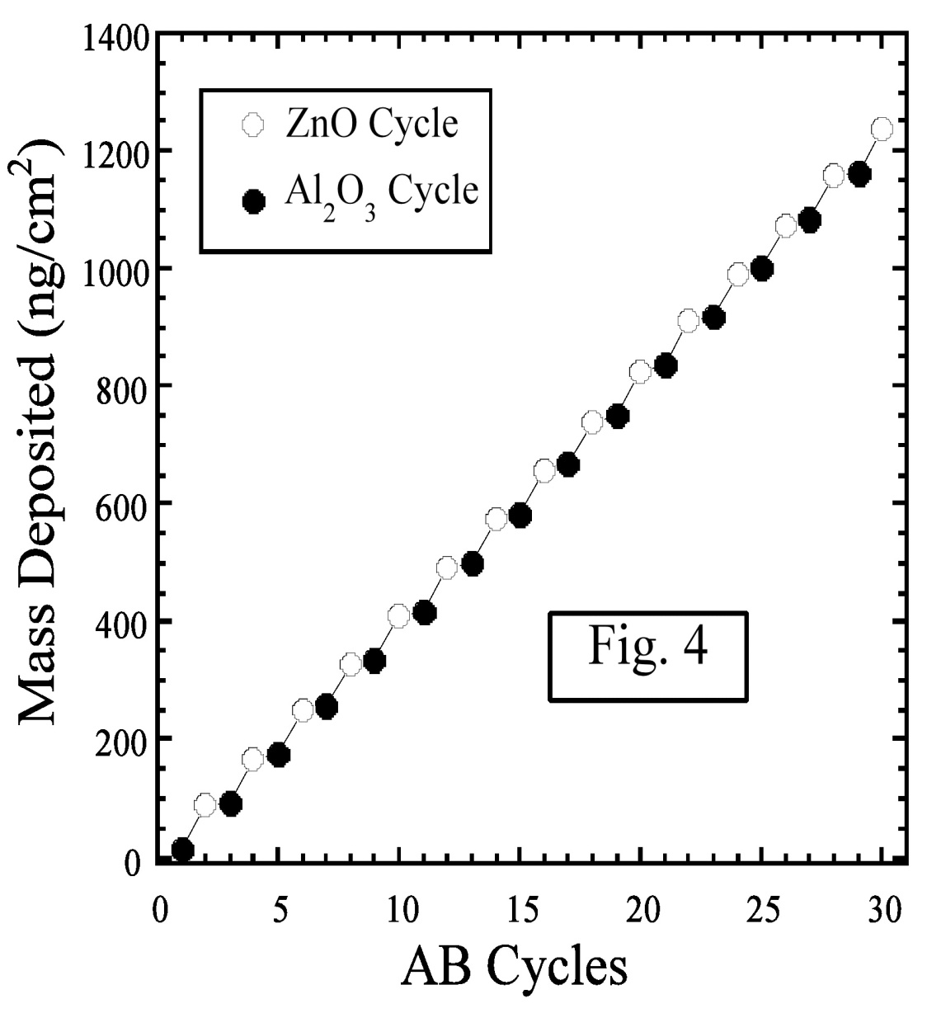
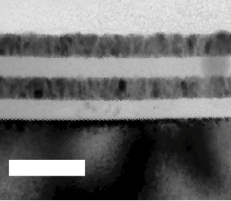
Mixed Oxide Deposition: Layer by Layer
Mixed Layer Growth
Layer by Layer
note “steps”
atomic layer sequence
“digitally” controlled
ZnO
[(CH₃CH₂)₂Zn
// H₂O]
[(CH₃)₃Al // H₂O]
Al₂O₃
ZnO
Al₂O₃
Mixed Layers w/ atomic precision
Low Temperature Growth
Transparent
Uniform
Even particles in pores can be
coated.
100 nm
Films Have Tunable Resistivity, Refractive Index, Surface Roughness, etc.
LDRD review 2009
NuFact09

Slide 7
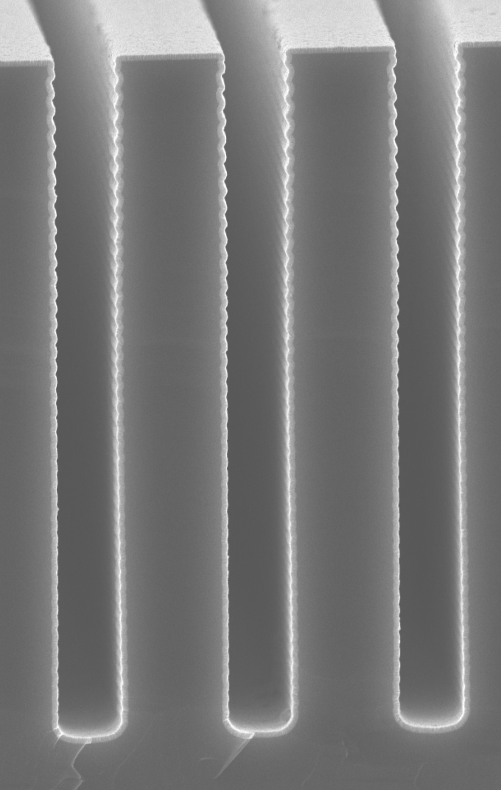
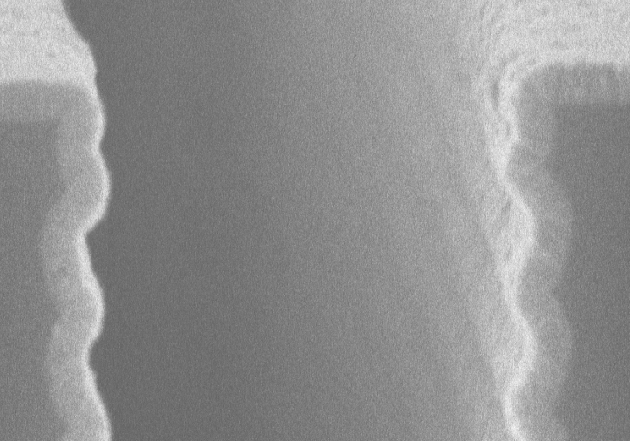
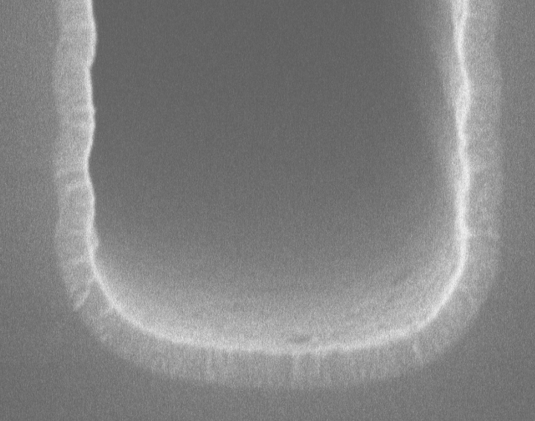
ZnO in Silicon High Aspect Ratio Trench
1 μm
ZnO
Si
200 nm
ALD is very good at coating non-planar surfaces

Slide 8
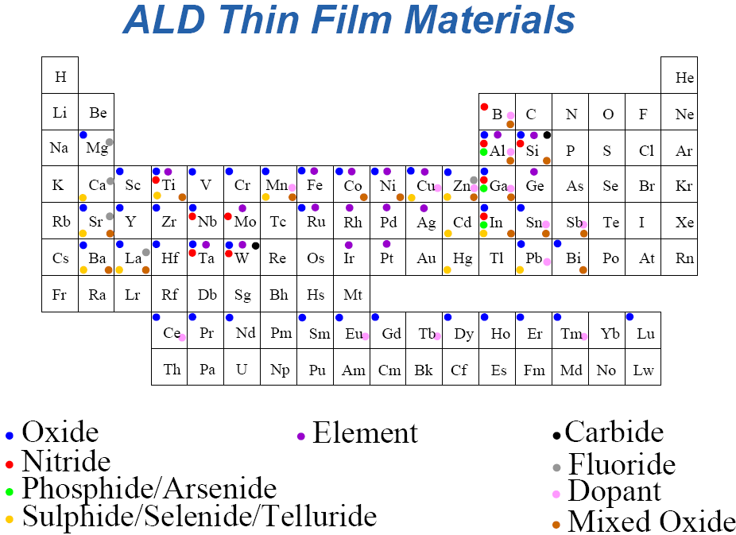
ALD Thin Film Materials
LDRD review 2009
NuFact09

Slide 9
Conformal Coating Removes Field Induced Breakdown
Synthetic Development Needed
Radius of Curvature of all asperities
(when polishing is not enough)
ALD can reduce field emission!
Could allow separation of superconductor and cavity support materials
(allowing increased thermal load, better mechanical stability)
110 nm NbSi film
RC_{before}=30nm
RC_{after}=140nm
Decrease field emission
By factor 5!
IMAGO tip ALD coated with NbSi
Normal conducting systems ( μ cooling, CLIC ) can also benefit.
• ~100 nm smooth coatings should eliminate breakdown sites in NCRF.
• Copper is a hard material to deposit, and it may be necessary to study other materials and alloys. Some R&D is required. This is underway.
• The concept couldn’t be simpler. Should work at all frequencies, can be in-situ.
LDRD review 2009
Fermilab Workshop 09
NuFact09

Slide 10
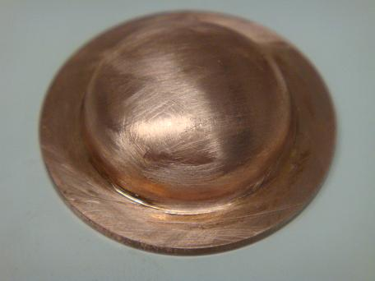
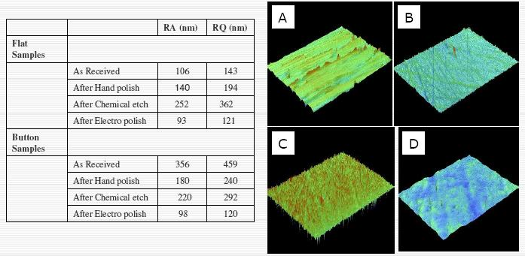
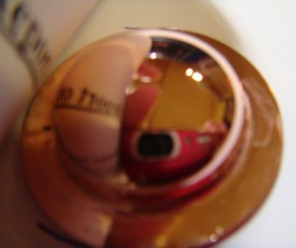
What could be done? fast time scale
Copper Buttons
356 nm
100nm
Reduce curvature radius
Reduce field emission
What material?: W, TiN, Cu
96 nm
NuFact09

Slide 11
Components of thermal ALD System
Ar, N₂
Precursors
Gas Switching
Valves
Carrier Gas
TMA
H₂O
Heated Substrates
N₂
Flow
Reaction Chamber
Flow
Heaters
Pump
For cavities: the chamber is the cavity!
New cavity dedicated system: controlling the outside atmosphere and High Temp.
Fermilab Workshop 09
NuFact09

Slide 12
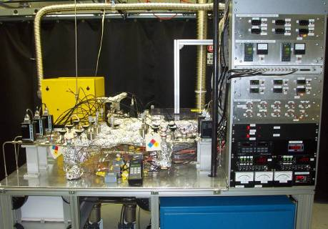
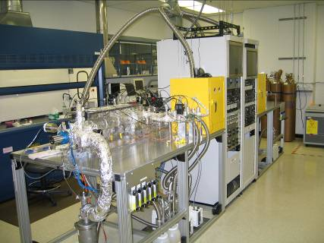
ANL thermal ALD facilities
10 chemical precursor channels
  gas, liquid, or solid
  precursor temperature to 300 C
  ozone generator
Reaction temperature to 500 C
In-situ measurements
  thickness (quartz microbalance)
  gas analysis (mass spectrometer)
Coat flat substrates (Si), porous membranes, powders, etc.
NuFact09

Slide 13
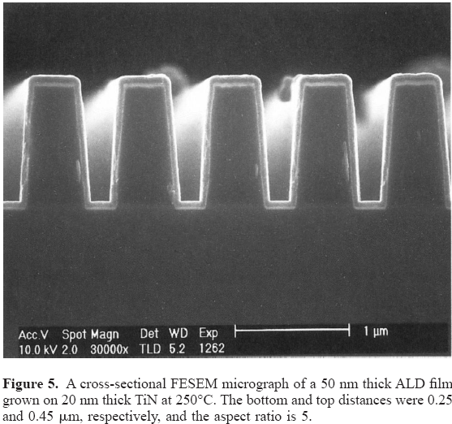
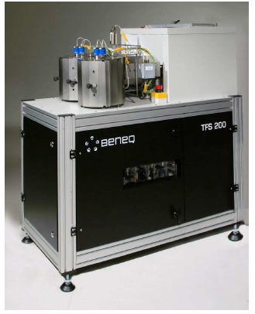
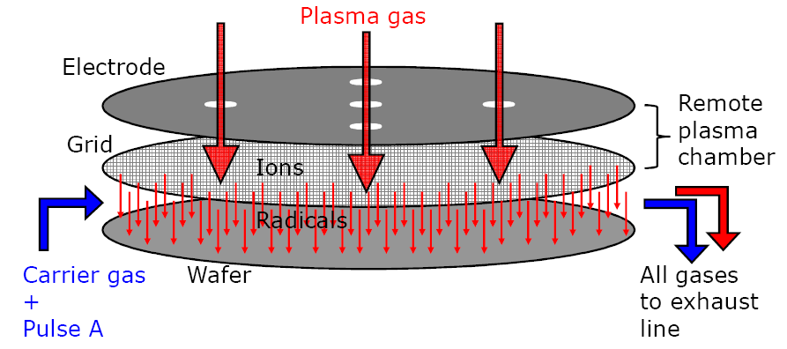
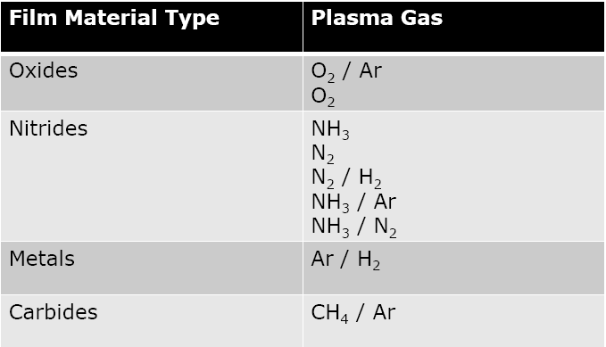
Argonne ALD facilities: Plasma ALD (PEALD)
Elemental Metals: Al, Cu, W, Mo…
& alloys: NbN, TiN, Pt/Ir etc…
Purer materials-> bulk properties
NuFact09

Slide 14
Niobium surfaces are complex
Inclusions,
Hydride precipitates
Surface oxide
Nb₂O₅ 5-10 nm
Residue from chemical processing
50 nm
RF depth
Interface: sub oxides NbO, NbO₂
often not crystalline
(niobium-oxygen “slush”)
Interstitials dissolved in niobium (mainly O, some C, N, H)
e⁻ flow only in the top 50 nm of the superconductor in SCRF cavities!!!
Clean niobium
Grain boundaries
LDRD review 2009
Fermilab Workshop 09
NuFact09

Slide 15
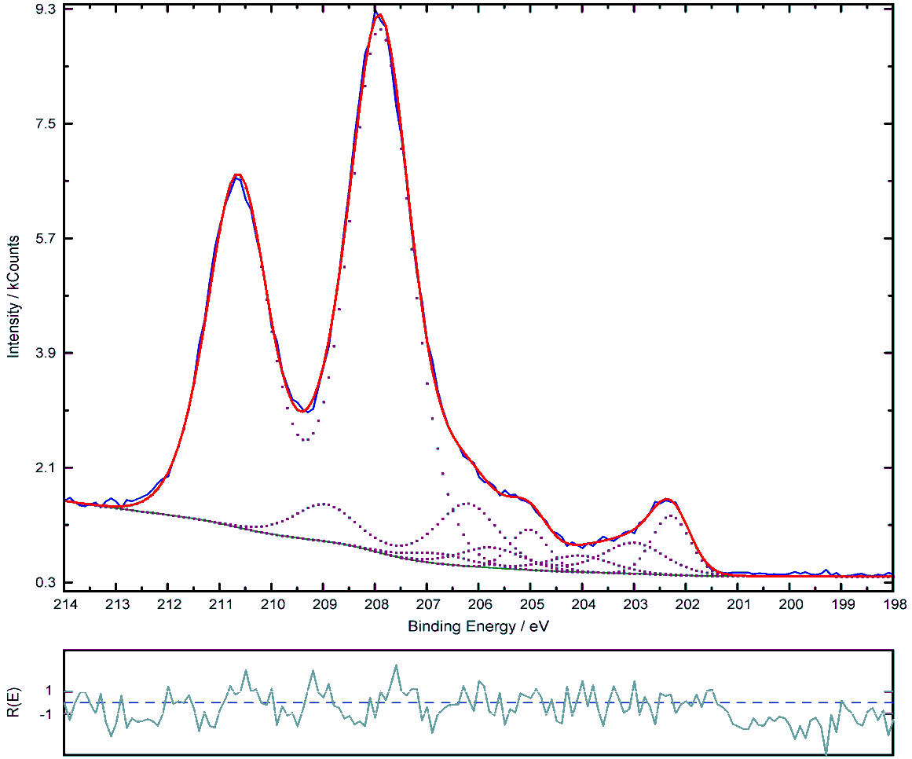
XPS - a Surface Probe of Nb Oxidation
Dielectric Nb₂O₅
Nb₂O_{5-δ}, NbO_{2+δ} are magnetic
NbO_{x} (0.2 < x < 2) is
Metallic
NbO_{x} precipitates
(0.02 < x < 0.2)
Nb₂O₅
NbO_{x}
Nb
Nb samples supplied by FNAL!
LDRD review 2009
NuFact09

Slide 16

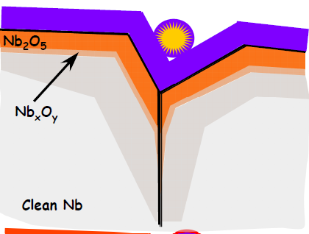
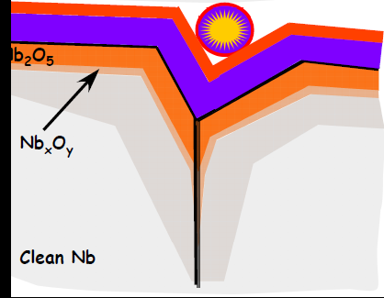
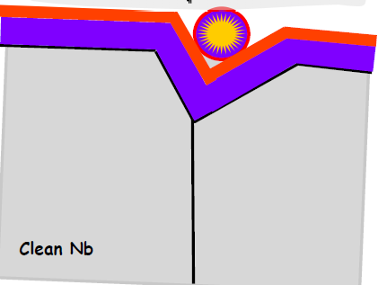
Fixing Niobium surfaces
1. Begin with EP, Clean, Tested Cavity
2. ALD with 10 nm of Al₂O₃
3. Add a low secondary electron emitter
4. Bake (>400 C) to “dissolve O into bulk
LDRD review 2009
Fermilab Workshop 09
NuFact09

Slide 17
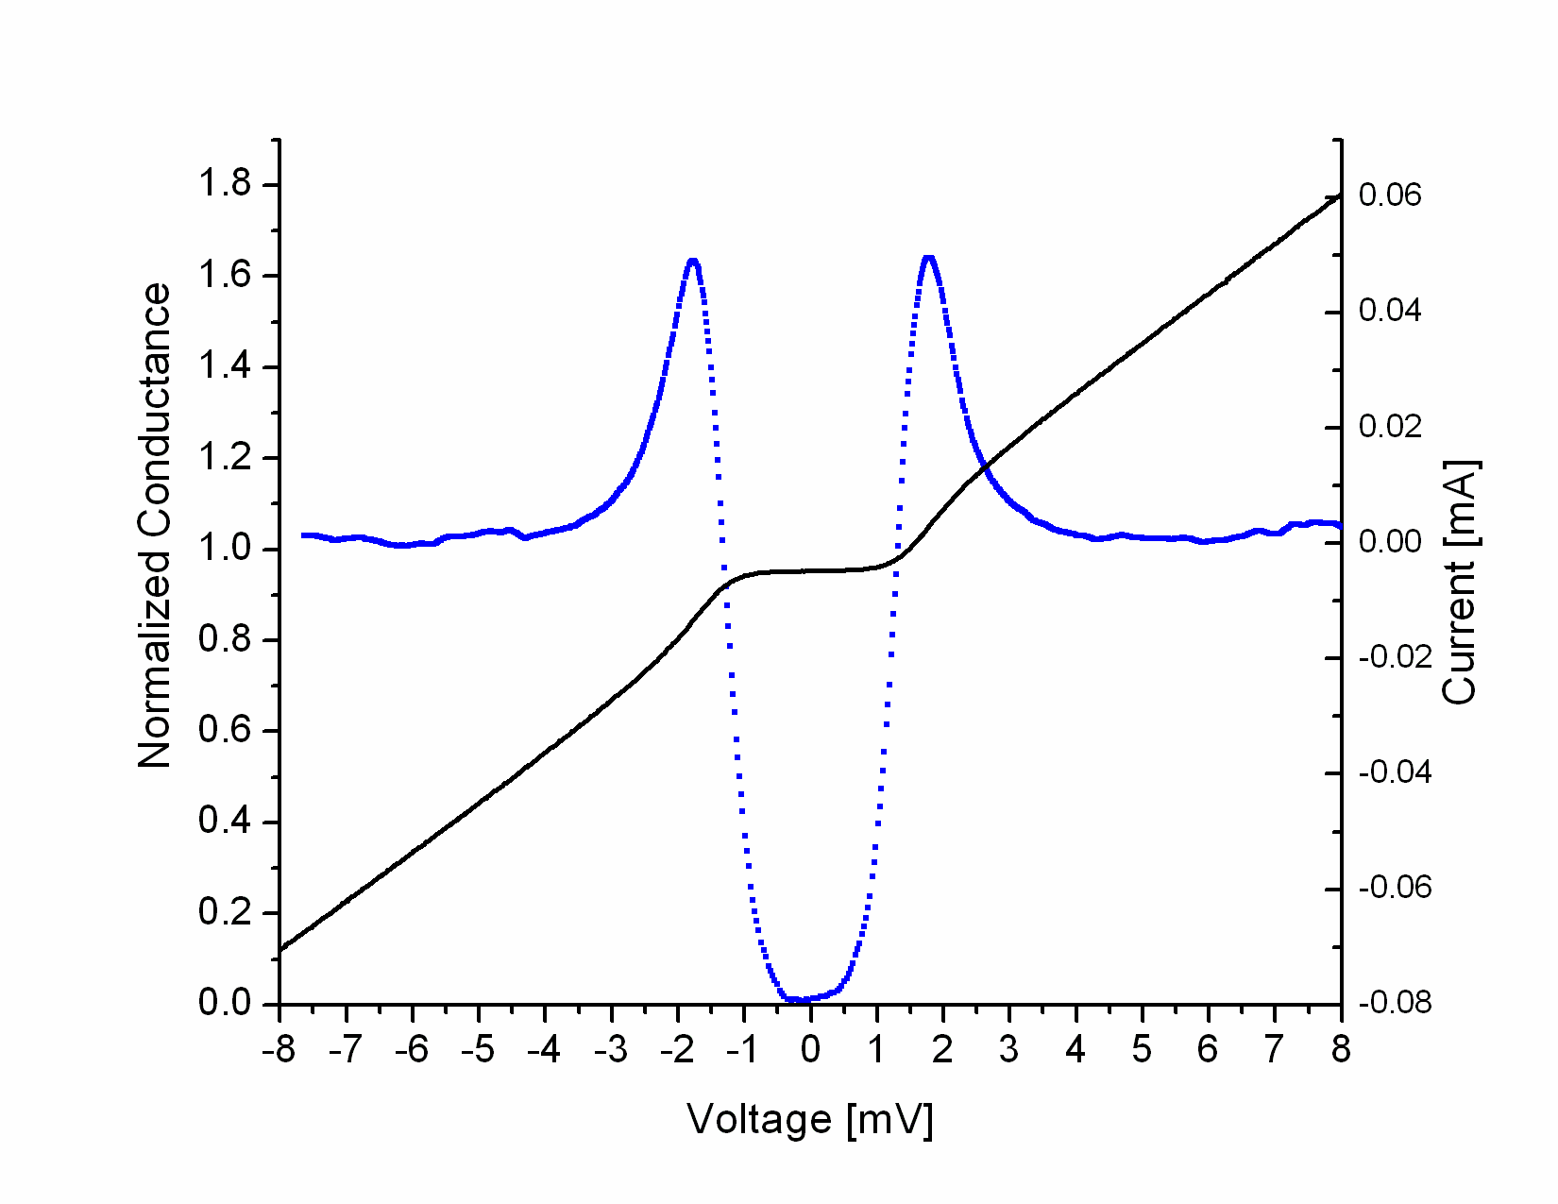
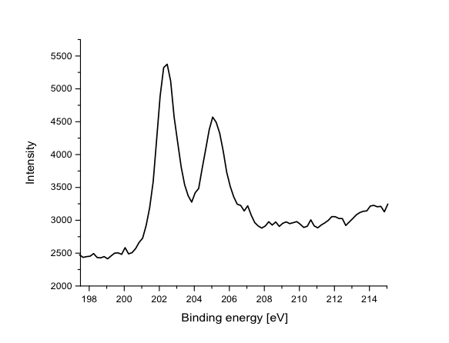
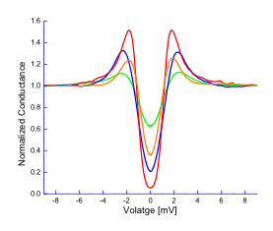
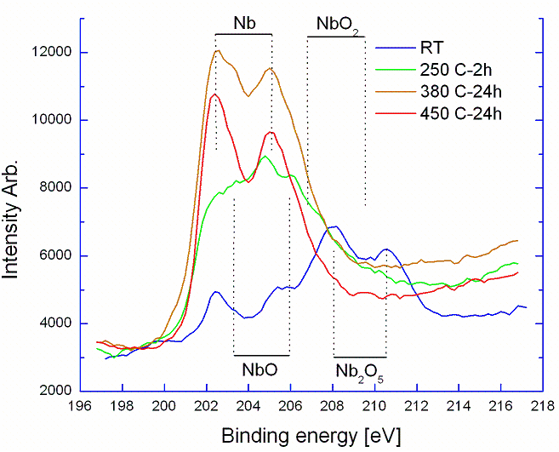
Solution to the Nb oxide problem: ALD + annealing in UHV
Reference sample, DC sputtering
Al₂O₃(2nm)
Nb
Al₂O₃ Protective layer, diffusion barrier
Al₂O₃(2nm)
T=1.7 K
NbO_{x}
Nb
Heating ->reduction + diffusion
of the oxides
Th.Proslier, J.Zasadzinski, M.Pellin et al. APL 93, 192504
LDRD review 2009
NuFact09

Slide 18
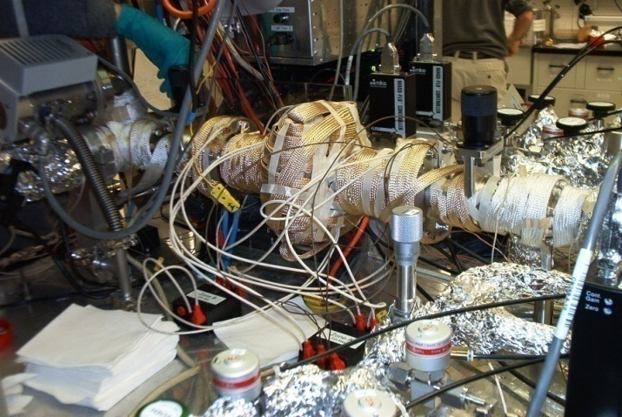
Cavity Experimental Plan
Obtain a Single Cell Cavity from JLab
  “good” performance
  Tested several times
Coat cavity with 10 nm’s Al₂O₃, 3 nm Nb₂O₅
  Niobia to reproduce original cavity surface
  Dust, clean room care
Acceleration Test at J Lab
  First test of ALD on cavities
  Check for “stuck” dust, high pressure rinse difficulties, material incompatibilities, etc.
  Goal: No performance loss
Bake @ retest still trying to finish
LDRD review 2009

Slide 19
Cavities used for ALD
Jlab has provided three different niobium cavities to ANL for
atomic layer deposition:
Cavity 1:
Material: RRR > 300 poly-crystalline Nb from Tokyo-Denkai
Shape/frequency: Earlier KEK shape, 1300 MHz
Baseline: electropolished, in-situ baked
Cavity 2 :
  Material: RRR > 300 large grain Nb from Tokyo-Denkai
  Shape/frequency: TESLA/ILC shape, 1300 MHz
  Baseline: BCP, in – situ baked
Cavity 3:
Material: RRR > 300 poly-crystalline Nb from Fansteel
Shape/Frequency: CEBAF shape, 1497 MHz
Baseline: BCP only
LDRD review 2009
NuFact09

Slide 20
J Lab Cavity 1: Best Previous Performance
Strong field emission for last 5 MV/m
LDRD review 2009
Fermilab Workshop 09
NuFact09

Slide 21
J Lab Cavity1: Last Acceleration Test (Cluster Cleaning)
Cavity “as received” for ALD Cavity Treatment
LDRD review 2009
Fermilab Workshop 09
NuFact09

Slide 22
J Lab Cavity1: After ALD Synthesis (10 nm Al₂O₃ + 3 nm Nb₂O₅)
Only last point shows detectable field emission.
2nd test after 2nd high pressure rinse. (1st test showed field emission consistent with particulate contamination)
LDRD review 2009
Fermilab Workshop 09
NuFact09

Slide 23
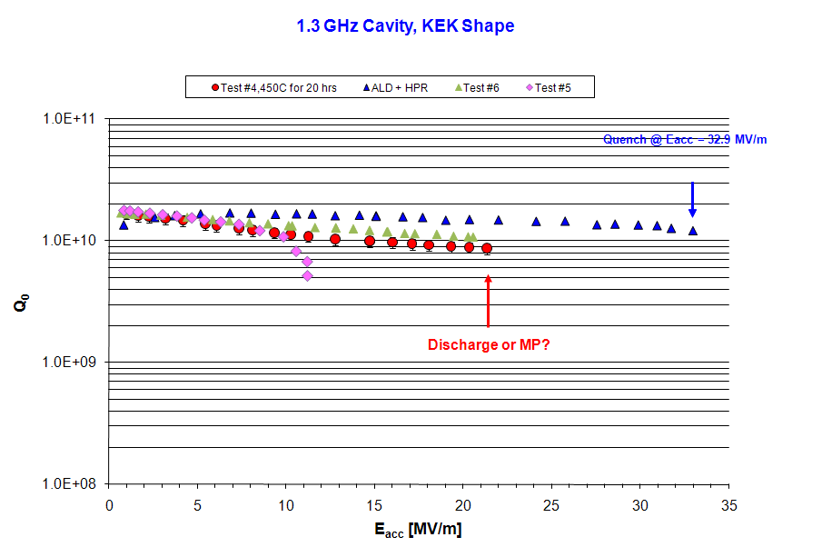
Baking 450 C/24hrs:
LDRD review 2009
Fermilab Workshop 09
NuFact09

Slide 24
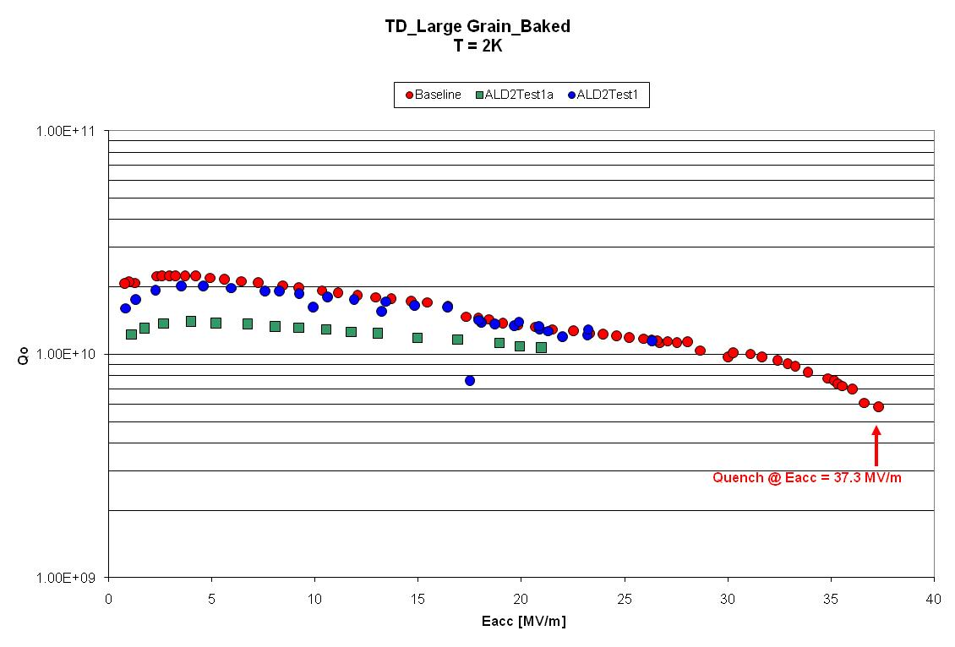
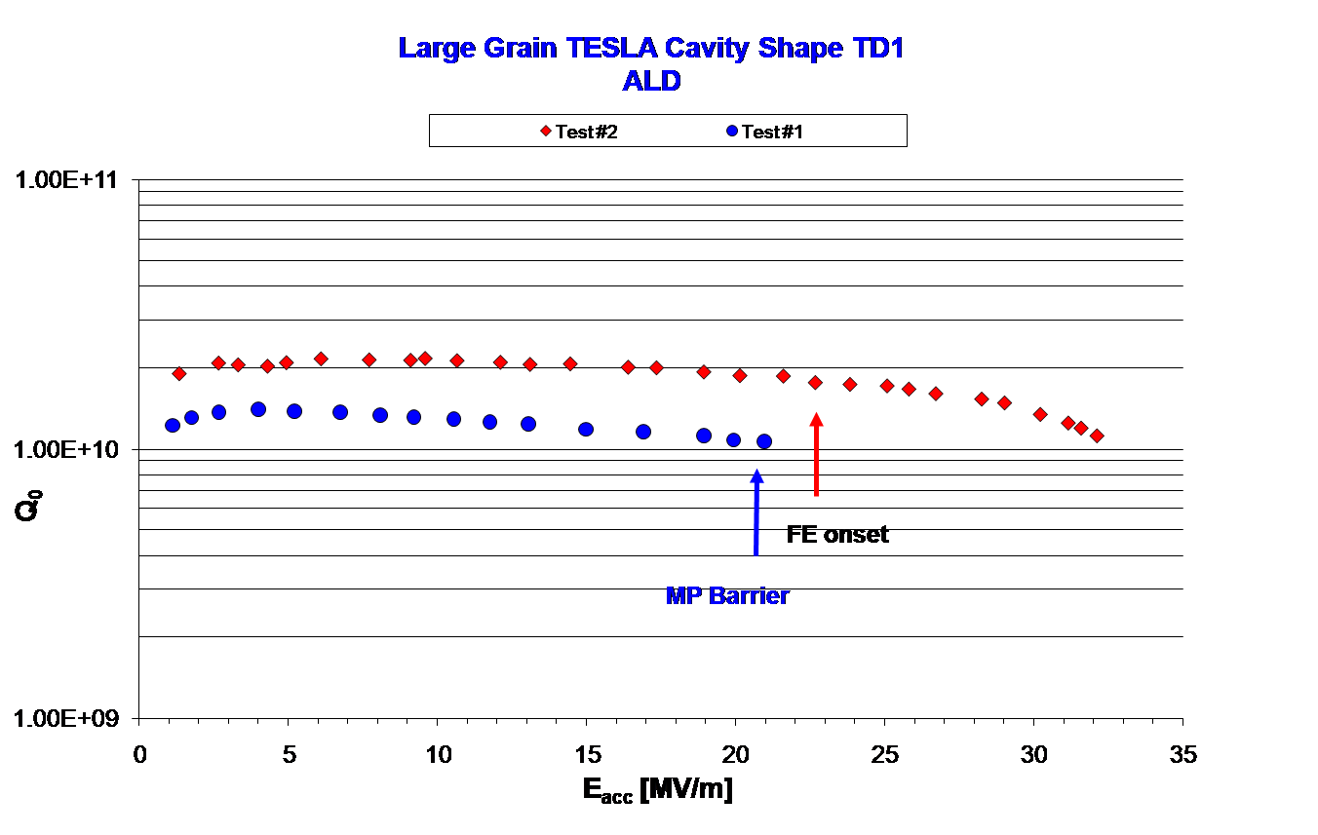
ALD2-Baseline
J lab Cavity 2: Large grain,10 nm Al2O3 + 3 nm Nb2O5
First coating: 10 nm Al₂O₃ + 3 nm Nb₂O₅
Baseline
Test 2
Test 1
Second coating: 5 nm Al₂O₃ + 15 nm Nb₂O₅
LDRD review 2009
Fermilab Workshop 09
NuFact09

Slide 25
J Lab Cavity 3: Small grain 2 steps Coating, 15 nm Al₂O₃
LDRD review 2009
Fermilab Workshop 09
NuFact09

Slide 26
J Lab Cavity 3
Baking 450C/20hrs--Coating: 5nm Al₂O₃+15 nm Nb₂O₅
Second coating
LDRD review 2009
Fermilab Workshop 09
NuFact09

Slide 27
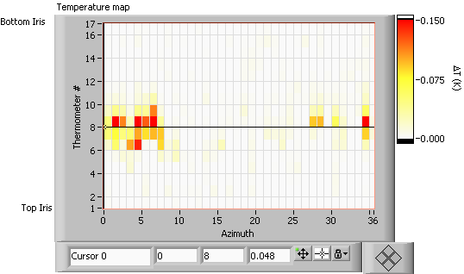
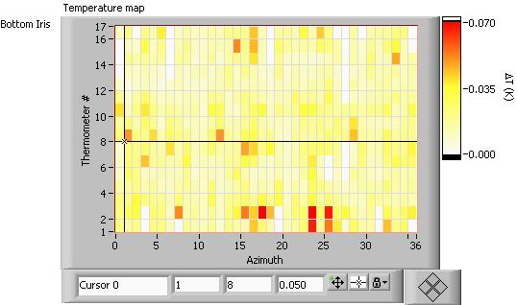
HT baking: T maps and Rs(T)
T-map at the highest field measured
during the test after 120 °C, 23 h UHV bake.
T-map at the highest field measured
during the test after 450 °C, 20 h heat treatment
Treatment | Δ/kT_{c} | ℓ (nm) | R_{res} (nΩ)
Add. HPR | 1.866 ± 0.018 | 19 ± 44 | 16.0 ± 0.8
120 °C/23 h bake | 1.879 ± 0.005 | 18 ± 55 | 16.3 ± 0.5
450 °C/20 h HT | 1.911 ± 0.026 | 58 ± 17 | 93.8 ± 0.2
Ohmic losses
HT baking: Improve the super. properties
Fermilab Workshop 09
NuFact09

Slide 28
Preliminary Conclusion
The ALD process shows promise, especially, if one thinks about multi-layer coatings to improve cavity performances as proposed by A. Gurevich. NbN layers are being produced now (though not of high quality).
However, as typical for SC cavity work, development of the process is necessary – there is no “magic” process, which immediately solves all problems
The appearance of multipacting in cavity 1 and 2 is a little bit concerning, but can be overcome by additional coating. Layers that are expected to be much better have not yet been tested (TiN for example).
Baking doesn’t improve cavity performance: cracks can appear due to strong Nb oxide reduction -> path for oxygen injection -> Ohmic losses need a in-situ baking + ALD coating set up.
LDRD review 2009
Fermilab Workshop 09
NuFact09

Slide 29
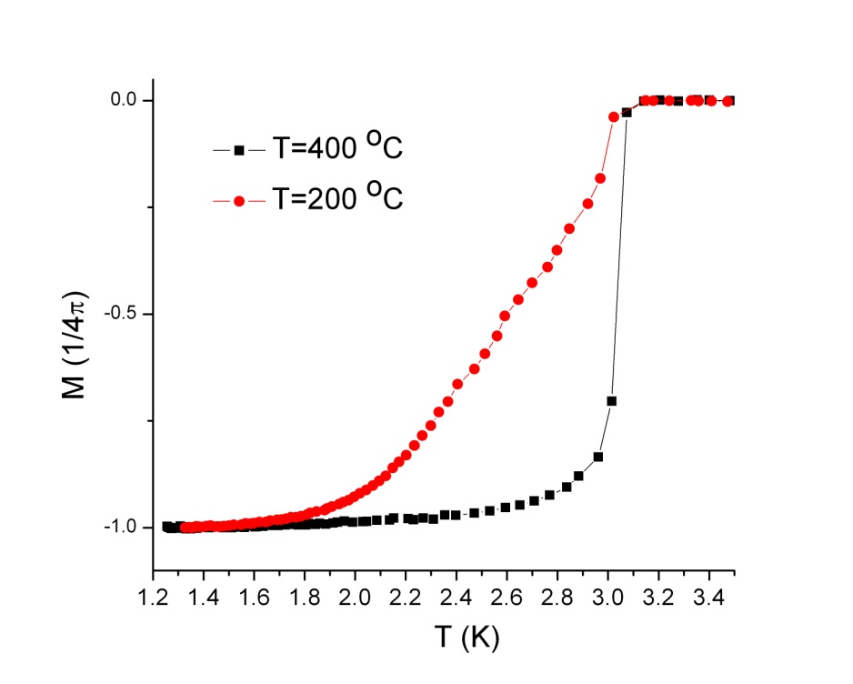
New materials grown by thermal ALD.
New precursor for Thermal ALD of Nb, NbN, Nb₂O₅ :
H₂O -> Nb₂O₅ + HF (gas)
GR = 2 Å/cy (usual: 0.5 Å/cy)
NbF₅ + Si₂H₆ -> NbSi + SiHF₃ (gas)
GR = 4.2 Å/cy
NH₃ -> NbN + HF (gas)
GR = 0.6 Å/cy (usual: 0.3/cy)
100 nm NbSi film
RC_{before}=30nm
Study metallic/ super. properties to optimize purity
Purpose: Aluminum cavity + Nb by ALD (few microns)+ multilayer NbN/SiO2
future publication.J.Chem
LDRD review 2009
NuFact09

Slide 30
Future of cavities at Argonne:
SRF project funded for 3 years
We would like very much to investigate Warm cavity.
Plasma ALD system create new opportunities :
    Plasma Etching to remove oxides
    Deposition of pure metals and superconductors
    Optimization of thin film superconducting properties: Multilayers
Fermilab Workshop 09
NuFact09

Slide 31
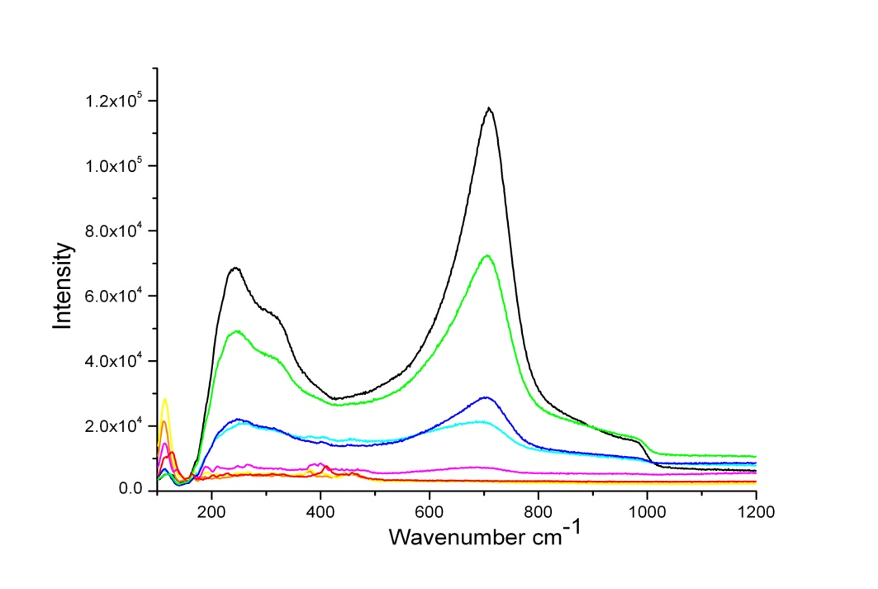
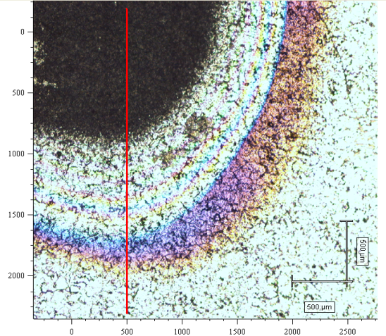
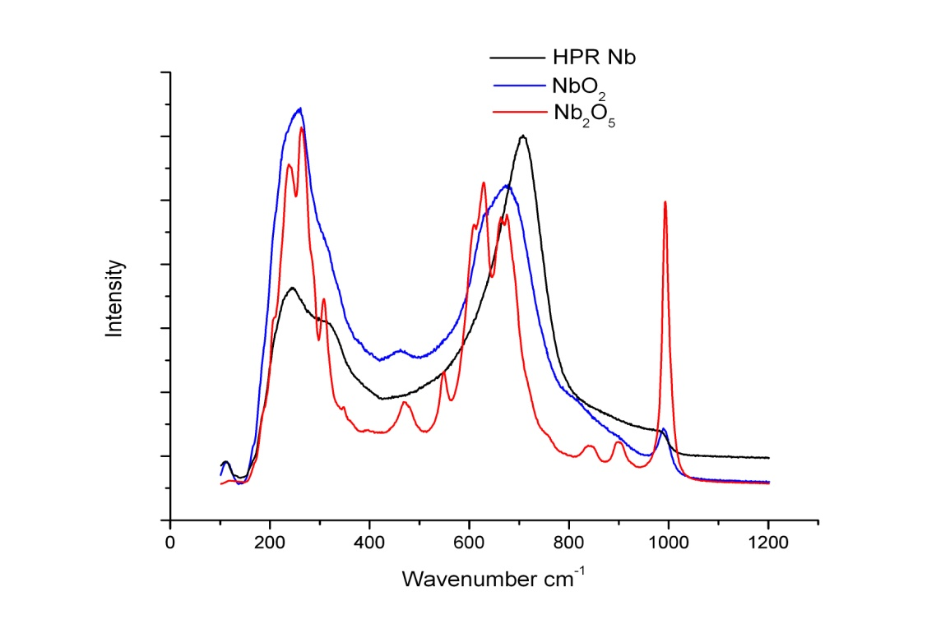
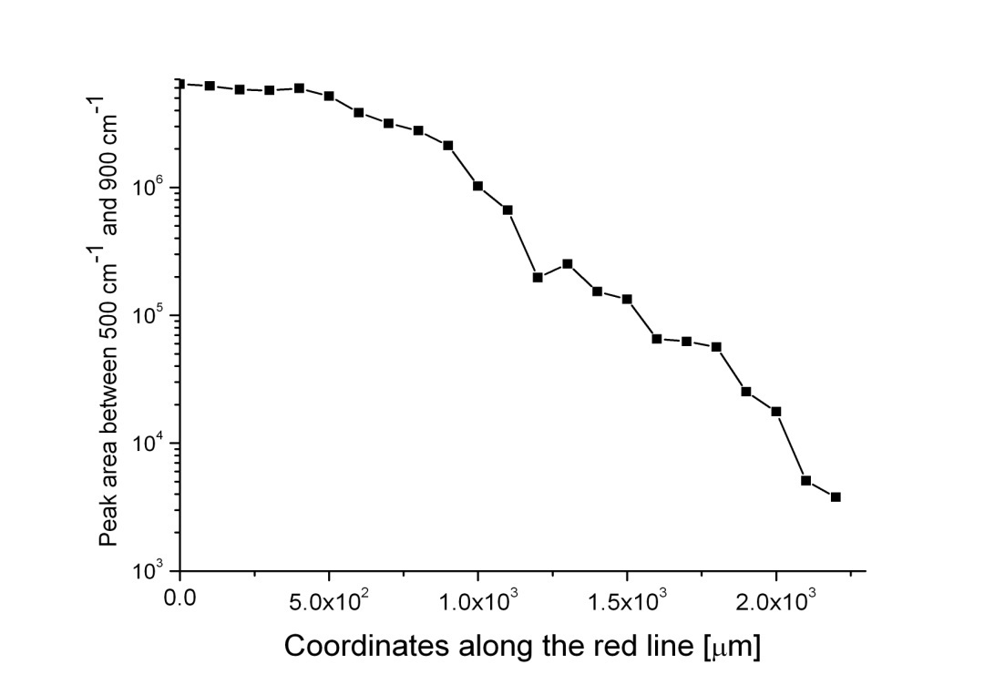
High Pressure rinsing study:
Nb Oxide peak
HPR damaged Nb sample
d~10×2.10³ = 20 µm
d=10 nm
d=10 e
LDRD review 2009
NuFact09

Slide 32
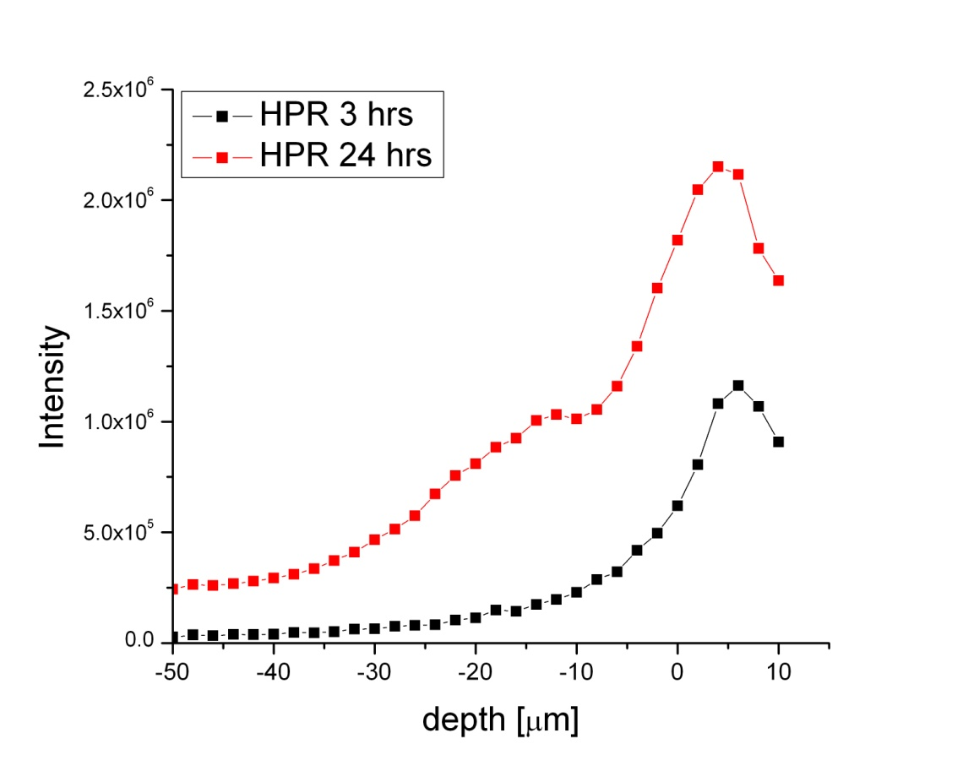
High Pressure rinsing study:
Raman co-focusing: Z-axis mapping
XPS, sputtering: depth profiling
NuFact09

Slide 33
Complex Oxide surface:
Interactions Oxide-superconductivity-cavity performance
Point contact spectroscopy: local probe the superconductivity at the surface
Magnetism-superconductivity
Quench mechanism
Raman spectroscopy: structure of the oxides
Damaged induced by HPR.
Correlation with other techniques: XPS, SEM, EDX, EPR, SQUID, XRD…
LDRD review 2009
NuFact09

Slide 34
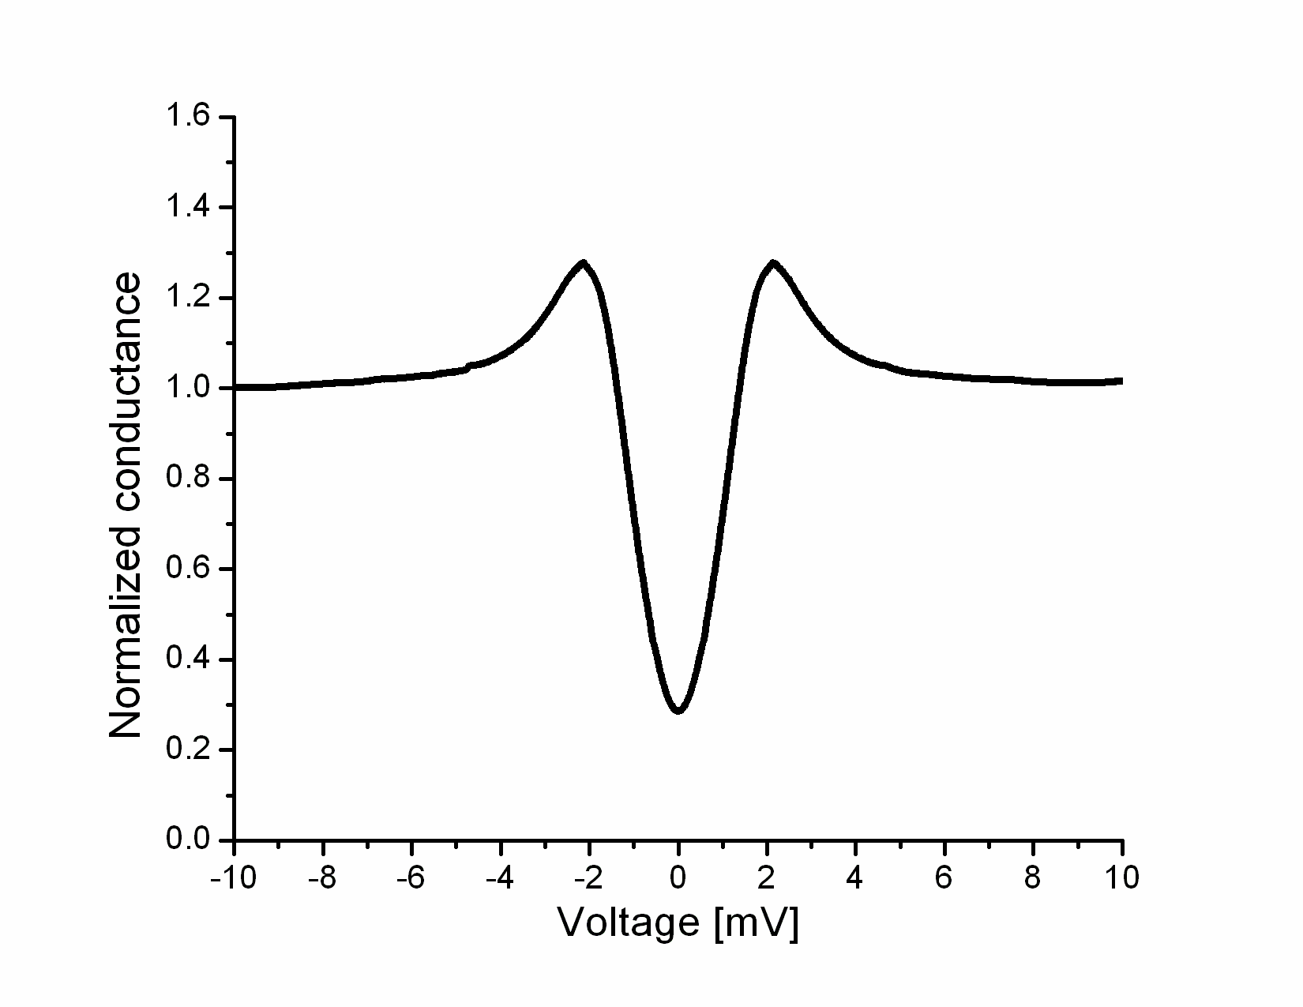
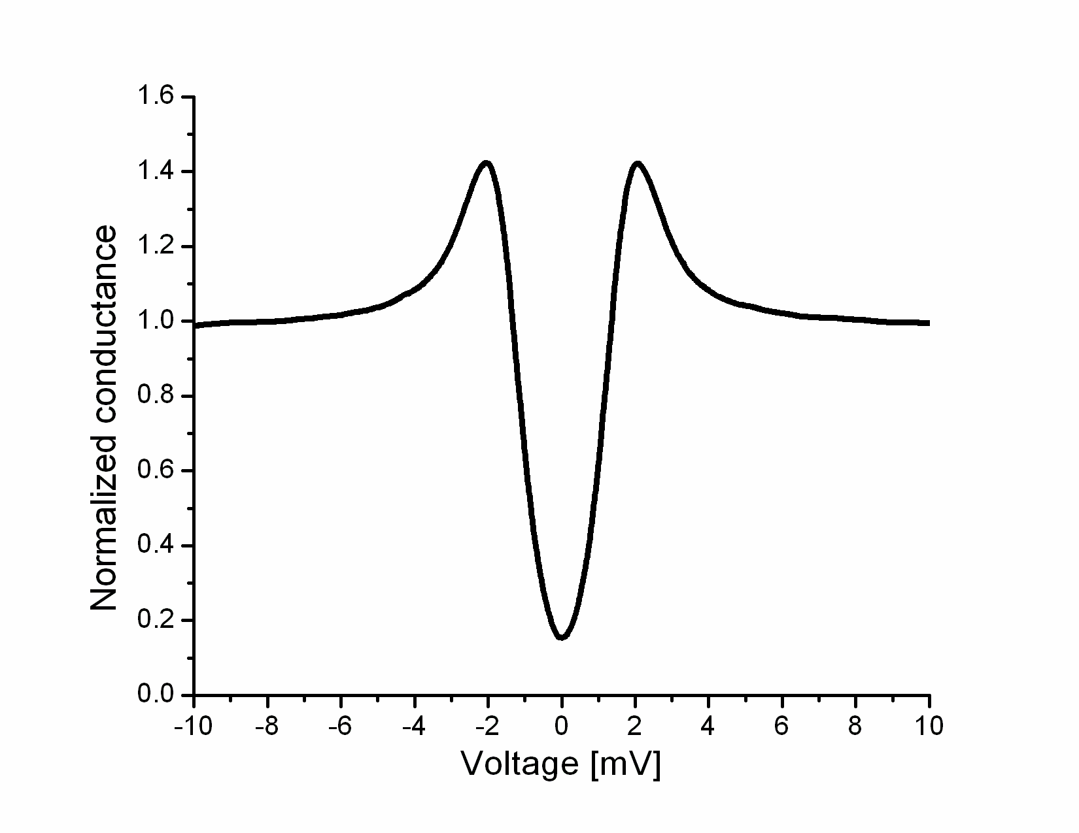
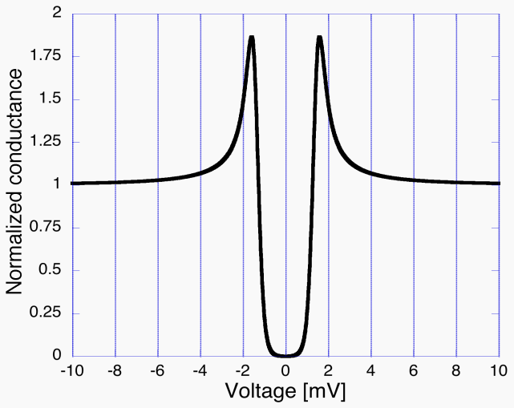
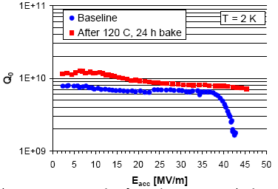
PCT Tunneling Data
Correlation of the local DOS with the low field Q
Cavity-grade niobium single crystal (110)-electropolished
2Δ
Unbaked Niobium
Baked Niobium 120C-24h
Ideal BCS, T~1.7K
Average ZBC ratio = 1.6
Qo improvement × 1.6
T.Proslier, J.Zasadzinski, L.Cooley, M.Pellin et al. APL 92, 212505 (2008)
ILC-Single crystal cavities P.Kneisel
NuFact09

