Slide 1

Pion Production in
Neutrino Interactions with Nuclei
Tina Leitner, Olga Lalakulich,
Oliver Buss, Ulrich Mosel, Luis Alvarez-Ruso
TexPoint fonts used in EMF.
Read the TexPoint manual before you delete this box.: AAAAAAAAAAA

Slide 2
Motivation
Neutrino detectors contain (heavy) nuclei. Interactions of neutrinos with nuclei may make the identification of elementary processes, like knock-out, pion-production or qe scattering difficult.
Neutrino-energy must be reconstructed from detector response.
In-medium physics: vector and axial form factors in medium can be tested.
  NUTEV anomaly for Weinberg angle
  Axial Mass: in MiniBooNE and K2K: 1.0 or 1.25 GeV?

Slide 3
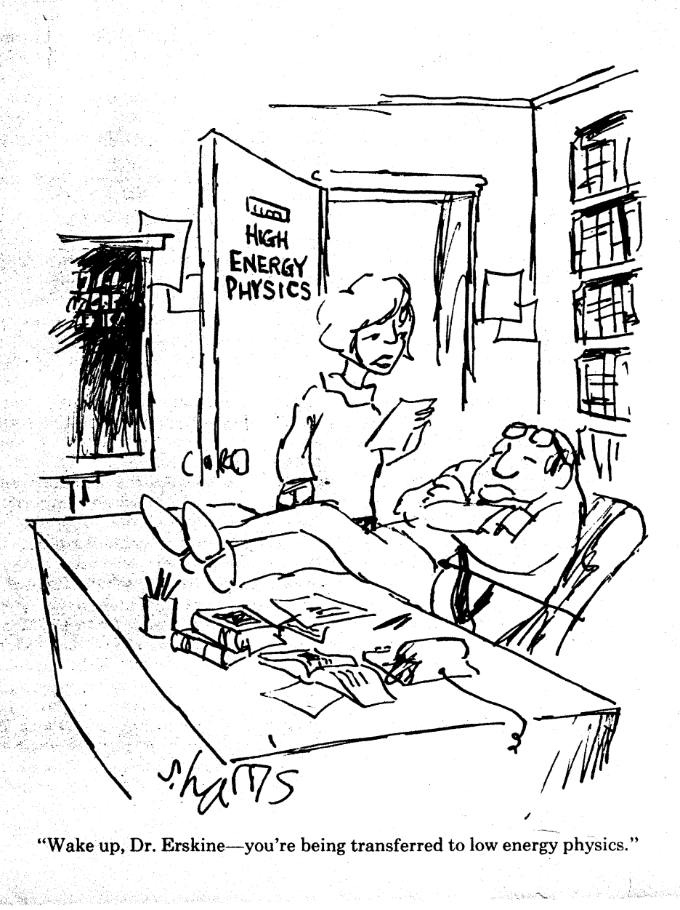
Low-Energy Physics
(Nuclear Structure)
determines response
of nuclei to neutrinos

Slide 4
Outline
Neutrino-nucleus reaction: ν_{l} A → l hadrons
at ~ 0.5 – 1.5 GeV neutrino energy
  scattering off a single nucleon
    free nucleon
    nucleon bound in a nucleus
  QE scattering off a nucleus
  and π production
    final state interactions (FSI)
      GiBUU transport model
Results: qe scattering, π production, nucleon knockout
Conclusions
l
ν
W, Z

Slide 5
Transport vs. Quantummechanics
Fully inclusive reactions: no info on final states, both
  Quantum-mechanical reaction theory (Relativistic Impuls Approximation RIA, Distorted Wave Impuls Approximation DWIA, Scaling)
  Transport theory
applicable. Lead to ≈same results.
Semi-Inclusive Reactions:
  RIA and DWIA describes only loss of flux in one channel, does not tell where the flux goes and does not contain any secondary reactions or sidefeeding of channels
  Transport describes elastic and inelastic scattering, coupled channel effects, full event history
Exclusive Reactions (coherent production):
  Phase coherence: Only QM applicable

Slide 6
Initial State Interactions

Slide 7
Model Ingredients: ISI
Nucleons move in density-, momentum-dep. potential (Skyrme or Walecka)
Momentum distribution from local Thomas-Fermi based on density profiles from electron scattering and Hartree-Fock calculations (for neutrons), Pauli principle incl.
Impulse-Approximation:
interaction with one nucleon at a time

Slide 8
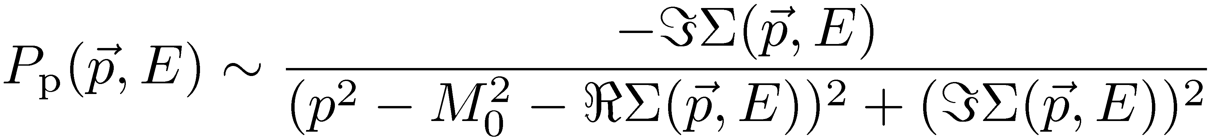
Model Ingredients: ISI
Potential smoothes E-p distributions
Hole spectral function (local TF)
Local Thomas-Fermi Particles in mean-field potential!
Particle spectral function: collisional broadening
Inclusive cross section

Slide 9
Model Ingredients: ISI
Free primary interaction cross sections, cross sections boosted to restframe of moving nucleon in Fermigas
  no off-shell dependence, but include spectral functions for baryons and mesons (binding + collision broadening)
Cross sections taken from
  Electro- and Photoproduction for vector couplings
  Axial couplings modeled with PCAC
Pauli-principle included
Shadowing by geometrical factor (Q²,ν) included

Slide 10
Quasielastic scattering
reactions:
hadronic
current:
with
    axial form factors
    related by PCAC
    dipole ansatz
    extra term
    ensures
    vector current conservation
    for nonequal masses
    vector form factors
    related to EM form factors by CVC
    BBBA-2007 parametrization
  in addition:
  strange vector and axial form factors for NC

Slide 11
Quasielastic scattering

Slide 12
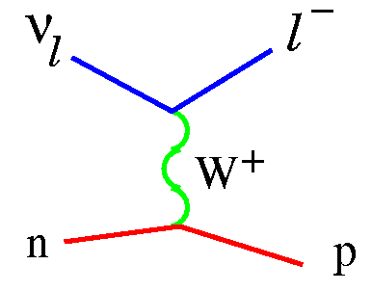
Resonance excitation
spin 1/2 resonances: P₁₁(1440), S₁₁(1535), S₃₁(1620), S₁₁(1650), P₃₁(1910)
spin 3/2 resonances: P₃₃(1232), D₁₃(1520), D₃₃(1700), P₁₃(1720)
R⁺
R⁺⁺ (I=3/2)
CV(q²) plus background from electron scattering (MAID),
axial formfactors from PCAC, dipole ansatz, bg scaled

Slide 13
CC pion production on free nucleons
CC production of Δ⁺ and Δ⁺⁺
  subsequent decay into 3 channels:
including higher resonances (isospin ½):
BNL data
ANL data
How much is background??

Slide 14
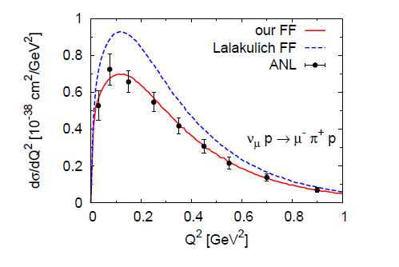
Resonance Formfactors
crucial for X-section for pion production:
Vector FFs from MAID (electroproduction),
Axial FFs refitted.
M_{A}^{Δ} = 0.95 GeV after refit
M_{A}^{Δ} = 1.05 GeV,
old value

Slide 15
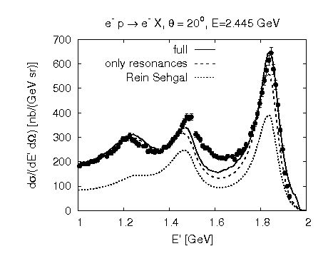
Rein-Sehgal Ffs fail badly for e-scattering,
Errors in V and A counteract each other

Slide 16
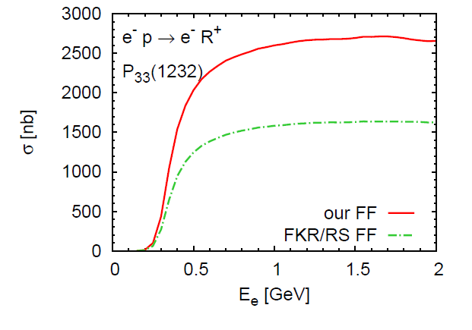
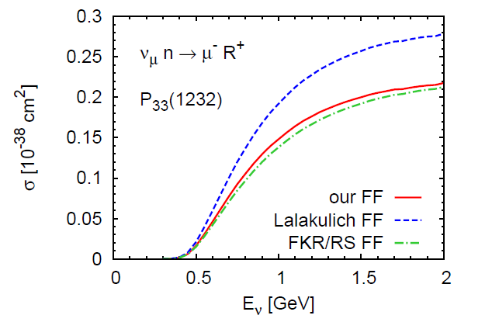
Importance of Formfactors
Rein-Segal formfactors bad in vector sector,
but reasonable in neutrino X-sect
➔ Fortunate cancellation of vector and axial contribs

Slide 17
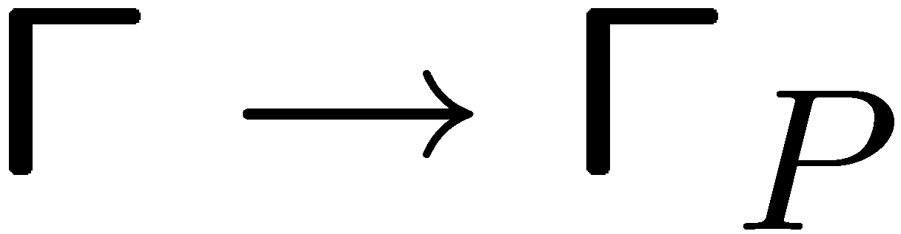
Medium modifications
Αll cross sections Fermi smeared
Δ cross section is further modified in the nuclear medium:
  π decay might be Pauli blocked: decrease of the free width
  additional "decay" channels in the medium:
  collisional width Γ_{coll}
  overall effect:
    increase of width
  Γ ! Γ^{med} = Γ_{P} + Γ_{coll}
    collisional broadening
"pion-less
decay"

Slide 18
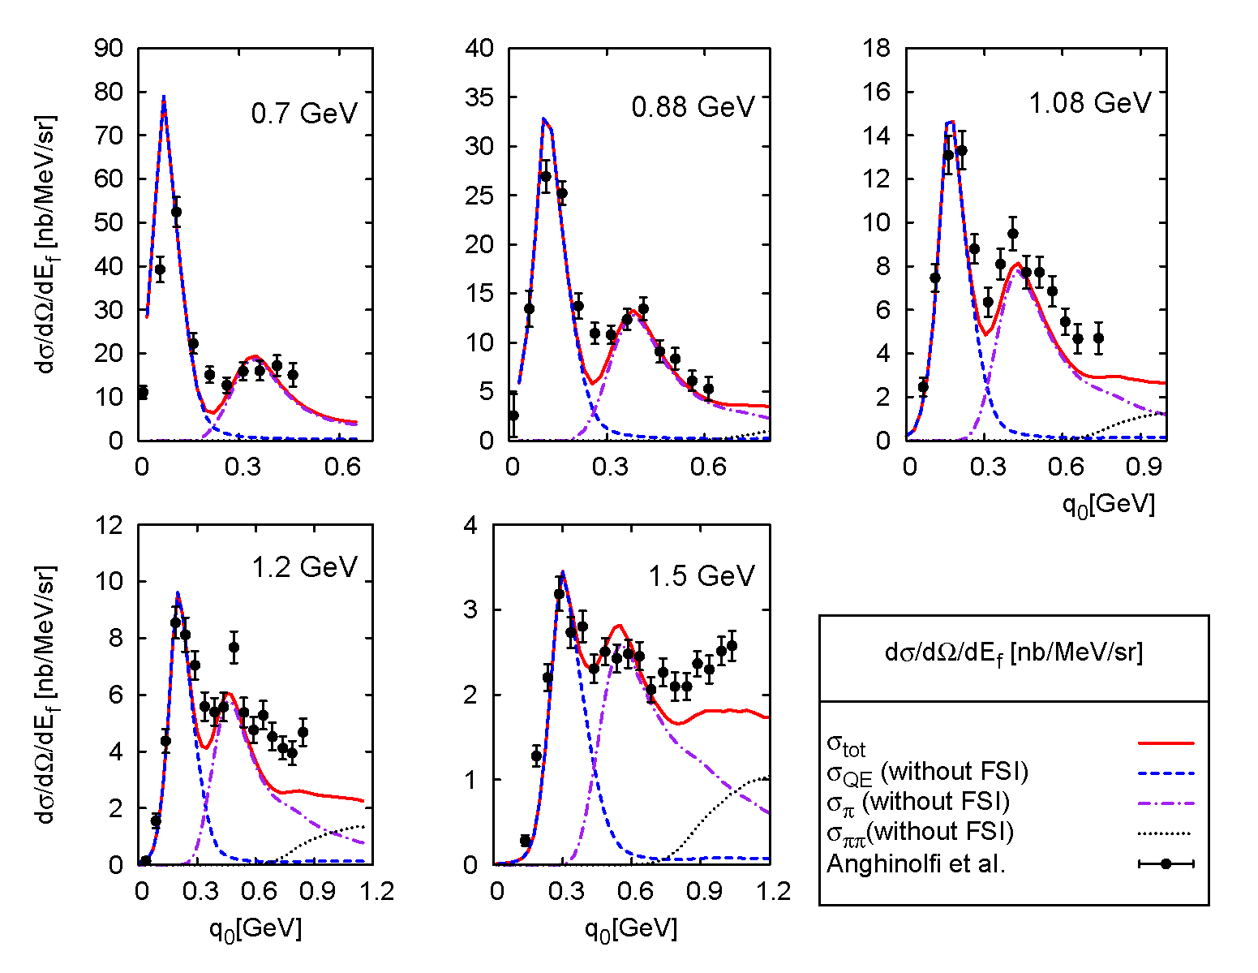
Necessary reality check: Electroproduction
Inclusive X-sections independent of fsi!
Inclusive
e-scattering
on ¹⁶O
2 π bg
Data:
Anghinolfi et al

Slide 19
Final State Interactions,
needed for semi-inclusive channels

Slide 20
Model Ingredients: FSI
Theoretical Basis
Kadanoff-Baym equation
    full equation can not be solved yet
    – not (yet) feasible for real world problems
  Boltzmann-Uehling-Uhlenbeck (BUU) models
    Boltzmann equation as gradient expansion
    of Kadanoff-Baym equations
    include mean-fields
    BUU with off-shell propagation (essential for propagating
    broad particles): GiBUU
  Cascade models (typical event generators, NUANCE, GENIE, …)
    no mean-fields, (no) Fermi motion
Simplicity

Slide 21
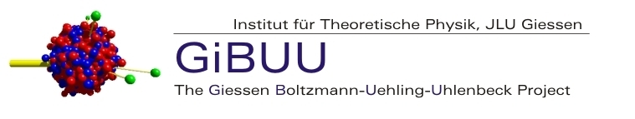
GiBUU transport
what is GiBUU?
semiclassical coupled channels transport model
Nuclear Physics based
general information (and code available):
http://theorie.physik.uni-giessen.de/GiBUU/
GiBUU describes (within the same unified theory and code)
  heavy ion reactions, particle production and flow
  pion and proton induced reactions (e.g. HARP)
  low and high energy photon and electron induced reactions
  neutrino induced reactions
  ……..using the same physics input! And the same code!

Slide 22
Model Ingredients: FSI
time evolution of spectral phase space density f
(for i = N, Δ, π, ρ, …) given by BUU equation
one equation for each particle species (61 baryons, 21 mesons)
coupled through the potential U_{S} and the collision integral I_{coll}
cross sections from resonance model (and data) for W < 2.5 GeV
at higher energies (W > 2.5 GeV) particle production through
string fragmentation (PYTHIA)
one-particle spectral phase space density for particle species i
Hamiltonian

Slide 23
Quasielastic Scattering
Nucleon Knockout
and its Entaglement with Pion Production

Slide 24
CC nucleon knockout: ν_{μ}⁵⁶Fe → μ⁻ N X
w/o FSI
Dramatic FSI Effect
w FSI
E_{ν} = 1 GeV

Slide 25
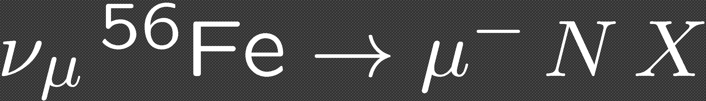
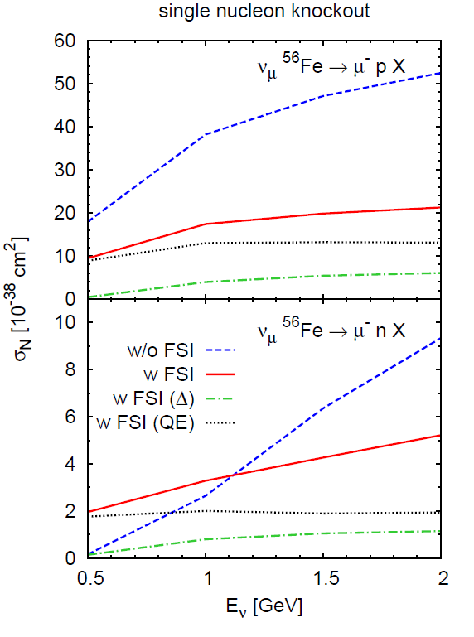
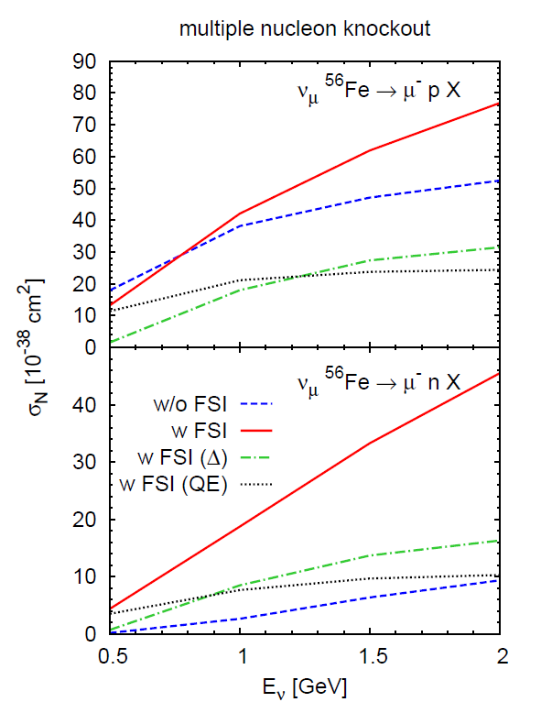
CC nucleon knockout
w FSI (Δ): nucleons through initially produced Δ
w FSI (QE): nucleons through initially produced QE
Large ¢ contribution to knockout

Slide 26
Large ¢ + ¼ background contribution
W + N → N ¢
¢ + N -> N + N_{out} (pionless decay)
¢ → ¼ + N_{out}
¼ + N‘ → ¢
¼ + N‘ + N‘‘ → N‘ + N_{out}
(background contrib)

Slide 27
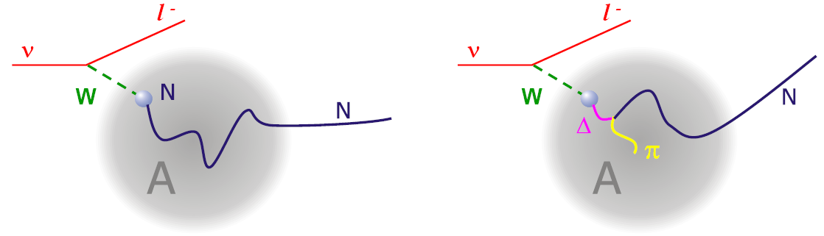
Different approaches to true CCQE
MiniBooNE
K2K
0 ¼ + X
QE induced
0 ¼ + 1 p + X
QE induced
¢ induced (fakes)
¢ induced (fakes)

Slide 28
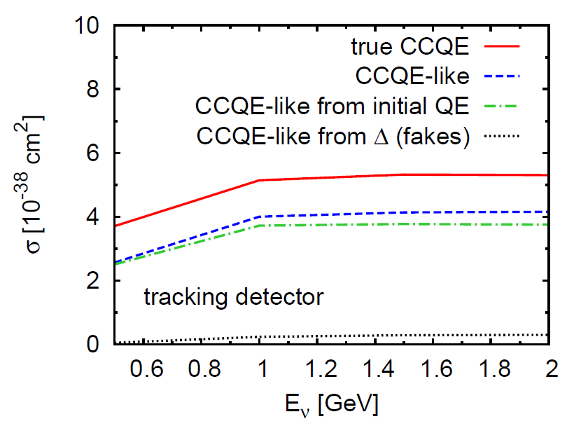
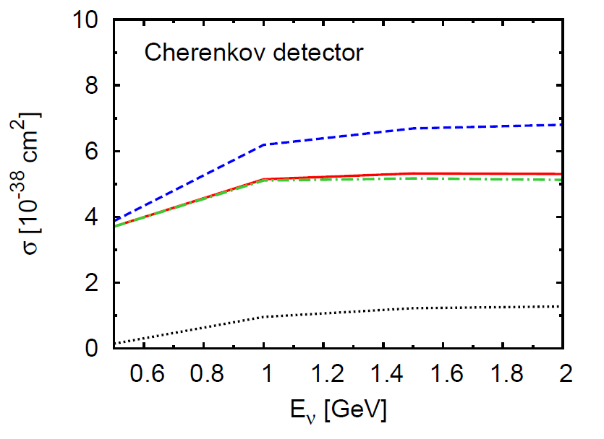
QE Identification
0 ¼ + 1 p + X
MiniBooNE
0 ¼ + X
K2K:
Misses secondary neutrons
MiniBooNE:
counts also pion-kicked or nucleon-kicked nucleons
K2K

Slide 29
Pion Production
and its Entaglement with QE

Slide 30
Checks of model
1. Test of pion fsi
Pion reaction Xsect.
Pion reaction X-section
necessary, but not sufficient test
Rather insensitive to pion mfp

Slide 31
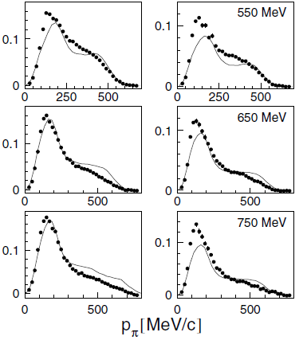
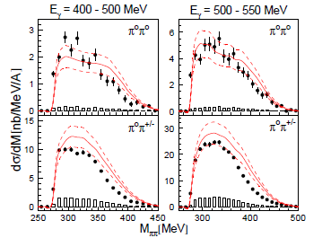
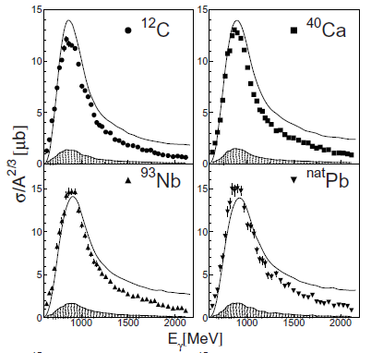

Checks of model
2. Photo-hadronproduction data from TAPS
low Q^2 test
γ −>π⁰
γ ->2π⁰
γ -> η
Typical shape,
Δ dominated

Slide 32
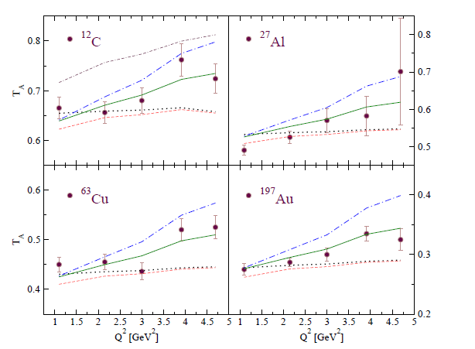
Checks of model
3. Exclusive pion production data from JLAB (CT experiment)
GiBUU:
Solid curves
Kaskulov and Mosel, Phys.Rev.C79:015207,2009

Slide 33
CC pion production: ν_{μ}⁵⁶Fe → μ⁻ π X
w/o FSI
w FSI
E_{ν}= 1 GeV

Slide 34
Validation of pion spectra in photoproduction
γ −>π⁰
Typical shape of spectra:
determined by Δ absorption

Slide 35
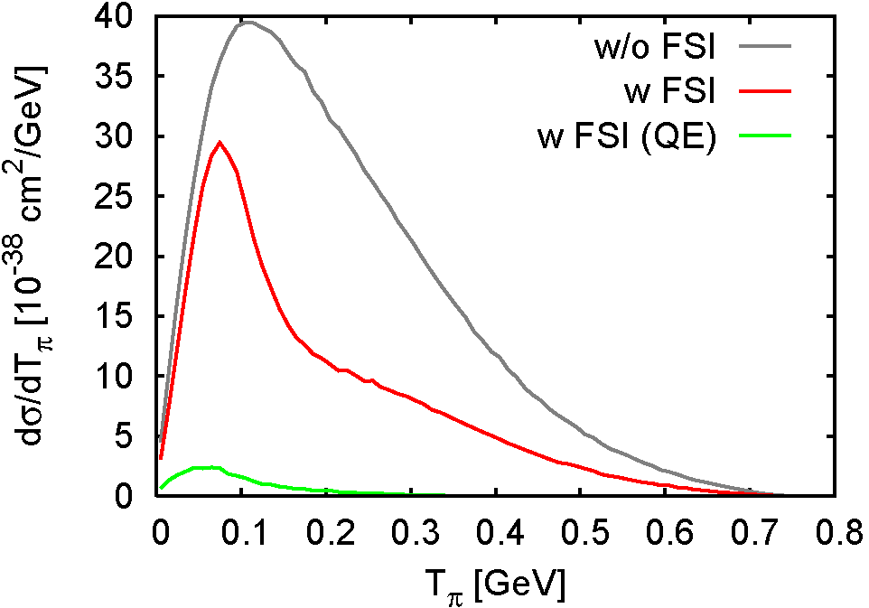
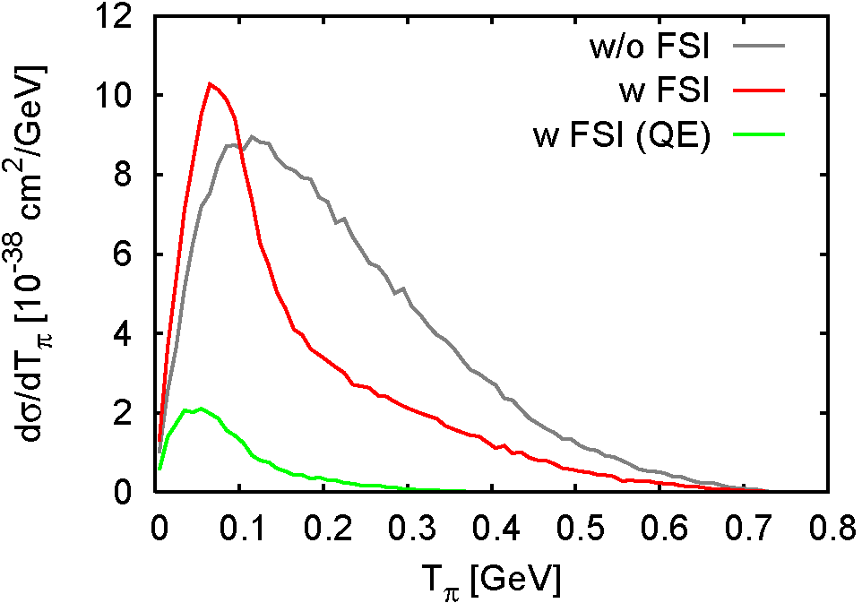
CC pion production: ν_{μ}⁵⁶Fe → μ⁻ π X
Effects of FSI on pion kinetic energy spectrum at E_{ν} = 1 GeV
  strong absorption in Δ region
  side-feeding from dominant π⁺ into π⁰ channel
  secondary pions through FSI of initial QE protons
Significant distortion of spectra by FSI
π⁺
π⁰
π⁰

Slide 36
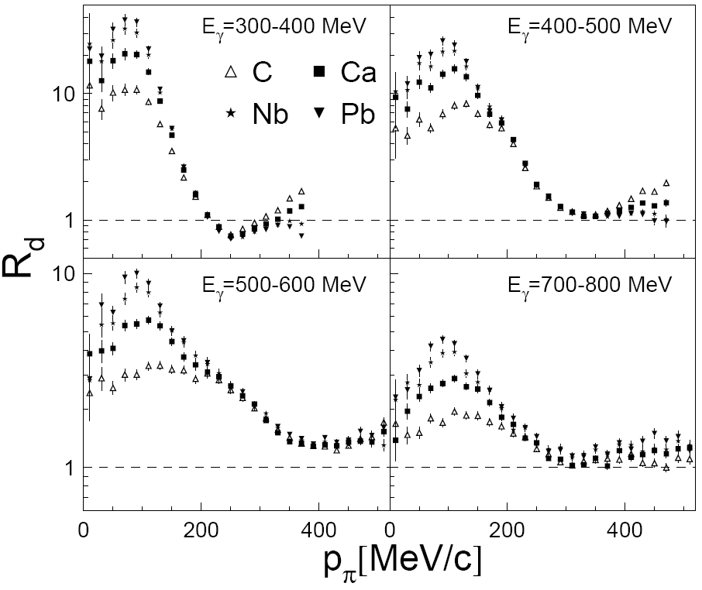
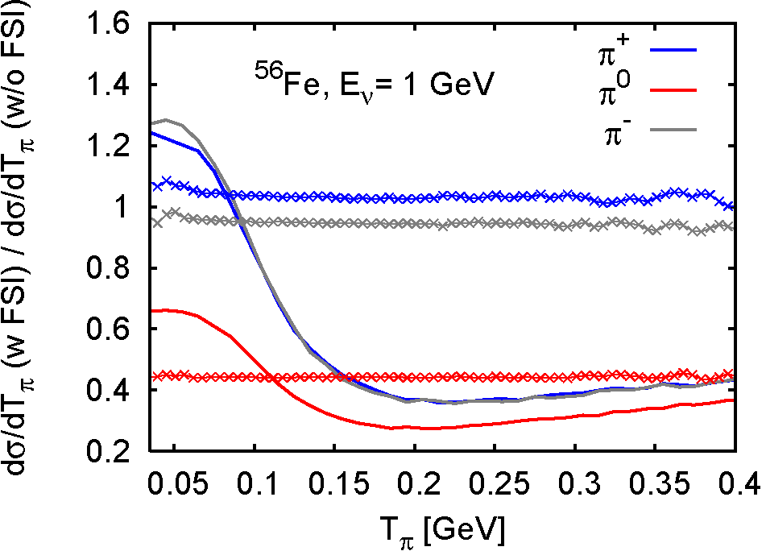
Effects of Δ Dynamics on Pion-Spectra
Photoproduction Data: γ + A → π⁰ + A*, TAPS
Paschos et al
GiBUU
Paschos
Photons
Neutrinos
Pion Absorption in the Δ Region absent in calcs of Paschos et al.
Notes:
36

Slide 37
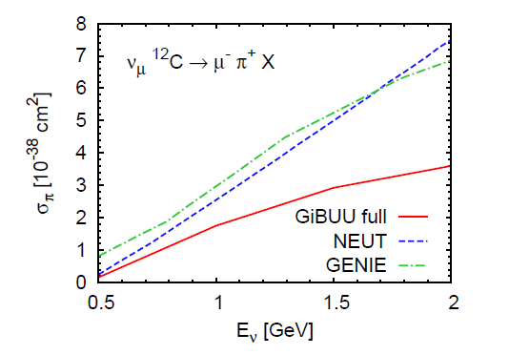
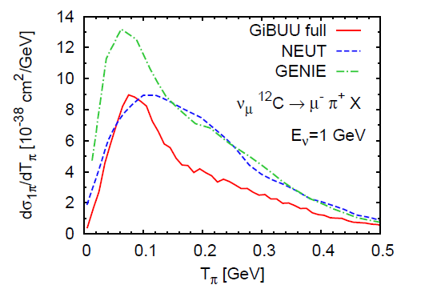
Comparison with generators NEUT, GENIE
Popular generators overestimate x-section for pions significantly,
give incorrect energy distribution

Slide 38
Influence of higher resonances

Slide 39
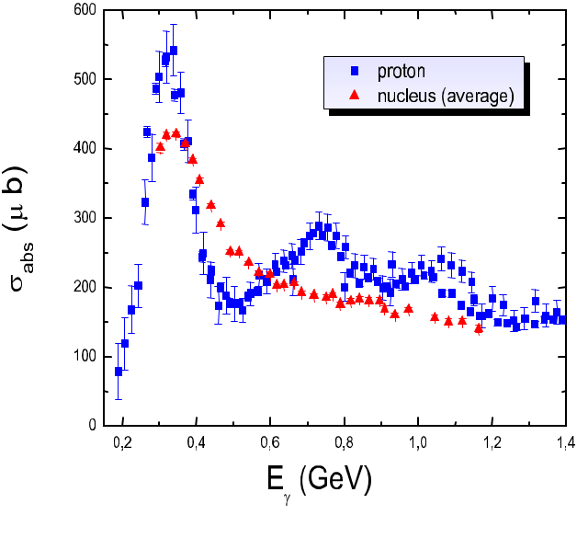
Higher Resonances
Photoabsorption X-section
Δ nearly unchanged
2nd resonances vanish
3rd resonances vanish
3rd resonance region
disappears by Fermi-motion

Slide 40
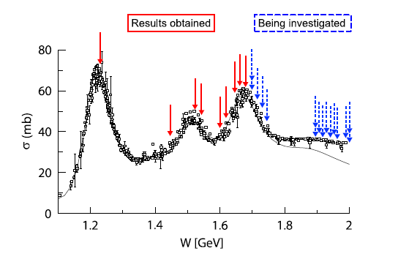
Nucleon Resonances
JLAB Resonance Project

Slide 41
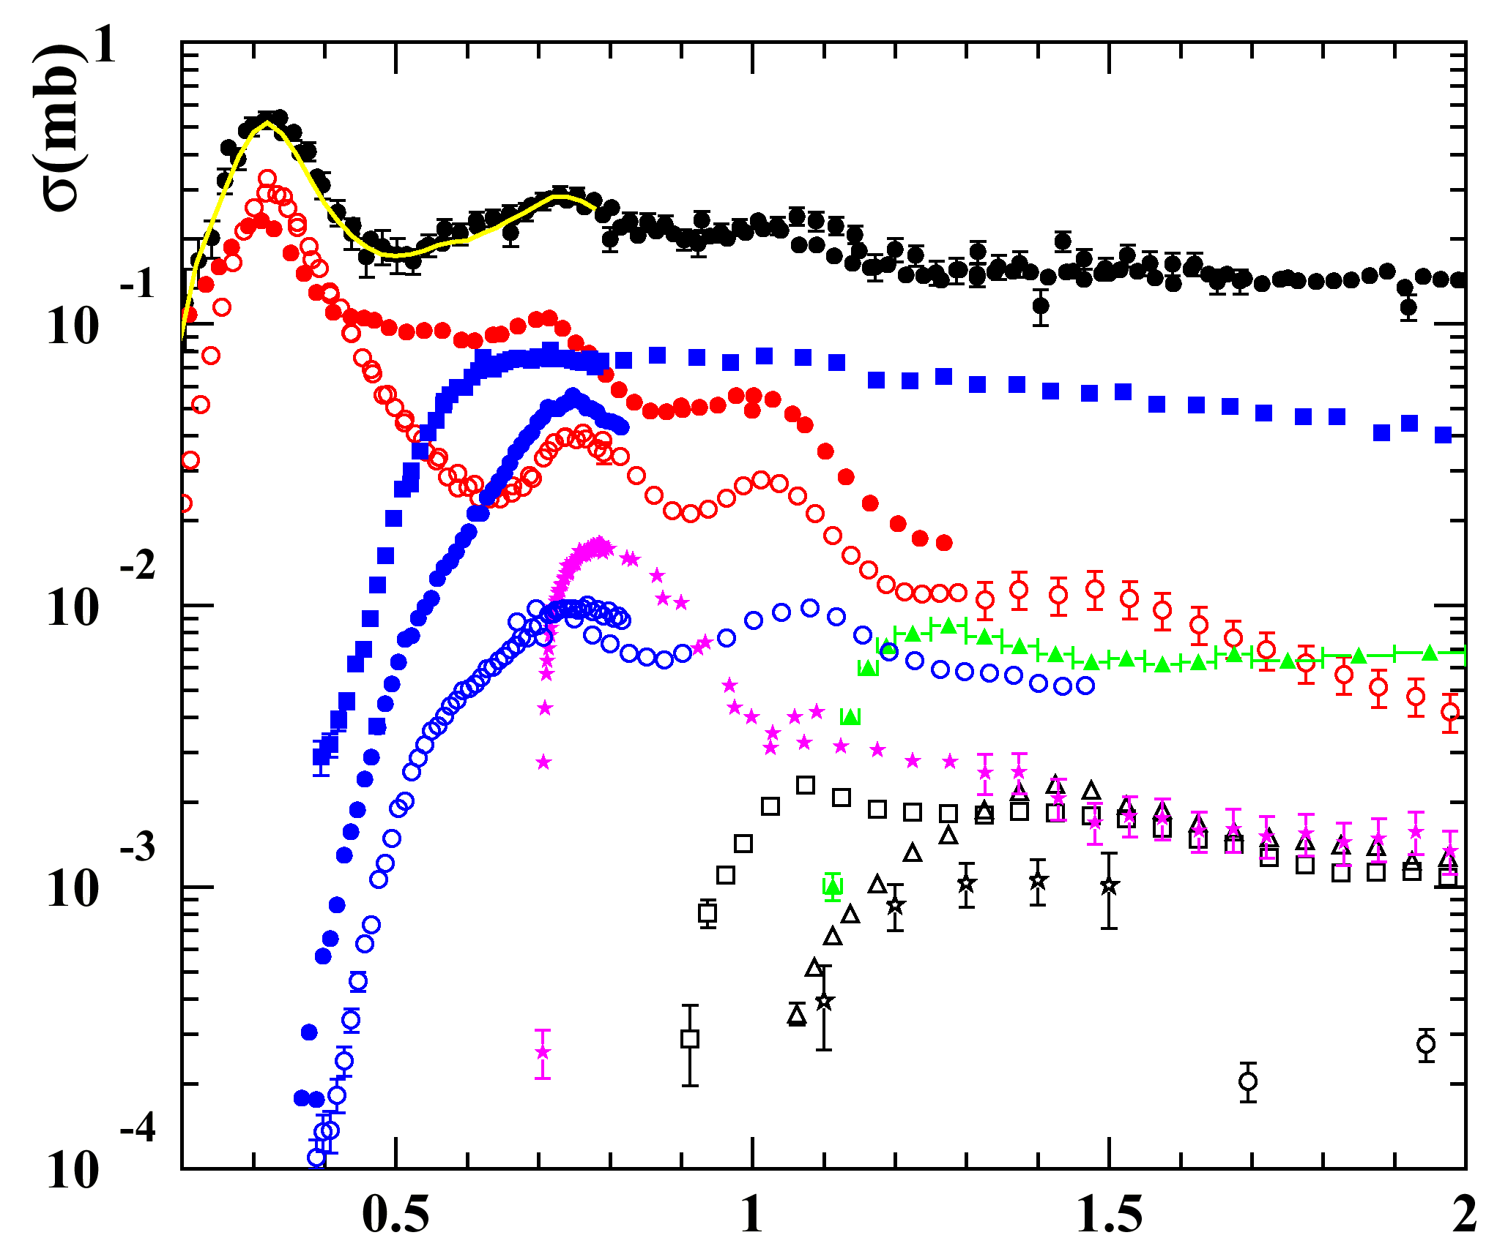
Meson Photoproduction from the Proton
partly preliminary!
sum
● γ + p total
SAPHIR (Bonn)
CBELSA (Bonn)
DAPHNE, TAPS (Mainz)
GRAAL (Grenoble)
○ π º
● π ⁺
■ π ⁺ π ⁻
● π ⁺ π º
○ π º π º
★ η
⬧ ω
□ K⁺ Λ
⬇ K⁺ Σº
 Kº Σ
○ φ
S. Schadmand
E_{γ}(GeV)
In neutrino-community convention
everything beyond1¼ is DIS

Slide 42
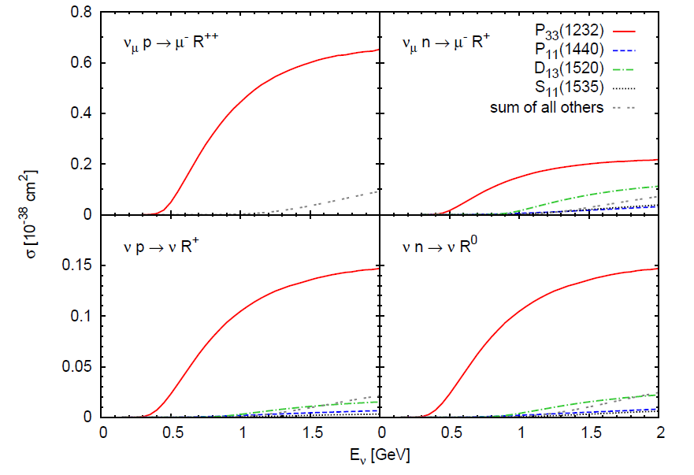
Higher Resonances
Relatively small influence of higher resonances

Slide 43
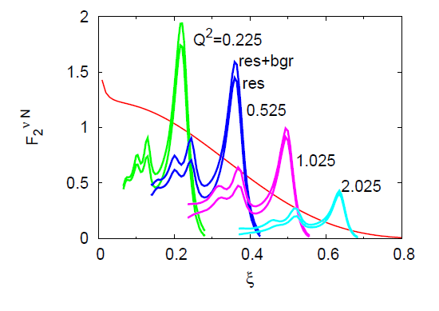
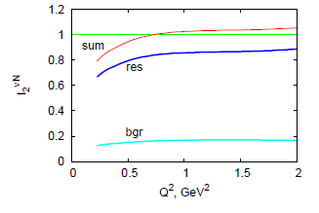
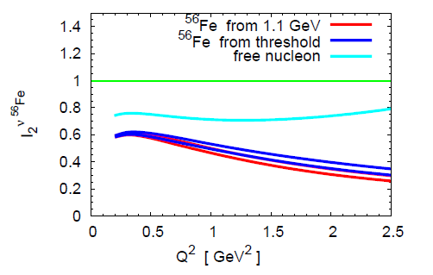

Transition to DIS
Bloom-Gilman duality
Problem: Resonance and BG contribs
Larger
BG in nuclear
Targets??
From Lalakulich et al.

Slide 44
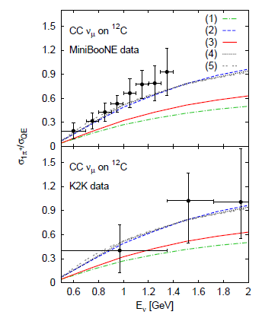
Pion Production
1:σ_{1π}/σ_{0π} after FSI
2: σ_{1π}/σ_{0π p} after FSI
3: σ_{1π}/σ_{QE} after FSI
4: σ_{1π}/σ_{QE} before FSI (‚Data‘)
5: σ_{1π}/σ_{QE} in vacuum
‚Data‘ before FSI

Slide 45
Application: MiniBooNE CC π/QE
single-¼⁺-like/QE-like ratio in mineral oil uncorrected for FSI arXiv:0904.3159
Possible reasons for discrepancy
ANL x-sections
Too large QE
Energy reconstruction
Consistency of event sim and GEANT

Slide 46
Energy Reconstruction
FWHM ~ 0.1 GeV
~ 15% tail to low E_rec

Slide 47
Energy Reconstruction
QE-π entanglement directly affects energy reconstruction

Slide 48
Coherent Pion Production

Slide 49
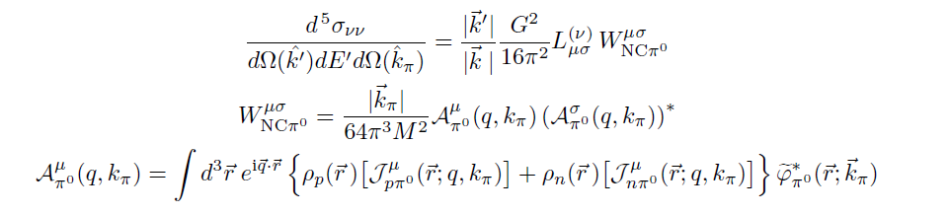
Coherent Pion Production
Standard formalism (from Amaro, Hernandez, Nieves, Valverde)
Nuclear Formfactor appears ➔ Local approximation:
Δ propagator pulled out from its location between initial and final states
How good is this approximation?

Slide 50
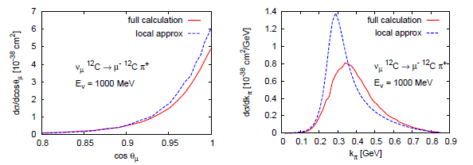
Coherent Pion Production
Local approximation overestimates
X-section for Carbon significantly
before pion fsi
From: Leitner, Mosel, Winkelmann: Phys.Rev.C79:057601,2009.

Slide 51
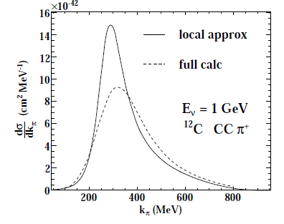
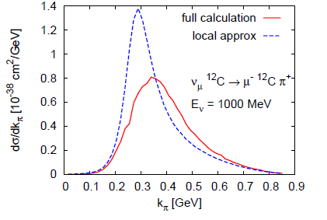
Coherent Pion Production
(before pion fsi)
C. Praet, Ghent thesis, 2009
Leitner et al, PRC 2009
Local approximation too large by factor ≈ 1.7 at 1 GeV,
larger discrepancy, factor 2, at 500 MeV, before pion fsi

Slide 52
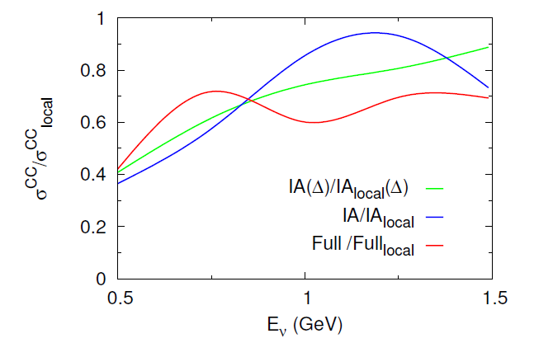
Coherent Pion Production
100% error at 0.5 GeV,
30% error at 1.0 GeV
S. Nakamura, NUINT 2009
Local approximation overestimates coherent X-section significantly
also after pion fsi

Slide 53
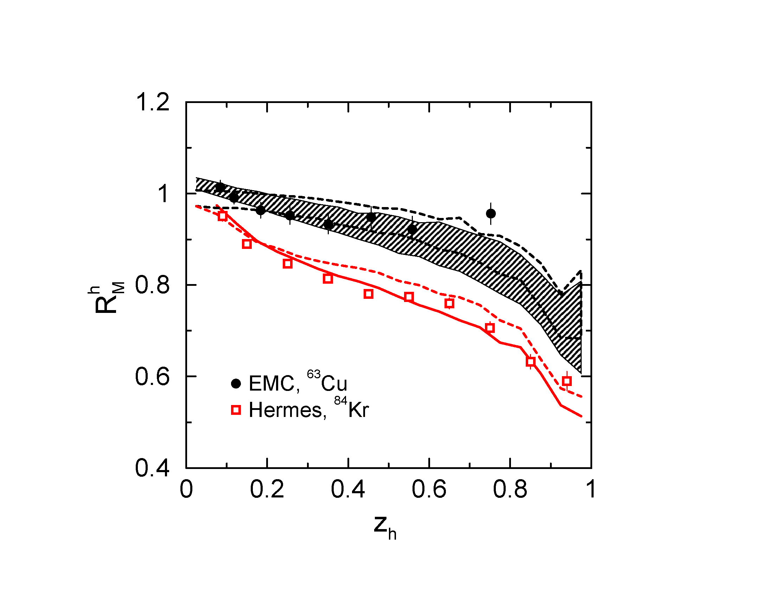
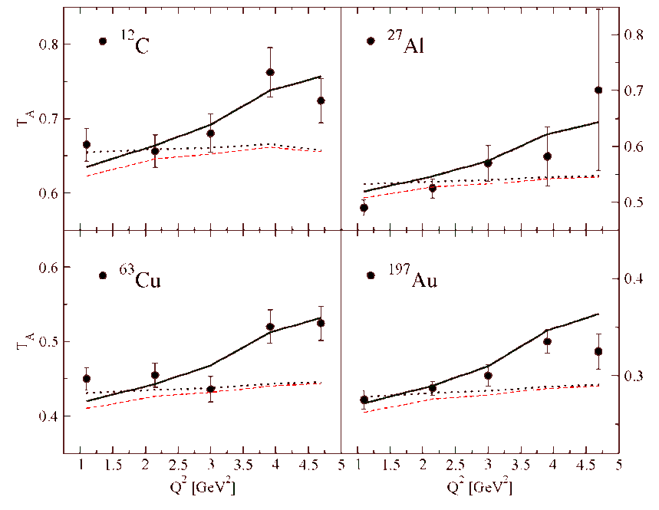
Extension to higher energy
GiBUU model
  extension to neutrino energies of up to ~100 GeV straightforward
  elementary cross section then dominated by DIS
GiBUU has been successfully applied to (Gallmeister, Kaskulow et al.)
high energy electro-production:
Hadron Attenuation at 27 – 280 GeV
Pion Attenuation at 5 GeV
Extension to neutrinos straightforward
B. Clasie et al., JLAB experiment

Slide 54
Summary
GiBUU is a multi-purpose theory and tool to describe inclusive and semi-inclusive reactions, consistently in very different reactions. Includes
  Elastic scattering
  Inelastic scattering
  Sidefeeding (cc effect)
  Method allows to propagate offshell particles out to detector
Method has been widely tested for heavy-ion, proton-, pion-, and photon-induced reactions. In particular inclusive electroproduction cross sections well described

Slide 55
Summary
Particle production at neutrino energies of ~1 GeV
  Inclusive cross section dominated by Δ excitation,
  with QE contribution, good description of electron data
  Semi-inclusive particle production incl. coupled channel FSI in GiBUU straightforward, tested against γA and πA
  Pion production cross sections from K2K and MiniBooNE well described
Knockout events contain admixtures of QE scattering and Delta excitations
  Δ excitations affect nucleon knockout, contaminate QE experiments on nuclear targets

Slide 56
Summary
At higher energies beyond ¢ : problem to separate resonance from bg contributions
Extension to higher energies (5 – 280 GeV) successful for electroproduction, for neutrinos (OPERA) to be done, straightforward
Plea to experimentalists:
Publish ‘pure data’, do not mix data and MC event generators in published results!
Theoretical analysis is nearly impossible if ‘data’ contain simulation results mixed in.

Slide 57
Literature
Charged current neutrino nucleus interactions at intermediate energies.
Tina Leitner, L. Alvarez-Ruso, U. Mosel (Giessen U.) . Jan 2006. 25pp.
Phys.Rev.C73:065502,2006. e-Print: nucl-th/0601103
Neutral current neutrino-nucleus interactions at intermediate energies.
T. Leitner, L. Alvarez-Ruso, U. Mosel (Giessen U.) . Jun 2006. 16pp.
Phys.Rev.C74:065502,2006. e-Print: nucl-th/0606058
Neutrino-induced coherent pion production.
L. Alvarez-Ruso, L.S. Geng (Valencia U. & Valencia U., IFIC) , S. Hirenzaki (Nara Women's U.) , M.J. Vicente Vacas (Valencia U. & Valencia U., IFIC) , T. Leitner, U. Mosel (Giessen U.) . Sep 2007. 4pp.
Proc. 5th International Workshop on Neutrino-Nucleus Interactions in the Few-GeV Region (NuInt07), Batavia, Illinois, 30 May - 3 Jun 2007.
AIP Conf.Proc.967:201-204,2007. e-Print: arXiv:0709.3019 [nucl-th]
Neutrino Interactions with Nuclei.
T. Leitner, O. Buss, U. Mosel (Giessen U.) , L. Alvarez-Ruso (Valencia U. & Valencia U., IFIC) . Sep 2007. 5pp.
Proc. 5th International Workshop on Neutrino-Nucleus Interactions in the Few-GeV Region (NuInt07), Batavia, Illinois, 30 May - 3 Jun 2007.
AIP Conf.Proc.967:192-196,2007. e-Print: arXiv:0709.0244 [nucl-ex]
The Influence of the nuclear medium on inclusive electron and neutrino scattering off nuclei.
O. Buss, T. Leitner, U. Mosel (Giessen U.) , L. Alvarez-Ruso (Valencia U. & Valencia U., IFIC) . July 2007. 6pp. Phys.Rev.C76:035502,2007. e-Print: arXiv:0707.0232 [nucl-th]
Time Dependent Hadronization via HERMES and EMC Data Consistency.
K. Gallmeister, U. Mosel (Giessen U.) . Jan 2007. 20pp.
Nucl.Phys.A801:68-79,2008. e-Print: arXiv:0905.1644 [nucl-th]

Slide 58
Literature
Electron- and neutrino-nucleus scattering from the quasielastic to the resonance region.
T. Leitner, O. Buss, L. Alvarez-Ruso, U. Mosel , Phys.Rev.C79:034601,2009.
e-Print: arXiv:0812.0587 [nucl-th]
Neutrino induced pion production at MiniBooNE and K2K.
T. Leitner, O. Buss, U. Mosel, L. Alvarez-Ruso , Phys.Rev.C79:038501,2009.
e-Print: arXiv:0812.1787 [nucl-th],
Neutrino-induced coherent pion production off nuclei - revisited.
T. Leitner, U. Mosel, S. Winkelmann . Phys.Rev.C79:057601,2009.
e-Print: arXiv:0901.2837 [nucl-th]
Hadronic transport approach to neutrino nucleus scattering: the Giessen BUU model and its validation.
T. Leitner, O. Buss, U. Mosel . May 2009. Temporary entry

