Slide 1
h_{b} and other ϒ(5S) results at Belle
D. Santel
Rencontres de Blois June 1, 2011
Introduction to h_{b} and ϒ(5S)
Search for the h_{b}
Observation of the Z_{b}
ϒ(5S)→h_{b}(nP)π⁺π⁻
ϒ(5S)→ϒ(nS)π⁺π⁻
Preliminary Results

Slide 2
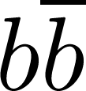
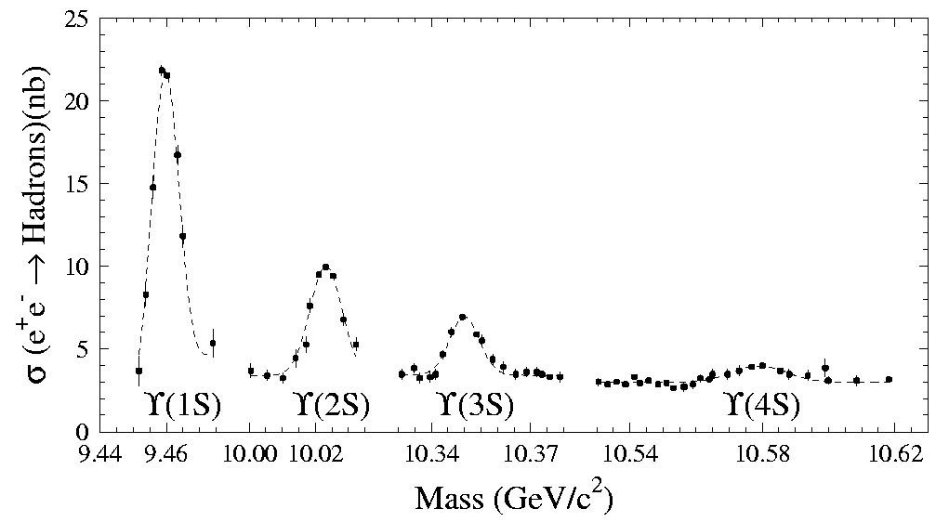
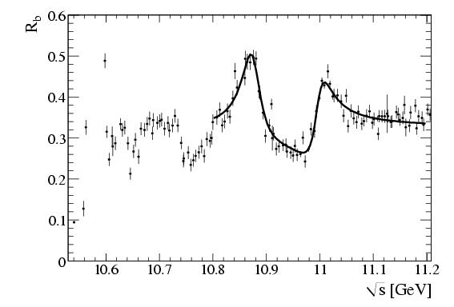
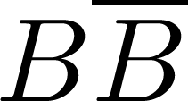
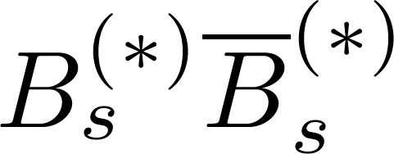
ϒ(5S)
Bottomonium ( ) s=1, l=0, J^{PC}=1⁻ ⁻, n=5
BaBar PRL 102, 012001 (2009)
ϒ(1S)
ϒ(5S)
ϒ(6S)
ϒ(4S)
ϒ(2S)
ϒ(3S)
ϒ(4S)
10.865 ± 0.008 GeV
2M(B)
2M(B_{s})
ϒ(4S) just above threshold, 96% decays
⇒B studies, CP violation, etc.
(ϒ(5S)) just above threshold, ~60% , ~20% , few bottomonia
⇒B_{s} studies
This talk
Notes:
AAAA
A.Drutskoy, 32 Int'l Conference on HEP, August 16-22, 2004
2
Y(5S) above Bs*Bs* threshold, Y(4S) above BB threshold, B=bbar u/d Bbar = b ubar/dbar, B=bottom + light quark

Slide 3
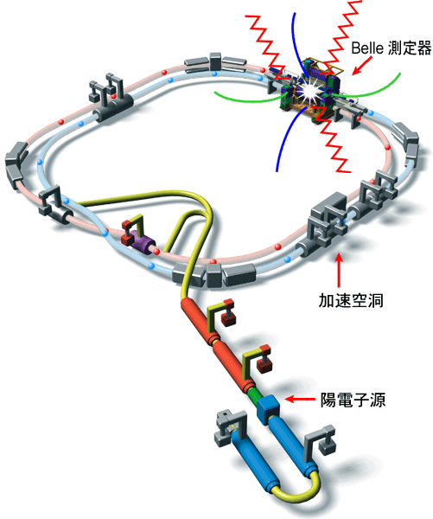
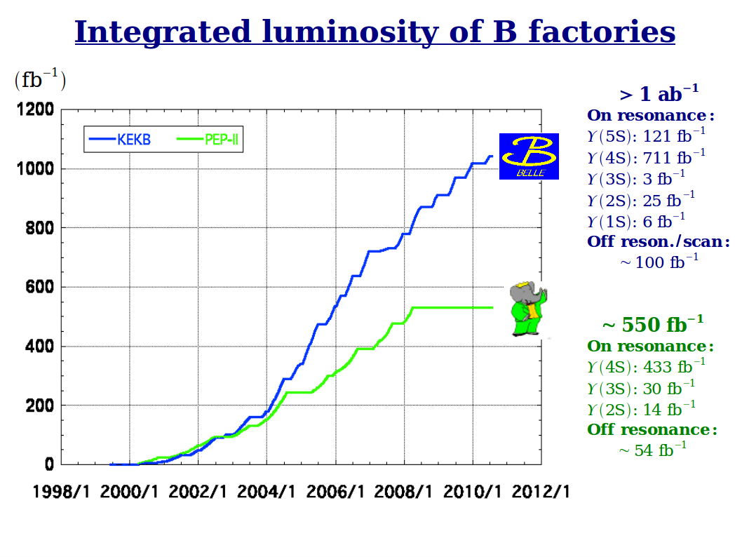
KEKb Tsukuba, Japan
3.6 GeV
8.2 GeV
Asymmetric e⁺e⁻ storage rings
Has run at CM energies:
~9.46 GeV (ϒ(1S), 5.75 fb⁻¹)
~10.02 GeV (ϒ(2S), 25 fb⁻¹)
~10.36 GeV (ϒ(3S), 2.95 fb⁻¹)
~10.58 GeV (ϒ(4S), 710.5 fb⁻¹)
Continuum below ϒ(4S), 90 fb⁻¹)
~10.87 GeV (ϒ(5S), 121.4 fb⁻¹)
Integrated Luminosity
Res/E_{CM}(GeV)/lum
ϒ(1S): 9.46, 5.75 fb⁻¹
ϒ(2S): 10.02, 25 fb⁻¹
ϒ(3S): 10.36, 2.95 fb⁻¹
ϒ(4S): 10.58, 710.5 fb⁻¹
ϒ(5S): 10.87, 121.4 fb⁻¹
Off resonance/scan:
~100 fb⁻¹
ϒ(2S): 10.02, 14 fb⁻¹
ϒ(3S): 10.36, 30 fb⁻¹
ϒ(4S): 10.58, 433 fb⁻¹
Off resonance:
~54 fb⁻¹
cavity
e⁺ source
Notes:
What energies are used for Y(4S)?

Slide 4
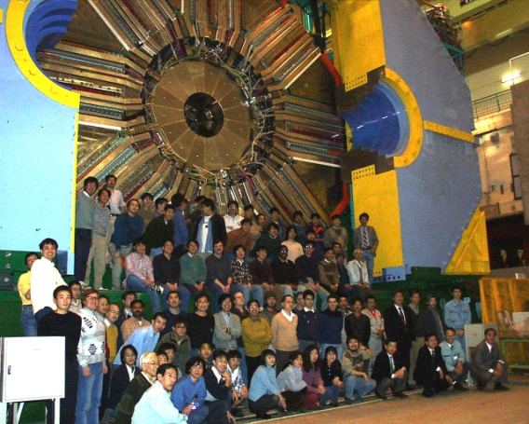
International Collaboration: Belle
BINP
Chiba U.
U. of Cincinnati
Ewha Womans U.
Fu-Jen Catholic U.
U. of Giessen
Gyeongsang Nat’l U.
Hanyang U.
U. of Hawaii
Hiroshima Tech.
IHEP, Beijing
IHEP, Moscow
IHEP, Vienna
ITEP
Kanagawa U.
KEK
Korea U.
Krakow Inst. of Nucl. Phys.
Kyoto U.
Kyungpook Nat’l U.
EPF Lausanne
Jozef Stefan Inst. / U. of Ljubljana / U. of Maribor
U. of Melbourne
Nagoya U.
Nara Women’s U.
National Central U.
National Taiwan U.
National United U.
Nihon Dental College
Niigata U.
Nova Gorica
Osaka U.
Osaka City U.
Panjab U.
Peking U.
Princeton U.
Riken
Saga U.
USTC
Seoul National U.
Shinshu U.
Sungkyunkwan U.
U. of Sydney
Tata Institute
Toho U.
Tohoku U.
Tohuku Gakuin U.
U. of Tokyo
Tokyo Inst. of Tech.
Tokyo Metropolitan U.
Tokyo U. of Agri. and Tech.
INFN Torino
Toyama Nat’l College
VPI
Yonsei U.
13 countries, 57 institutes, ~400 collaborators

Slide 5
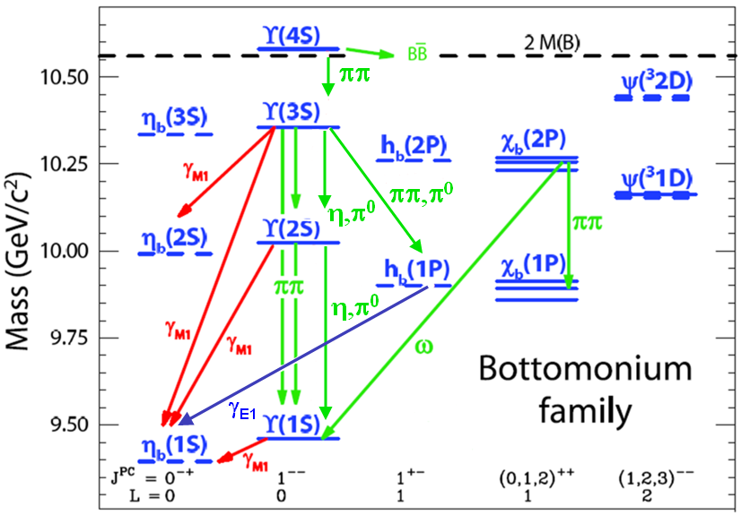
Bottomonia
_
h_{b}: (bb) : S=0 L=1 J^{PC}=1⁺⁻
Godfrey et al. Phys. Rev. D 66 , 014012 (2002)
Expected mass:
Spin-weighted average of Mχ_{b}
ΔM=M_{measured}-M_{theory}:
Test of hyperfine interaction
Predictions ΔM~0-4 MeV
Evidence for h_{b} seen at BaBar
arXiv:1102.4565
ϒ(³2D)
ϒ(³1D)
For h_{c} ΔM = –0.12 ± 0.30 MeV,
Expect ΔM_{b} < ΔM_{c}
CLEO arXiv:1104.2025v1
Notes:
Spin weighting: 2J+1
ΔM_{CoG} ⇒ test of hyperfine interaction

Slide 6
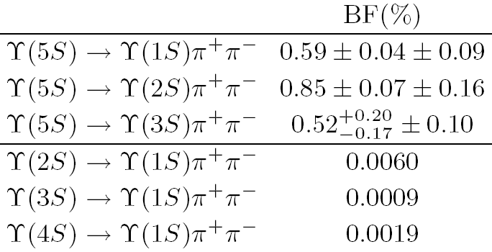
Puzzles of ϒ(5S) decays
1. Anomalous production of ϒ(nS) π⁺π⁻
PRL100,112001(2008)
Γ(MeV)
>10²x
Possible explanations...
Rescattering ϒ(5S)→BBππ→ϒ(nS)ππ
Tetraquark ϒ(5S)→T_{bb}π→ϒ(nS)ππ
Exotic resonance Y_{b} near ϒ(5S)
analog of Y(4260) resonance with anomalous Γ(J/ψ π⁺π⁻)
Check shapes of R_{b} and σ(ϒππ) as function of E_{CM}
Meng et al. Phys.Rev.D78:034022,2008
Karliner et al. arXiv:0802.0649v2; Xiang Liu et al. Eur. Phys. J. C (2009) 61: 411–428; Yan-Rui Liu et al. Eur.Phys.J.C56:63-73,2008; N. Brambilla et al, Eur.Phys.J. C71 (2011) 1534; N. Brambilla et al. CERN Yellow Report, CERN-2005-005, Geneva: CERN, 2005.- 487 p.
Hou et al., Phys.Rev.D74:017504,2006
Ali et al. Phys.Rev.Lett.104:162001,2010
Notes:
arXiv:0802.0649v2

Slide 7
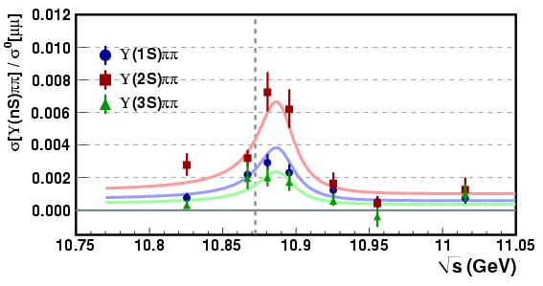
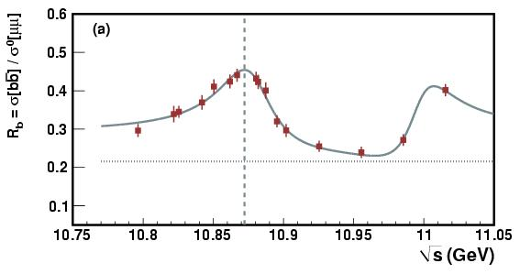
Energy Scan
R_{b} peaks at 10.87, σ(ϒππ) peaks at 10.89
PRD82,091106R(2010)
10.89 GeV
σ[ϒ(nS)ππ]/ σ [μμ]
~1-2fb⁻¹/point
10.87 GeV
σ[bb]/ σ [μμ]

Slide 8
Search for h_{b}
ϒ(5S) → h_{b}(nP) π⁺π⁻
h_{b}: No clear exclusive decays
E_{ϒ(5S)} is given by c.m. energy and boost
E_{π+π-} is measured
reconstructed
accelerator information
Missing mass technique
Energy conservation, using known initial and final states

Slide 9
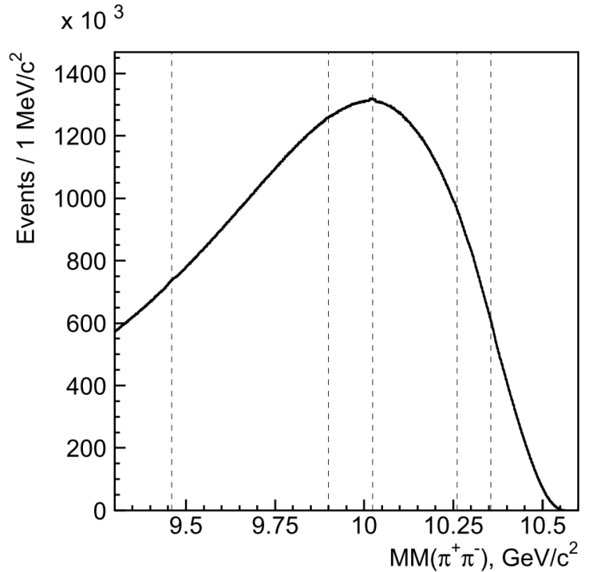
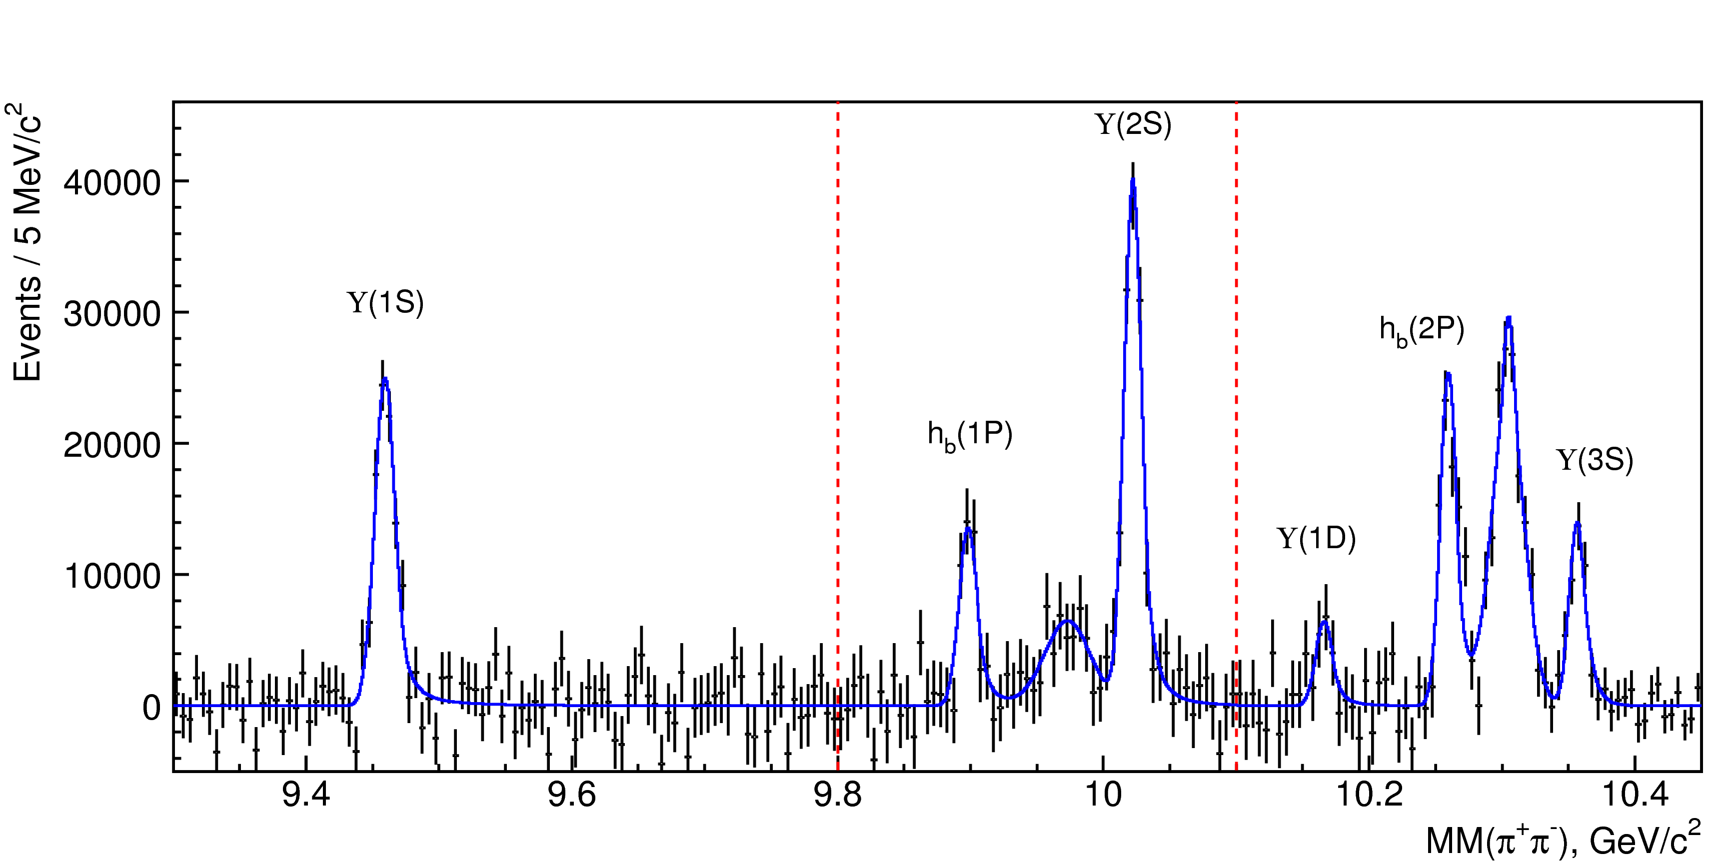
MM(π⁺π⁻) spectrum
Raw spectrum
ϒ(2S)
Fit Region 1
Fit Region 2
Fit Region 3
2S→1S
ϒ(1S)
h_{b}(2P)
h_{b}(1P)
ϒ(3S)
3S→1S
Background-subtracted data

Slide 10
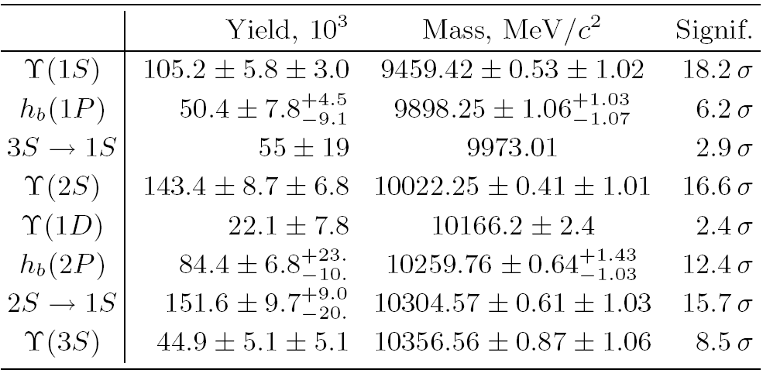
Mass measurements
First observations
Results, 121.4 fb⁻¹
Mizuk arXiv:1103.3419v1
BaBar evidence:
9902±4±1 MeV
ϒ(3S) → π⁰ h_{b}(1P)
→π⁰γη_{b}(1S)
arXiv:1102.4565
ΔM=M_{measured}-M_{theory}:
h_{b}(1P) 1.62 ± 1.52 MeV/c²
h_{b}(2P) 0.48 ^{+1.57} MeV/c²
consistent with zero
_{-1.22}

Slide 11
Ratio of production rates
for h_{b}(1P)
=
for h_{b}(2P)
S(h_{b})= 0 ⇒ spin-flip no spin-flip
Naive heavy quark theory: spin-flip suppressed as m→∞
⇒ Expect ratio<<1
Process with spin-flip of heavy quark is not suppressed
Γ(h_{b}ππ) ≈ O(Γ(ϒππ)) (also high) ⇒ Exotic? ⇒ Study substructure

Slide 12
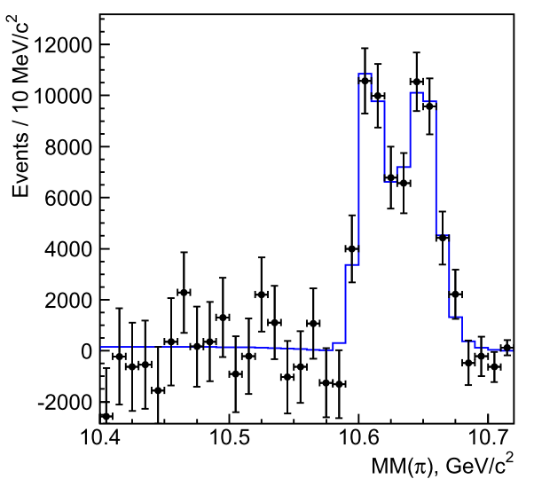
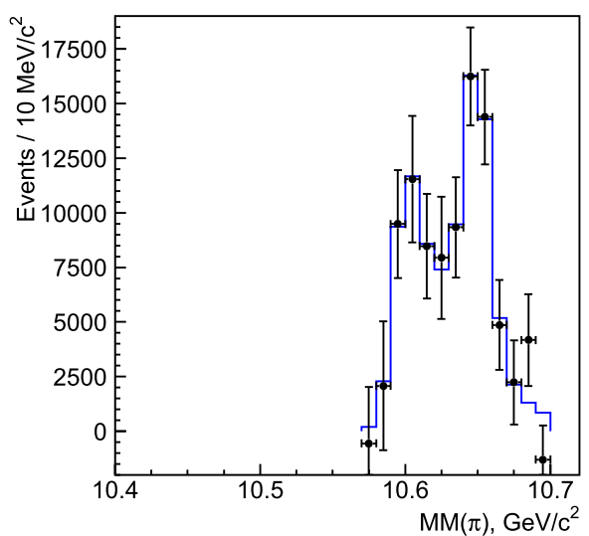
ϒ(5S)→ h_{b}(nP)π⁺ π⁻ (χ² Fit)
M(X)=MM(π⁻)
32 bins from 10.4 MeV < MM(π) < 10.72 MeV and fit to MM(π⁺π⁻) for each MM(π) bin
Assume J^{P}=1⁺ for Z_{b}, so use P-Wave BWs and Blatt Weisskopf FFs
ϒ(5S)→h_{b}(2P)π⁺π⁻ similar with binning: 10.57 MeV < MM(π)<10.72 MeV
q₀ = daughter momentum
R = 1.6 GeV⁻¹
h_{b}(1P)
h_{b}(2P)
Clear structure!
--all h_{b} are evidently from resonances
Look in similar (and cleaner) decays:
ϒ(5S)→ϒ(nS)ππ

Slide 13
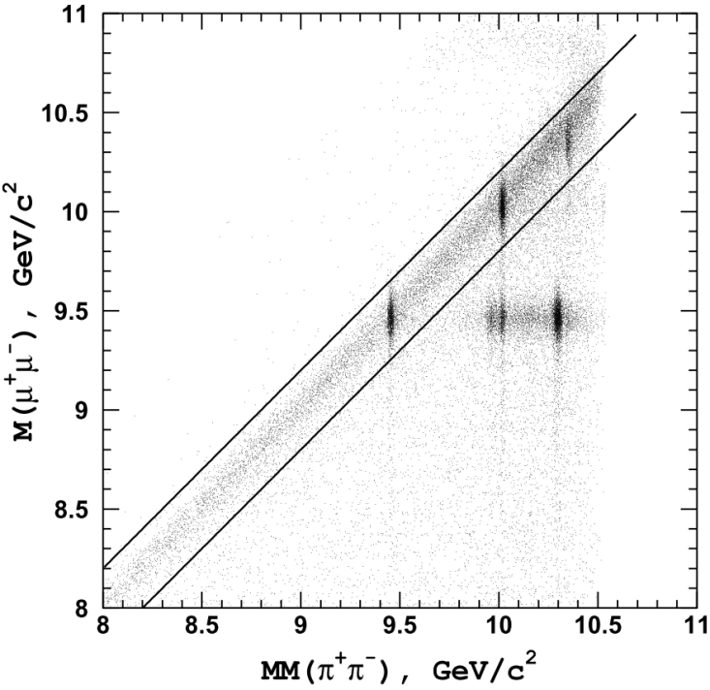
Dalitz analysis of ϒ(5S)→ϒ(nS)ππ
Clean exclusive decay: ϒ→μ⁺μ⁻
ϒ(3S)
ϒ(2S)
ϒ(5S)→ϒ(nS)π⁺π⁻ Dalitz analysis event selection
Require: π⁺π⁻μ⁺μ⁻
Selection using MM(π⁺π⁻) and M(π⁺π⁻μ⁺μ⁻)
ϒ(1S)
M(π⁺π⁻μ⁺μ⁻)~ϒ(5S)

Slide 14
Signal Selection
Signal
Projections along MM(π⁺π⁻)
Sideband
arXiv:1105.4583v1
ϒ(1S)
ϒ(2S)
ϒ(3S)
Plot these events: M(ϒπ)² vs. M(π⁺π⁻)²

Slide 15
Dalitz plots
arXiv:1105.4583v1
Signal
Signal
Signal
ϒ(1S)
ϒ(2S)
ϒ(3S)
Sideband
Sideband
Sideband
Photon conversions

Slide 16
Dalitz plots
arXiv:1105.4583v1
Signal
Signal
Signal
ϒ(1S)
ϒ(2S)
ϒ(3S)
Sideband
Sideband
Sideband
Photon conversions

Slide 17
Unbinned maximum likelihood fit
Fits performed in M²(ϒπ) and M²(ππ)
Constant=1
A_{f0} and A_{f2} = contributions from f₀(980) and f₂(1270).
A_{f0} Flatte, m=950 MeV
A_{f2} Breit Wigner, m=1275 MeV
Amplitude/phase floated in ϒ(1S)ππ fit (strongest potential contribution), fixed to ϒ(1S)ππ results for other channels

Slide 18
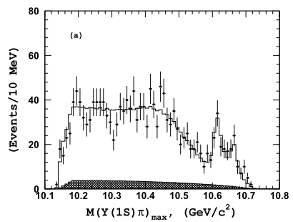
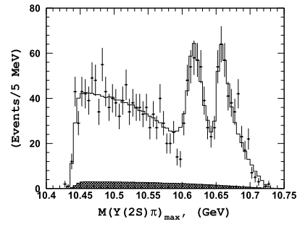
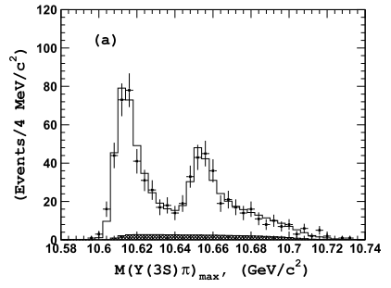
Projections of Fits
arXiv:1105.4583v1
M(ϒ(1S)π_{max})
M(ϒ(2S)π_{max})
M(ϒ(3S)π_{max})
Notes:
Due to phase space, signal-like reflections seen with wrong-pion--Upsilon reconstruction
Significant overlap of signal and reflection in Y(3S)

Slide 19
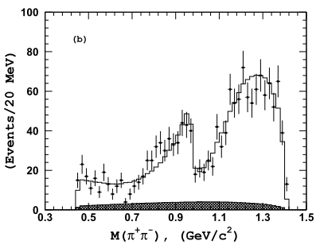
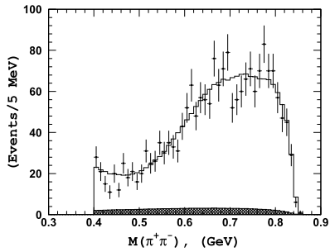
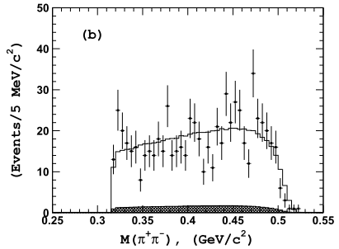
Projections of Fits
arXiv:1105.4583v1
M(ϒ(1S)π_{max})
M(ϒ(2S)π_{max})
M(ϒ(3S)π_{max})

Slide 20
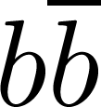
Candidate for Z_{b}
charged tetraquark/di-meson candidate
For Q=c: Z(4430): Seen at Belle in decay to
s=1 l=0 + π (ψ(2S)π⁺)
B₀ → K⁻ Z⁺(4430) → K⁻ ψ(2S)π⁺
Analogue for Q=b: "Z_{b}" in decay to + π
Z_{b}→h_{b}π
ϒ(5S)→Z_{b}π→h_{b}(nP)π⁺π⁻
Z_{b}→ϒπ
ϒ(5S)→Z_{b}π→ϒ(nS)π⁺π⁻
Phys.Rev.Lett.100:142001,2008

Slide 21
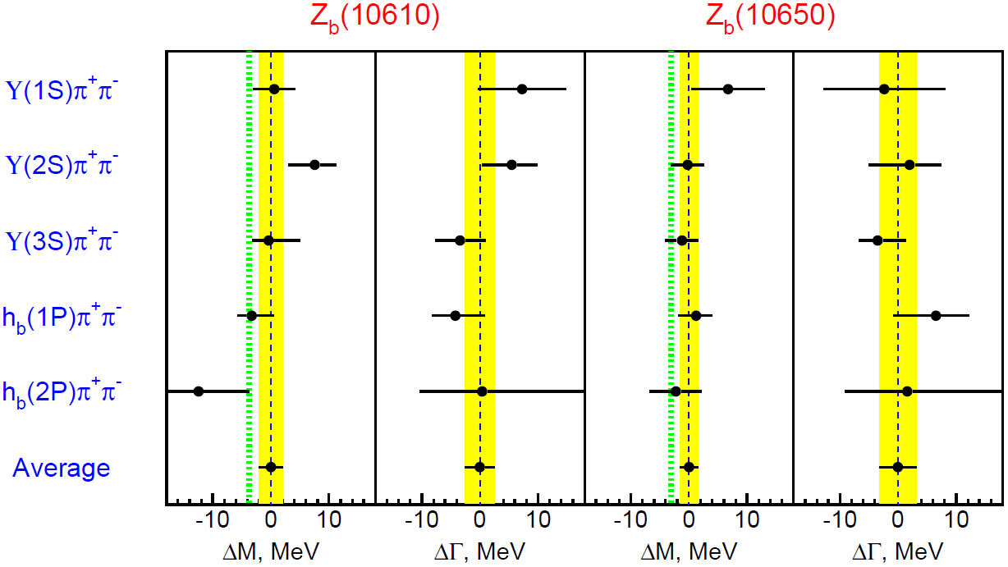
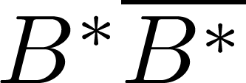
Summary of parameters of charged Z_{b} states
[preliminary]
arXiv:1105.4583v1
Masses directly above B*B^{(*)} threshold ⇒
molecular interpretation favored
Z_{b}(10610)
Z_{b}(10650)
Relative phase
Z_{b}(10610) to Z_{b}(10650)
~0° for ϒππ
~180° for h_{b}ππ
M=10608.4±2.0 MeV
M=10653.2±1.5 MeV
Γ=15.6±2.5 MeV
Γ=14.4±3.2 MeV
*Also fit for angular dependence. Results favor J^{P}=1⁺ over 1⁻, 2⁺, 2⁻

Slide 22
Summary of the Belle results
Preliminary
First observation of h_{b}(1P) and h_{b}(2P)
arXiv:1103.3419
Masses consistent with CoG of χ_{bJ} states
First observation of two charged bottomonium-like resonances
M = 10608.1 ± 1.7 MeV
Γ = 15.5± 2.4 MeV
Z_{b}(10610)
arXiv:1105.4583v1
M = 10653.3 ± 1.5 MeV
Γ = 14.0 ± 2.8 MeV
Z_{b}(10650)
Seen in 5 different final states, parameters are consistent
Expectation J^{P}=1⁺ agrees with data; other J^{P} are disfavored.
Amplitude ratio A[Z_{b}(10610)] / A[Z_{b}(10650)] ~1.
Relative phase ~0° for ϒ and ~180° for h_{b}.
Explains why h_{b}ππ is unsuppressed relative to ϒππ.

Slide 24
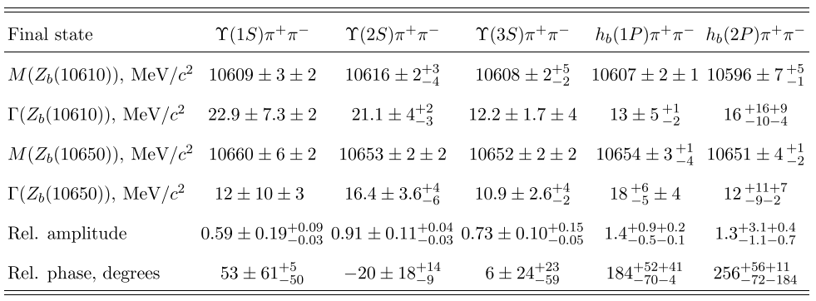
Fit Results
Five modes with consistent masses for both "Z_{b}" resonances.

Slide 25
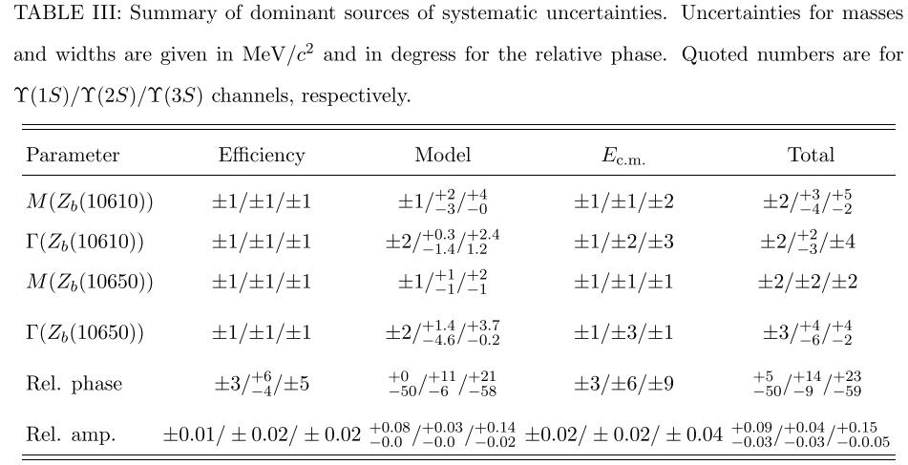
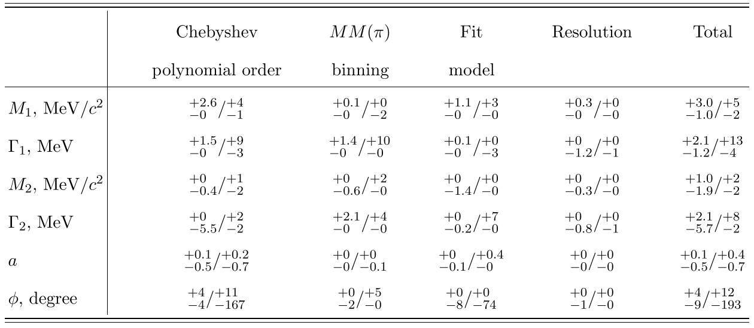
Systematics
ϒ(1S)/ϒ(2S)/ϒ(3S)
h_{b}(1P)/h_{b}(2P)
arXiv:1105.4583v1
Notes:
Eff: MC simulation of signal events uniformly distributed over the phase space
Model: Modifications of the nominal model: vary M(π + π−) dependence of the non-resonant amplitude A NR , try to include a D − wave component into A NR , etc. Variations in extracted Z b parameters from fits with modified models is model uncertainty.
Ecm: Affects plot boundaries. This effect is particularly important for the Υ(3S)π + π− channel. For an estimate of the associated effect on the Z b parameters: generate a normalization phase space MC that corresponds to E c.m. ± 3 MeV

Slide 26
Angular dependence
Fits performed for 1+, 1-, 2+, 2- spin possibilities
1+ least disfavored for hypotheses with J≤2. Probabilities at which other hypotheses are relatively disfavored: ( )
Caveats
Non-resonant component approximate
Neglect mutual cross-feed from two Z_{b} states
arXiv:1105.4583v1

Slide 27
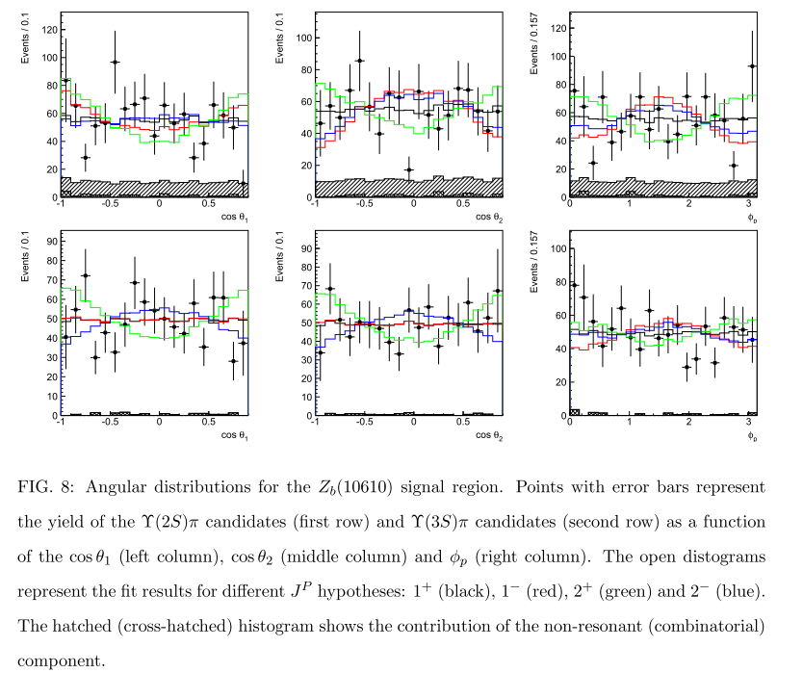
Z_{b}(10610)
ϒ(2S)π
ϒ(3S)π
Notes:
theta1, theta2, polar angles of pions
phi-p--angle between plane: pion and Y5s and plane: pion pion
∠(π_{i},e⁺), ∠(π₁,π₂), ∠[plane(π₁,e⁺), plane(π₁, π₂)]
0+ forbidden for Upsilon
0- forbidden for h_b

Slide 28
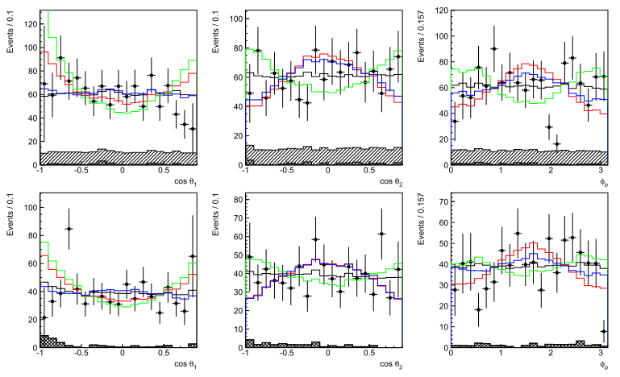
Z_{b}(10650)
ϒ(2S)π
ϒ(3S)π

Slide 29
Simple selection for h_{b} :
π⁺π⁻
: good quality, positively identified
Continuum events have jet-like shape ⇒ cut on R2<0.3
R2 = ratio of Fox-Wolfram moments
“blind analysis”

Slide 30
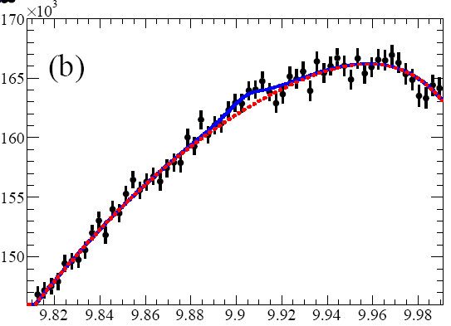
h_{b} also seen at BaBar
ϒ(3S) → π⁰ h_{b}(1P) → π⁰ γ η_{b}(1S)
3.0σ
arXiv:1102.4565
M_{recoil}(π⁰)

