Slide 1
The LHC
Status and Performance in 2011
Rencontres de Blois
“Particle Physics and Cosmology”
Blois, France
31st May 2011
Stephen Myers
Director for Accelerators and Technology,
CERN Geneva

Slide 2
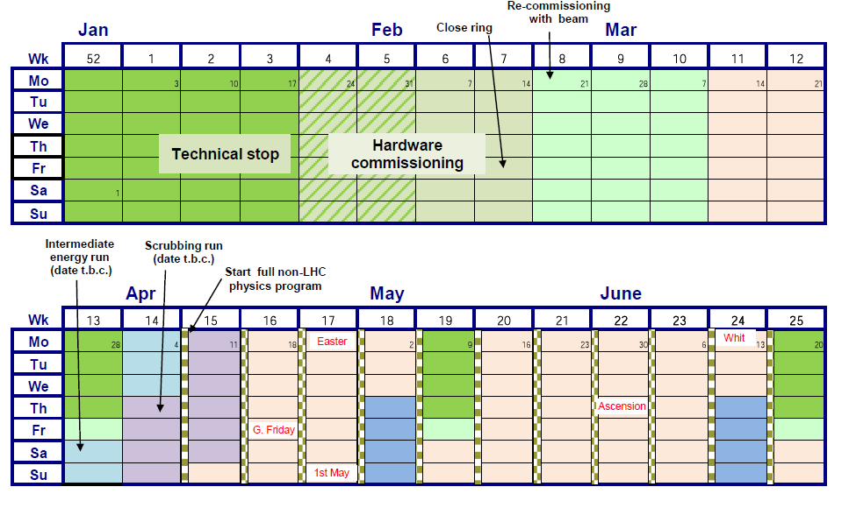
2011 LHC schedule
The 3 periods
Physics re-established with 75ns and increasing the number of bunches,
Intermediate energy run at 1.38 TeV/beam + Scrubbing Run
Start of going by steps towards 900b + TS + (MD)
Today
2

Slide 3
Period 1: Restablishing Physics at 75ns bunch spacing

Slide 4
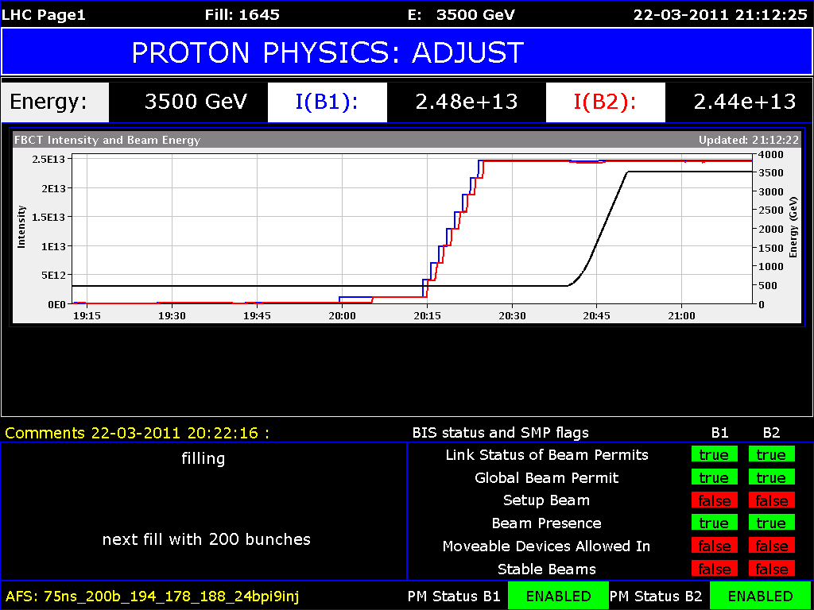
200 bunches; 75ns; 24bpi

Slide 5
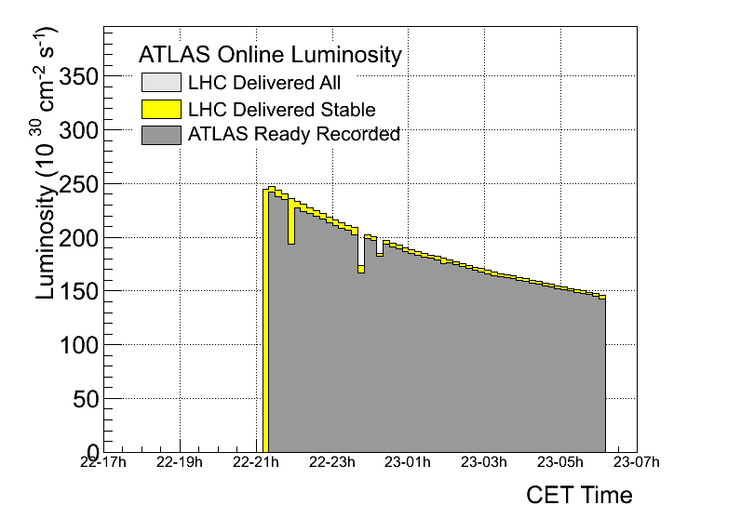
Best fill 1st Period; Luminosity with time

Slide 6
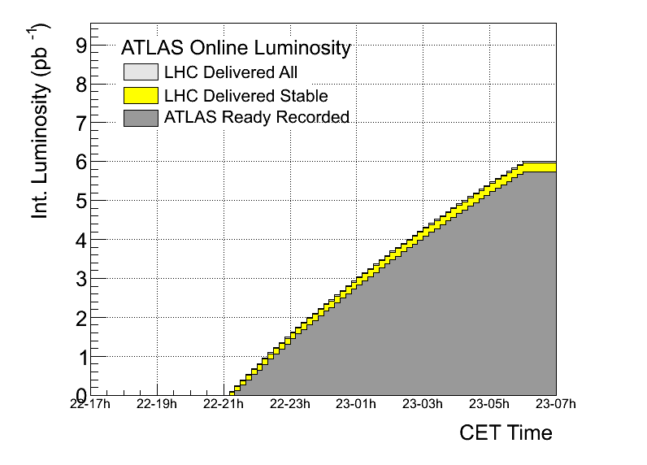
1st Period: Best Integrated Luminosity

Slide 7
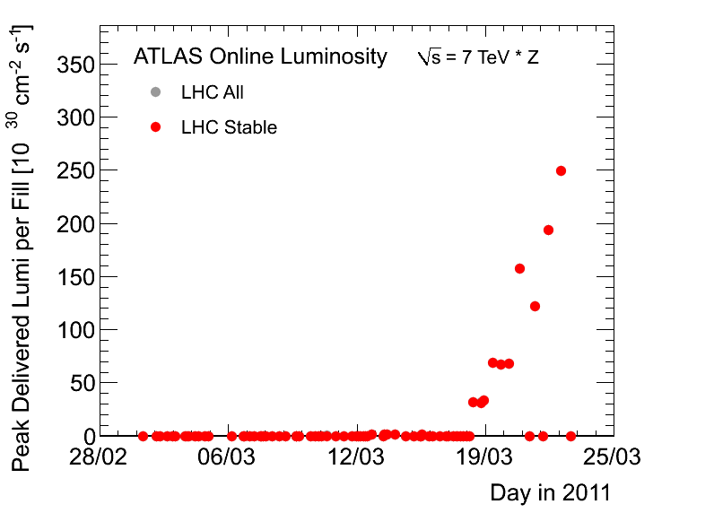
First Record Fill of 2011 (on March 23)
8 days into the run

Slide 8
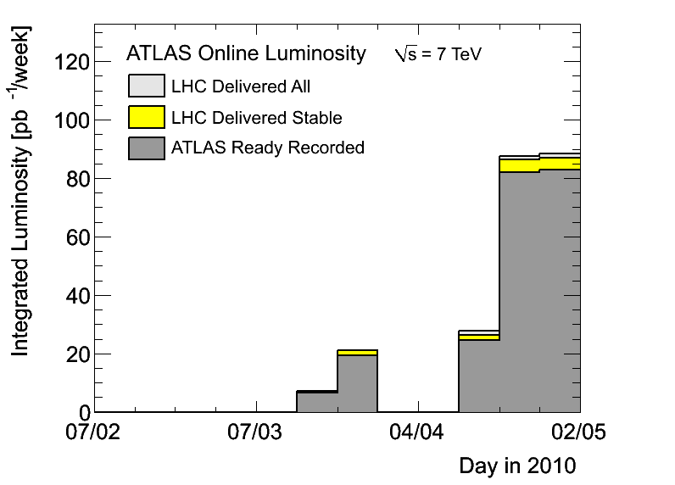
1st Period
Period 3
Period 1
Period 2

Slide 9
2nd Period (a) Intermediate Energy Run at 1.38TeV/beam
Accomplished without too much bother;
Done in 4 days 25th March – 28th March BEFORE the Technical stop

Slide 10
2nd Period (b)
Scrubbing Run at 450 GeV/beam.
10 days or real scrubbing foreseen, but because of technical hiccups took 12 days of calendar time

Slide 11
2011 LHC schedule
11

Slide 12
Scrubbing: only 5 effective days
Intensity progression – 50 ns
  Above 600 bunches beam stability became an issue an slowed down temporarily (many dumps) the progression.
    Tune shifts with intensity, RF tuning…
  All dumps well captured by MPS.
  No issues with HOM power for RF.
Date | Bunches B1+B2
Tue 5th April | 300+300
Wed 6th April | 408+336
Sat 8th April | 588+588
Sun 9th April | 804+804
Mon 10th April | 1020+1020

Slide 13
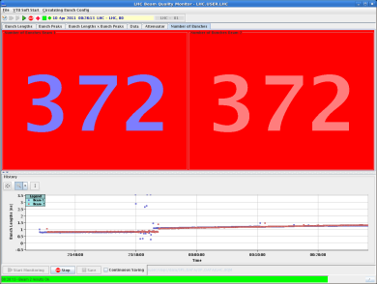
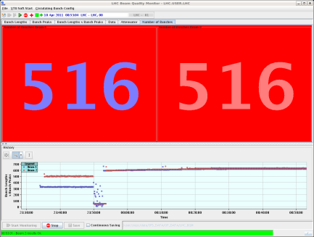
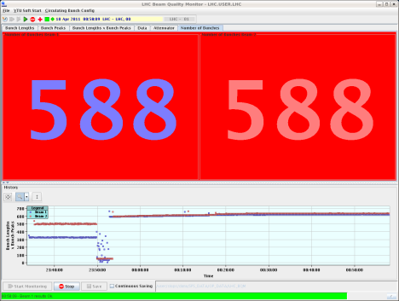
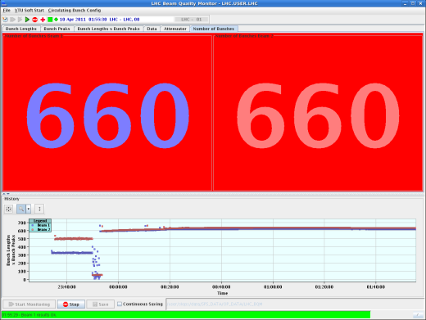
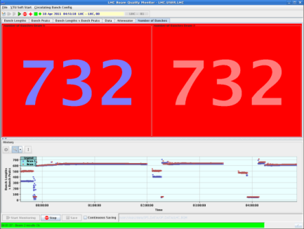
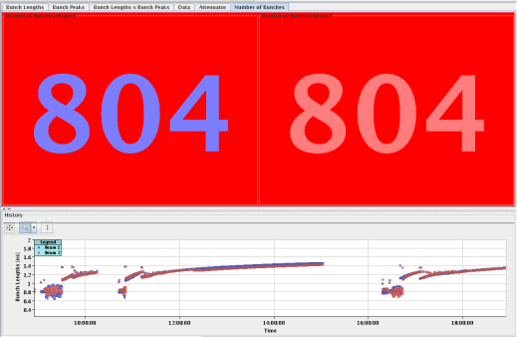
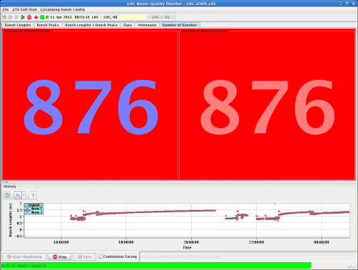
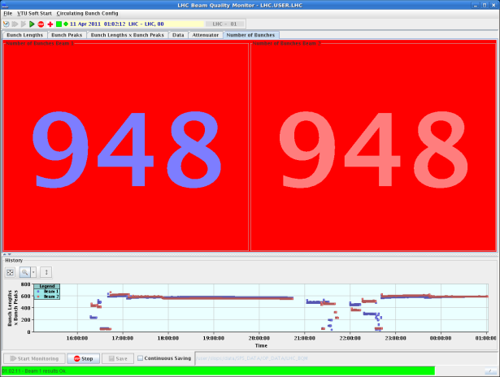
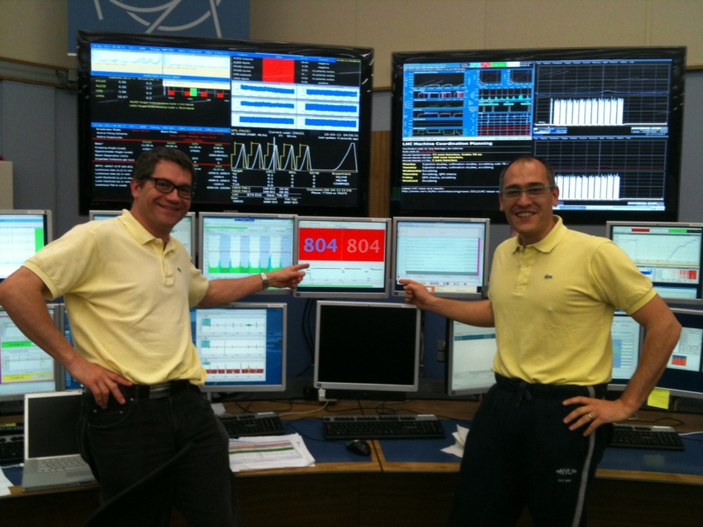
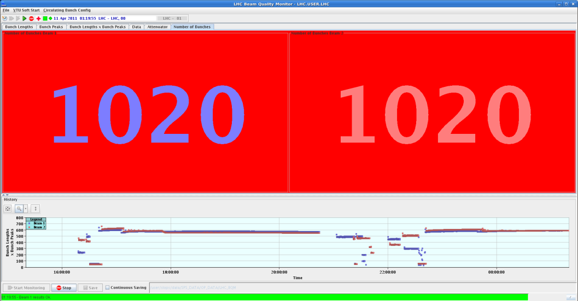
Summary of week 14 & part of 15
Scrubbing run
J. Uythoven, J. Wenninger,
G. Arduini
B. Holzer, R. Assmann
Decision: Continue physics with 50ns

Slide 14
Issues encountered with Higher Intensities
3rd Period: Increasing the number of bunches
Requires much finer control of the beam parameters
  Chromaticity, gain of feedback and use of Landau octupoles
  Injection quality
Many more UFOs: not yet serious

Slide 15
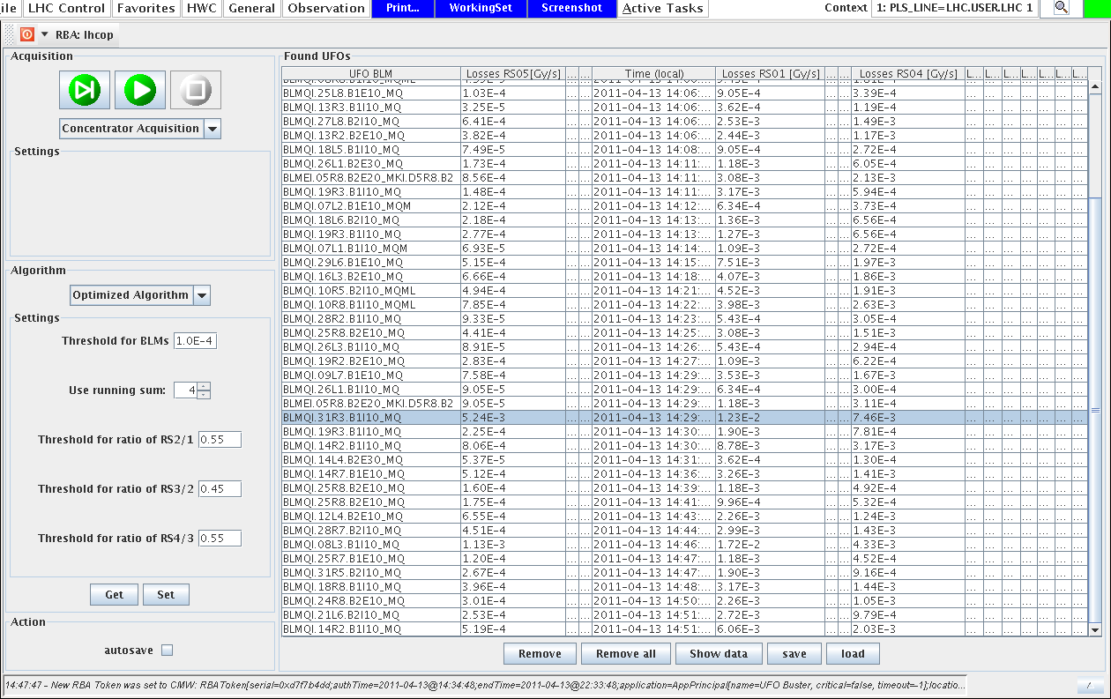
UFO’s: 90 in 90 minutes

Slide 16
Issues with Machine Protection
3rd Period: Increasing the number of bunches
Collimation loss of hierarchy at 450 GeV
  Due to order in which the loss maps were performed
72 (108/144) bunches
  Last bunch of previous injection got kicked; low intensity and higher emittance
  BPMs position calibration is sensitive to bunch intensity
  Dump interlock measures local position of all bunches
HTS quench (7th April) quench of 11 sc magnets
Injection Kicker Flashover (18th April)

Slide 17
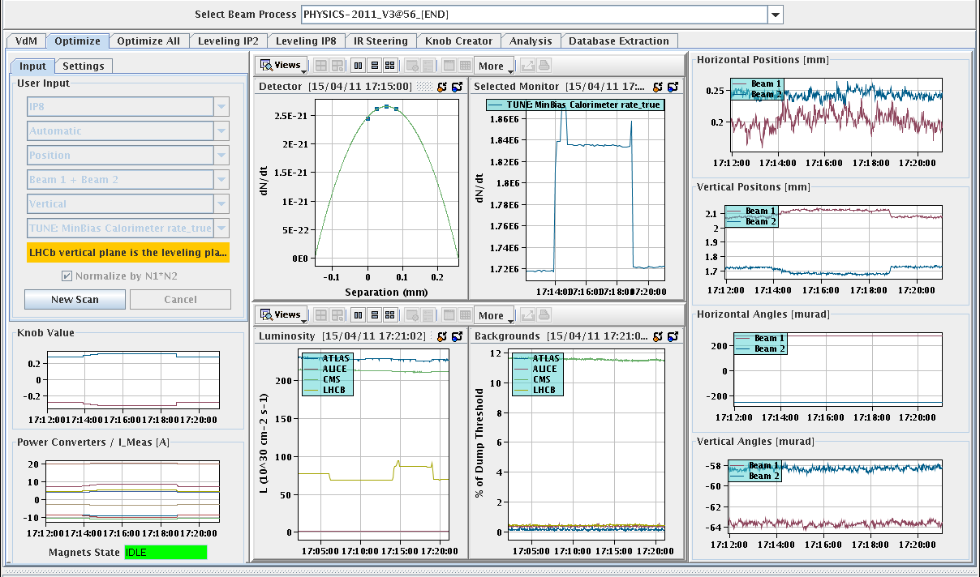
Lumi leveling test 15th April: now operational
LHCb

Slide 18
2011 LHC schedule
X
Technical Stop
Today
Machine Studies
X
18

Slide 19
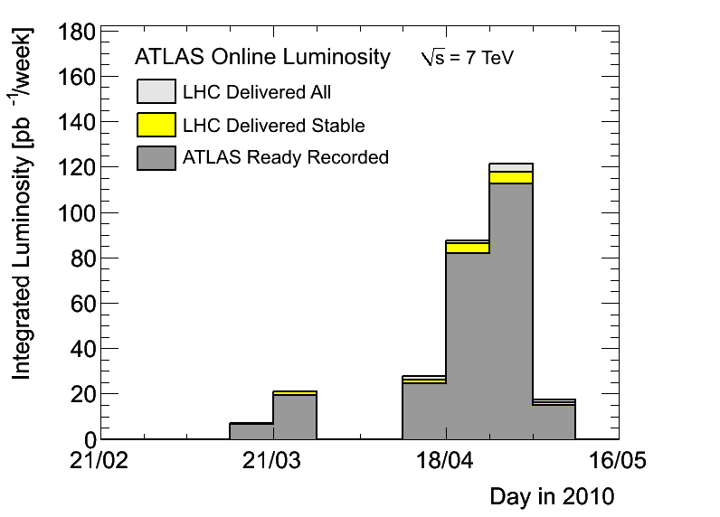
2011: Weekly summary of Integrated Luminosity
Before the Technical stop and MD

Slide 20
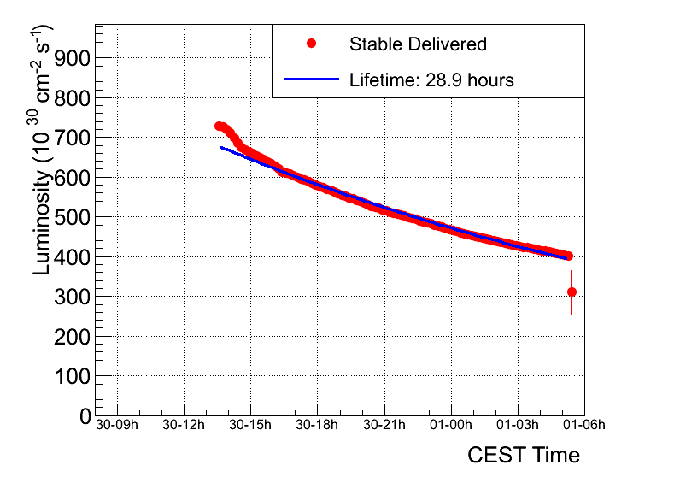
Fill 1749 – overnight (1—2 May)
Peak luminosity | ~6.9 e32
Integrated luminosity | ~29.7 pb-1
Stable beams | 15 hours 53 minutes
Colliding bunches | 598
Average emittance from luminosity | ~2.5 micron

Slide 21
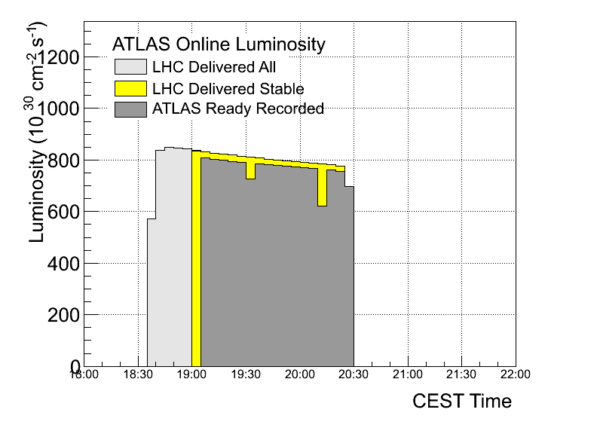
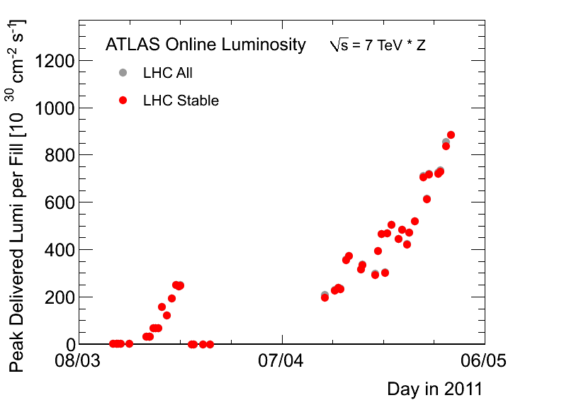
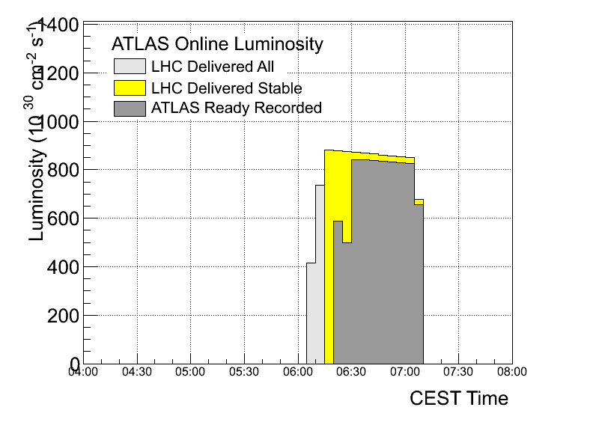
2 fills with 768 bunches/beam
Sunday May 01; 0.84x10³³ cm⁻² s⁻¹
Monday May 02, 0.88x10³³ cm-2 s-1

Slide 22
MD1

Slide 23
Some highlight …
MDs prove excellent performance potential of LHC:
  No head-on beam-beam limit encountered with 3 times nominal brightness. Total tune shift: 0.03 with ATLAS/CMS collisions.
  ATS injection optics with different integer tunes fine to 3.5 TeV.
  Collimation system reached tighter settings with better cleaning efficiency.
  Impedance and instabilities under control.
Operational improvements:
  90m optics for ALFA and TOTEM works fine.

Slide 24
Beam-beam limit
43% of design
50% above design
Collided high intensity beams (1.7 E11) and small emittances (smaller than 1.5 um) in IP1 and IP5.
First attempt achieved tune shifts 0.01 per IP, vertical blowup of emittance.
  Blowup most likely due to 10th order resonance.
In final attempt reduced vertical tune to end up below 10th order after putting beams in collision. No more blowup observed, tune shifts per IP in excess of 0.015 (with initial emittance below 1.2 um).
Collisions in IP1 and IP5, optimized and no more blowup.
No limit found for head-on beam-beam effects for the intensities investigated so far (no long range yet).
Factor of 4.5 above design

Slide 25
Next Years
Physics data-taking until end of 2012
  Implementation of the performance possibilities indicated during the machine studies (July 2011 performance review, following MD2)
    beam beam, aperture, emittance, intensity (pile-up)
  Following measurements of the copper stabilizers resistances during the Christmas stop, we will re-evaluate the maximum energy for 2012 (Chamonix 2012)
Long Shutdown in 2013
  repair/upgrade the magnet interconnects for operation at 6.5-7 TeV/beam
  install new collimation system in DS zone?

Slide 26
Some recent News

Slide 27
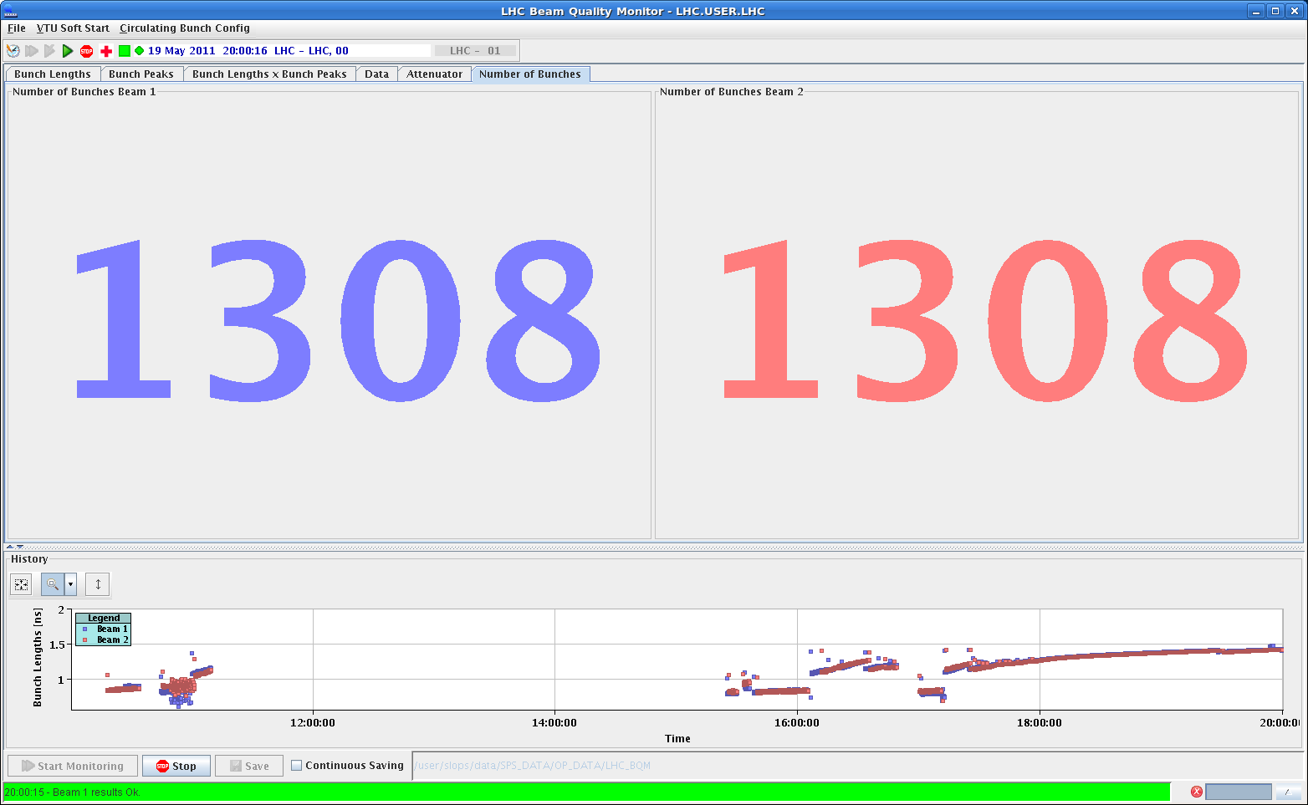
Filling with trains of 108 bunches (May 19)
While RF, cryo, vacuum monitoring
1.5x10¹⁴ p in the machine ~half nominal intensity

Slide 28
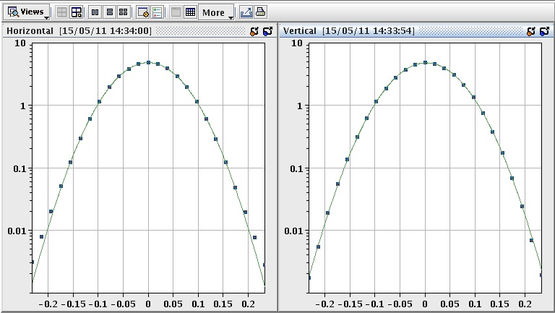
LHC precision front
absolute luminosity normalization
low, well understood backgrounds
precision optics for ATLAS-ALFA and TOTEM
VdM scan
IP1 H
IP1 V
precise measurement of the luminous region +
beam intensity --> absolute luminosity and
cross section calibration
currently ~ 5 % level, already better than Tevatron

Slide 29

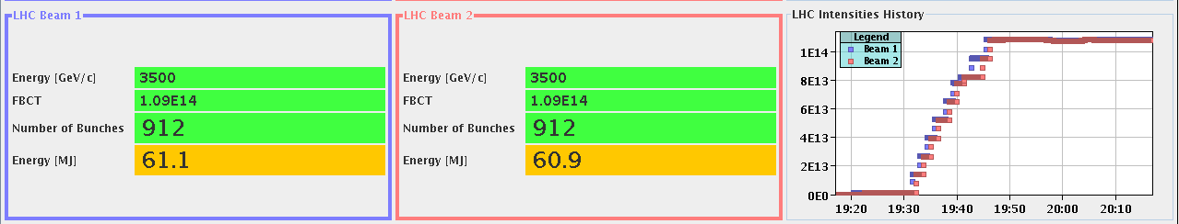
21 May: 912 bunches at 3.5TeV

Slide 30
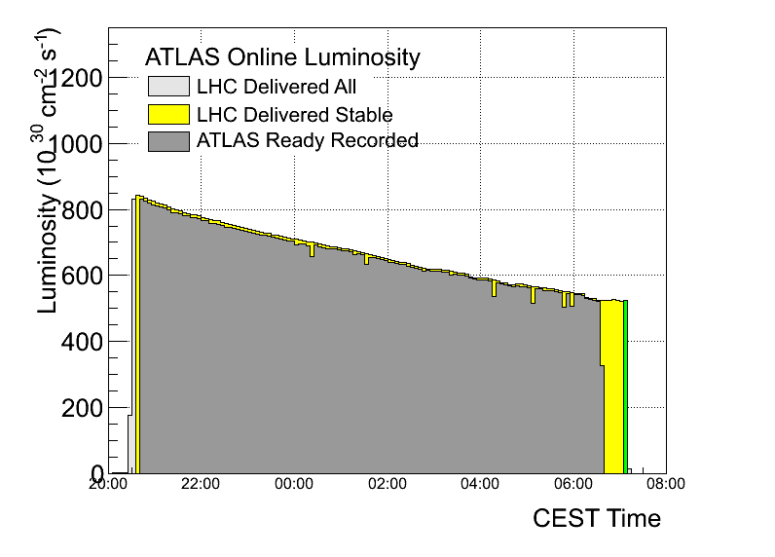
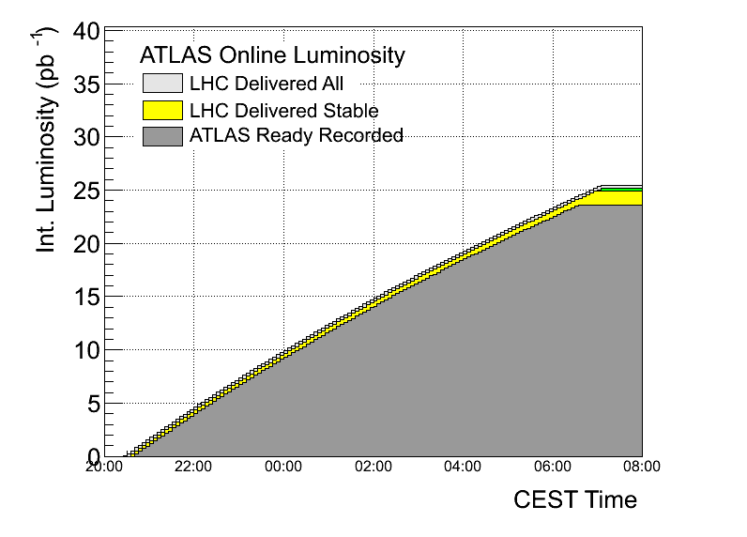
Sat-Sun Good Fill
Peak
Integrated

Slide 31
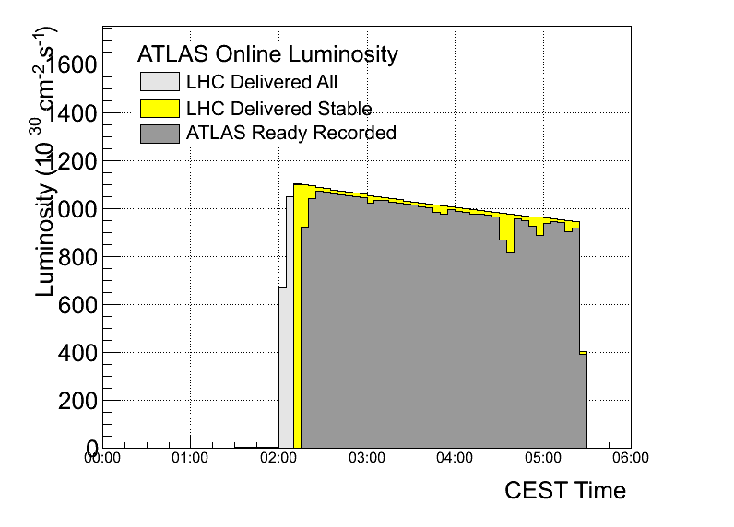
Sunday morning May 22: 1.1x10³³cm⁻²s⁻¹

Slide 32
May 29, 1092 bunches per beam

Slide 33
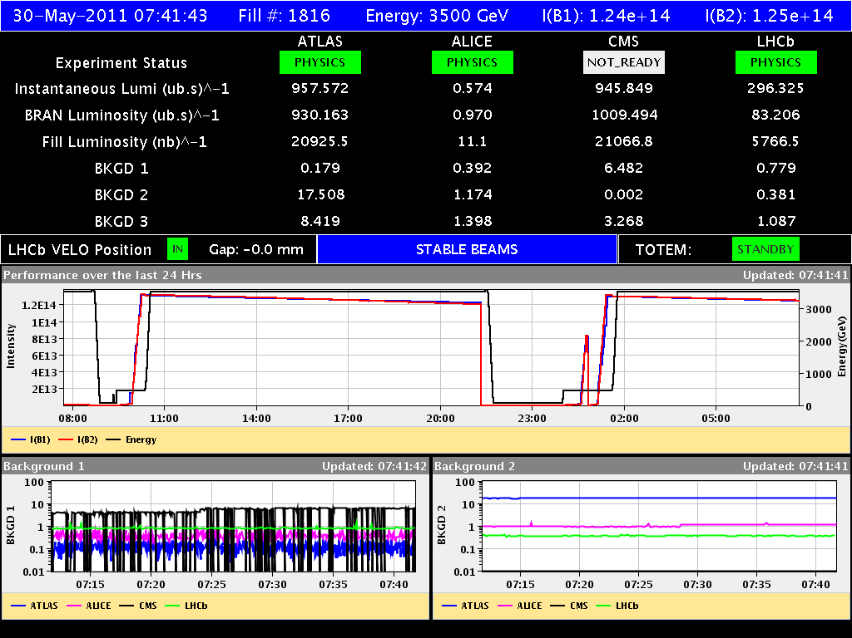
Back to back fills with 1092 bunches
Luminosity 1.2-1.3 x10³³cm⁻²s⁻¹

Slide 34
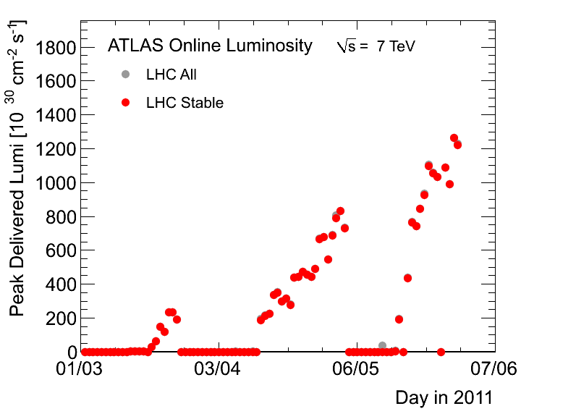
2011 Peak Liminosity (30 May)

Slide 35
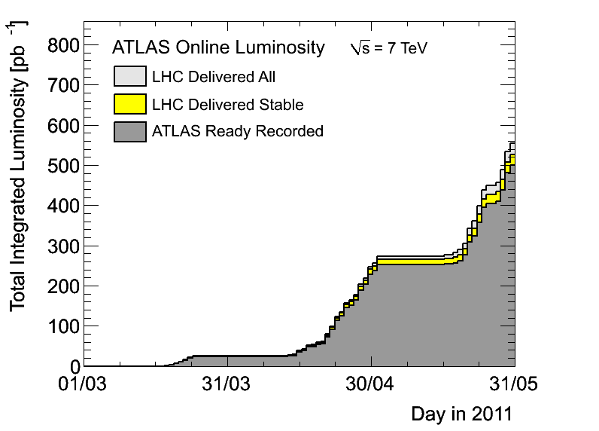
2011 Update (30 May)

Slide 36
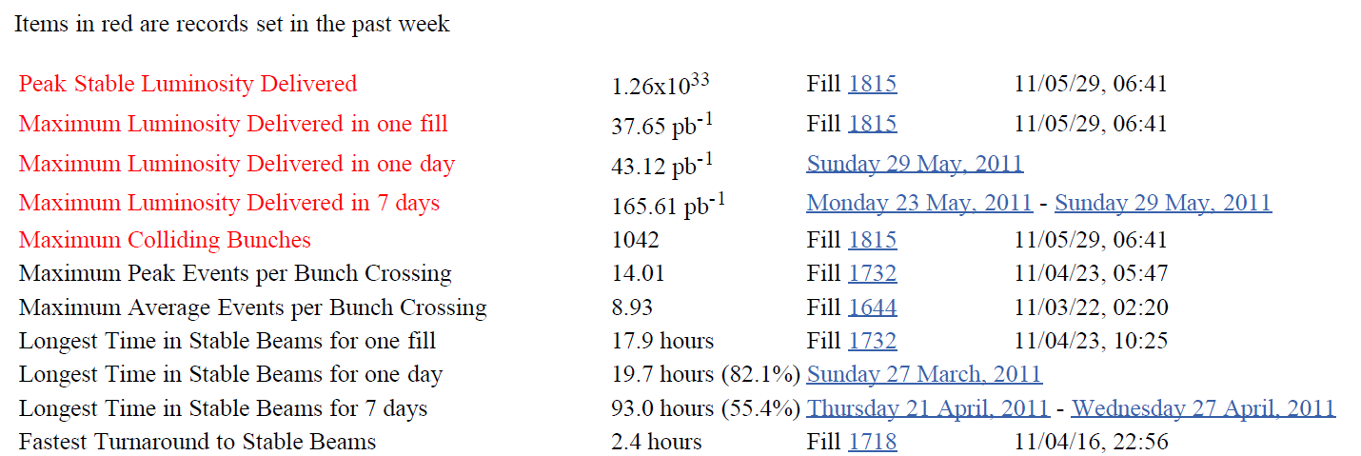
Records (May 31, 2011)

Slide 37


Summary
On Track
Intensity, peak and Integrated luminosity still going up very rapidly
Successfully implemented luminosity leveling for LHCb and luminosity calibration (vdM scans)
Recently a few “near misses” causing sleepless nights
  HTS protection fault for DFBs
  Injection kicker flashover
We must remain vigilant!!
Conclusions
Warning Shots

Slide 38
Thank you for your attention

Slide 39
Event of 7th April
Thursday afternoon (7th April) all powering was stopped in the LHC following the discovery of a worrying cabling problem affecting the QPS system protecting the HTS current leads.
Followed by an extensive verification campaign.
Lost about 2 days.

Slide 40
HTS quench (sc link)- what happened
QPS tripped the RB circuit in sector 45 on Thursday around 07:00. First time ever quench of HTS current lead
The HTS quenched due to a lack of cooling in the DFB
  Faulty electronics board corrupted the temperature feedback loop
Protection by the QPS monitoring the current leads.
  Logging of the two HTS signals showed that only one of the two measurements was correct, the other was measuring a short circuit
An identical fault on the redundant signal would have left the system unprotected and could lead to beyond repair damage to the DFB. No spares
Decided to stop powering magnets
  To validate other circuits

Slide 41
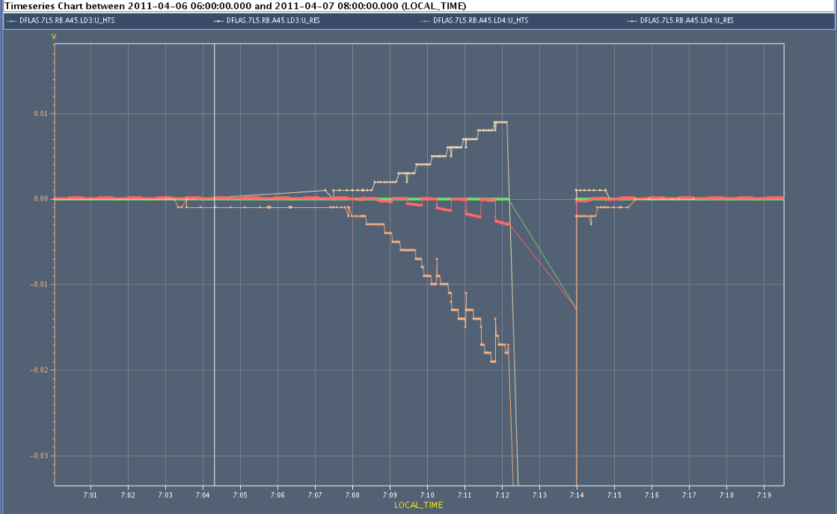
QPS signals monitoring the HTS
Ures Uhts redundant signals, logging swaps every 30 s from board A to board B
One of the signals is not correct !

Slide 42
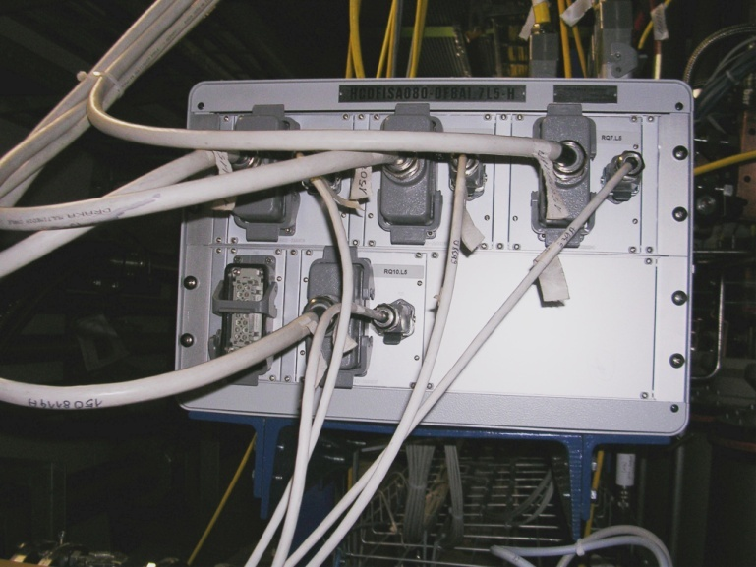
What was swapped…?
What was found swapped in RB.A45, Lead#2 on DFBAI (L5)?
  EE22 (pin 15) and EE42 (pin16)
  of cable between PE and QPS controller
This connection had been like this since 2005
Are all connections like this?
Stop operation until all connections are verified

Slide 43
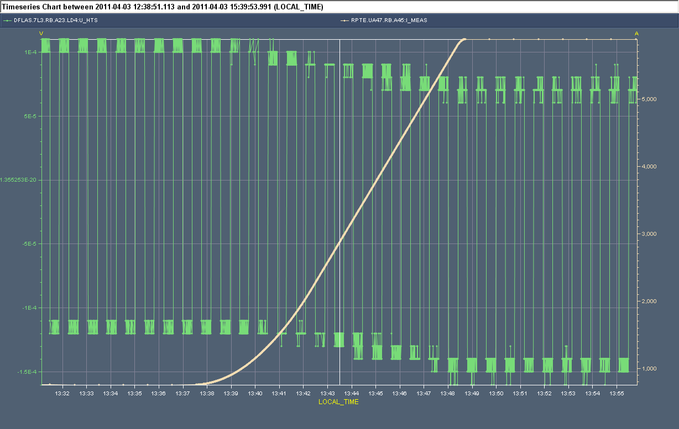
From the logging
Analysis of the logging data from old ramps allowed the QPS team to verify the correctness of the signals for other 13 kA circuits
Verification of U_RES & U_HTS on all IPQs, IPDs, ITs using dedicated powering cycles by the QPS team
  Verification of boards A & B
Board A
Example of a healthy channel: both boards move in unison during a ramp
Board B

Slide 44
Verification - Friday 8th April
In the late afternoon all high current circuits except the
600 A circuits had been checked.
  Acceptable risk for 600 A circuits.
All tests showed the presence of the expected signals.
Green light for powering from TE/MPE in the evening.
Among all the high current circuits we happen to quench exactly the one circuit with a cabling problem !!

Slide 45
Event of 18th April
Flashover (high voltage breakdown) on B2 MKI magnet D (first one seen by the beam) while injecting 72b
Extensive beam losses through P8 and arc 78: result
  Kicker interlocked off
  Quench heaters fired on 11 magnets
  Vacuum valves closed
  Several very anxious hours....

Slide 46
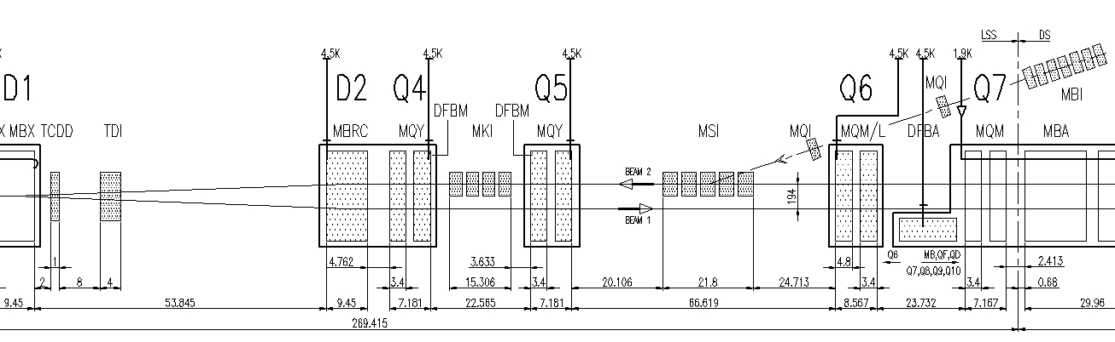
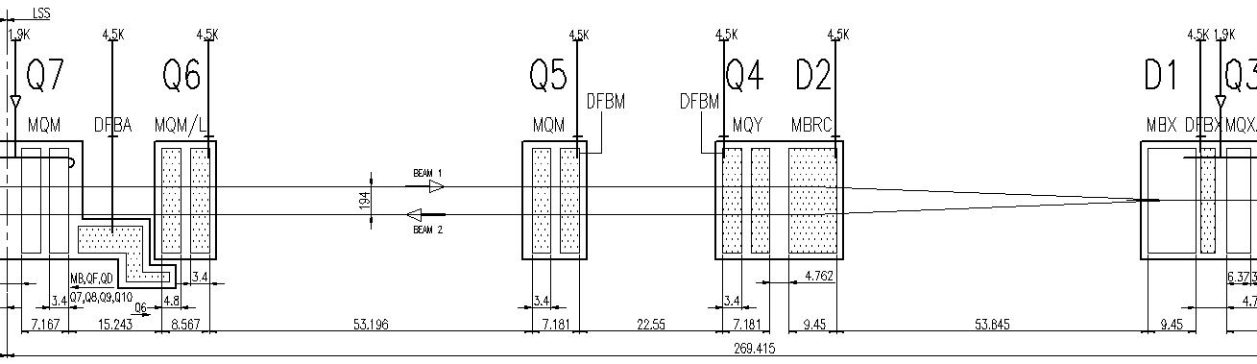
Overview of injection region (IR8)
TCDD
MKI
MSI
TDI (MKI +90º
TCLIB (TDI + 340º)
TCLIA (TDI + 200^{o)}

Slide 47
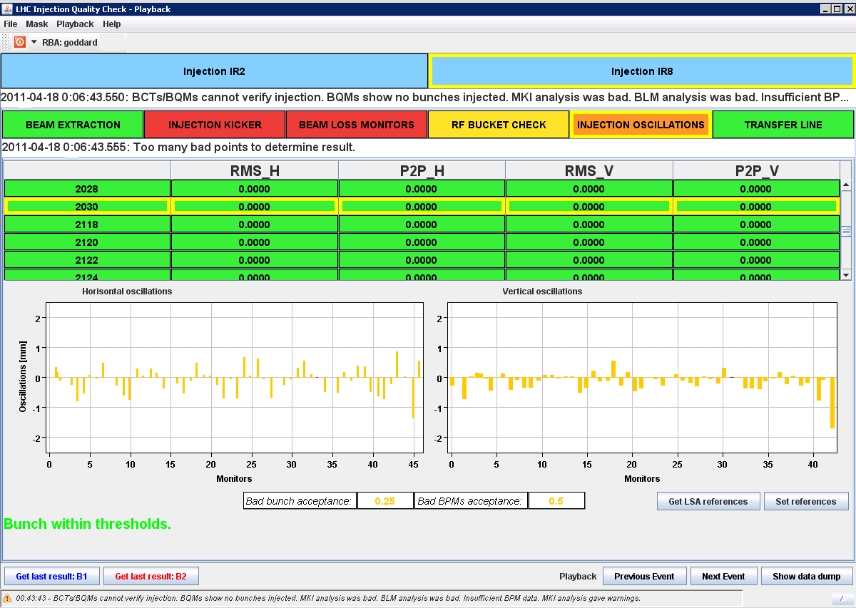
Bunch 36 in first injected batch OK -> breakdown after 1.8 us
From IQC

Slide 48
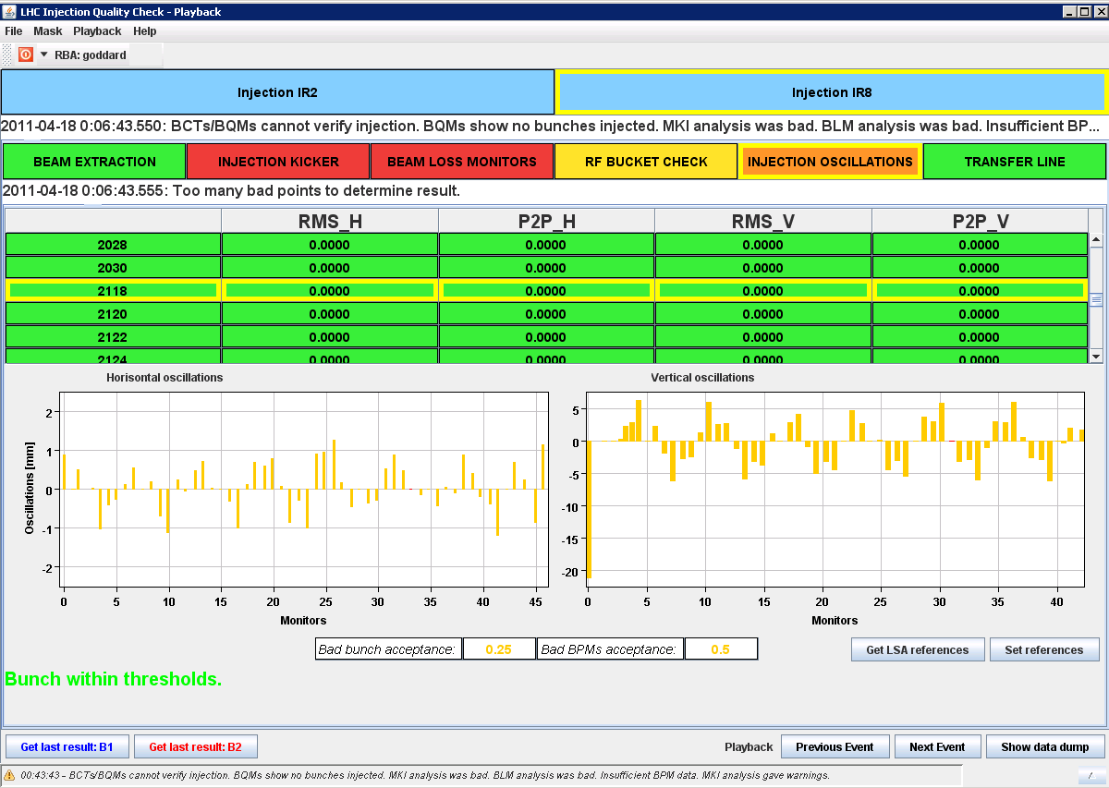
Bunch 1 in 2nd injected 36b batch +/-5 mm oscillations -> breakdown before 4 us
From IQC

Slide 49
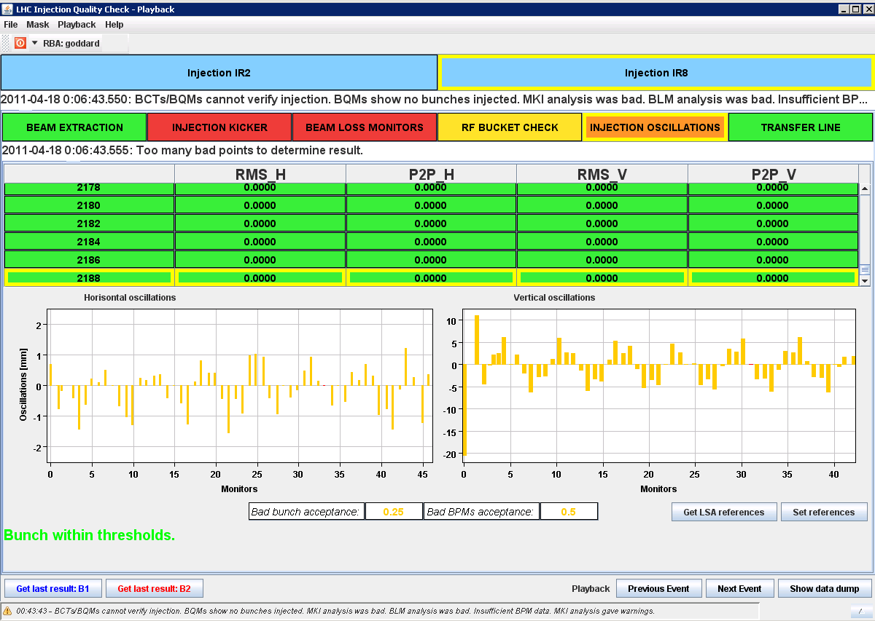
All 36b of 2nd batch were badly kicked
From the trajectory, can say that the beam was on LOWER TDI jaw and overkicked,
i.e. breakdown in second half of magnet (LHCb signals support this)
Grazing incidence – BPMs triggering in arc mean that more than 2e10 p+/b transmitted
From IQC

Slide 50
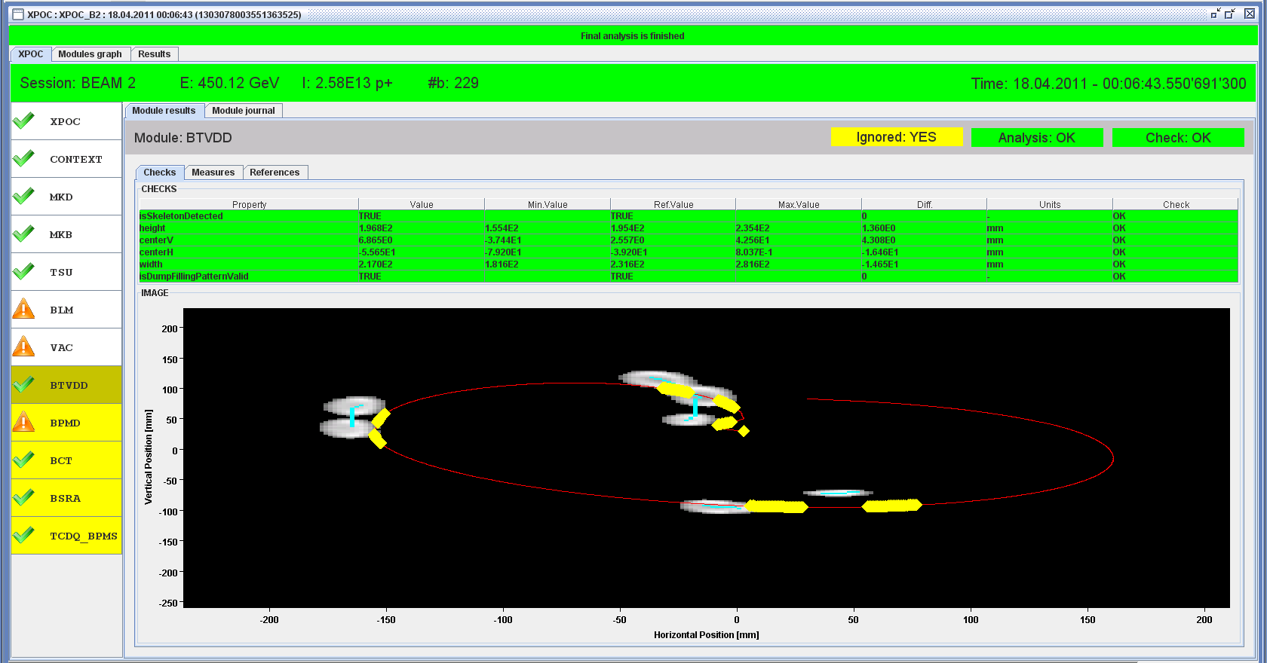
Second 36b
First 36b
See the two batches clearly on the BTVDD – 2nd batch with lower intensity and
vertically offset
FBCT in bump line records 2.58e13 p+ dumped – ‘missing’ about 2e12 p+, almost
exactly half of 36b batch – perfect grazing
From XPOC

Slide 51
Measures proposed and taken
New SIS to prevent injection if MKI pressure >1e-9 (will have to get some experience with this)
Checked carefully TDI alignments in P2 and P8, especially with respect to TCLI openings
  No anomalies found
New Fixed Display in CCC with MKI pressures
Vacuum sublimation made on MKI2 and MKI8
Production of 2nd spare MKI speeded up

Slide 52
Conclusion
Had a real breakdown in MKI8.D, between two 36b trains in a 72b batch
36b overkicked and grazed lower jaw of TDI/TCLI
  About half of this intensity was transmitted into LHC (2e12)
Known worst case scenario for injection protection
  Showers caused quenches and LHCb trips
  No damage (magnets, MKI, LHCb, TDI)
  Protection works – factor 8 to go to real worst-case
  Setting up and positioning of these devices critical
  BLMs need more dynamic range
Production of 2nd new spare MKI accelerated

Slide 53
HL-LHC: Luminosity Upgrade (x5 with “levelling”)
HE-LHC: Possible energy increase of the LHC
Longer Term

Slide 54
Luminosity Upgrade Scenario
  For LHC high luminosities, the luminosity lifetime becomes comparable with the turn round time ⇒ Low efficiency
  Preliminary estimates show that the useful integrated luminosity is greater with
    a peak luminosity of 5x10³⁴ cm⁻² s⁻¹ and a longer luminosity lifetime (by luminosity levelling)
    than with 10³⁵ and a luminosity lifetime of a few hours
  Luminosity Levelling by
    Beta*, crossing angle, crab cavities, and bunch length
    ??? Off steering

Slide 55
Hardware for the Upgrade
New high field insertion quadrupoles
Upgraded cryo system for IP1 and IP5
Upgrade of the intensity in the Injector Chain
Crab Cavities to take advantage of the small beta*
Single Event Upsets
  SC links to allow power converters to be moved to surface
Misc
    Upgrade some correctors
    Re-commissioning DS quads at higher gradient
    Change of New Q5/Q4 (larger aperture), with new stronger corrector orbit, displacements of few magnets
    Larger aperture D2

Slide 56
First Thoughts on an Energy Upgrade

Slide 57
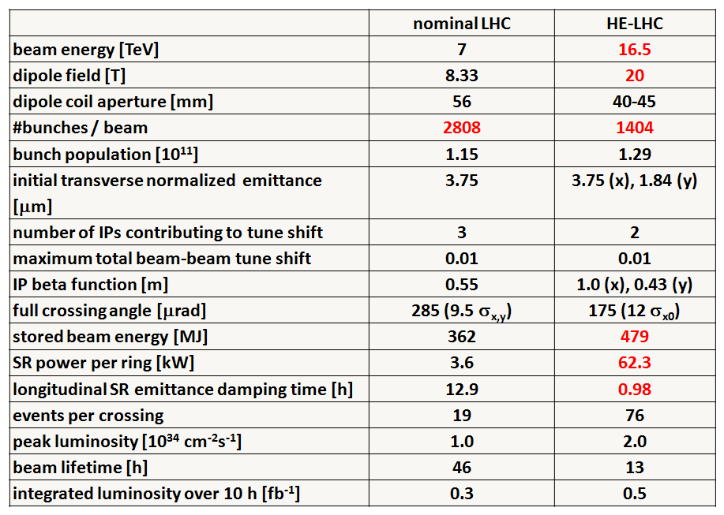
Preliminary HE-LHC - parameters
Very Long Term Objectives: Higher Energy LHC
Very preliminary with large error bars

Slide 58
HE-LHC – main issues and R&D
high-field 20-T dipole magnets based on Nb₃Sn, Nb₃Al, and HTS
high-gradient quadrupole magnets for arc and IR
fast cycling SC magnets for 1-TeV injector
emittance control in regime of strong SR damping and IBS
cryogenic handling of SR heat load (first analysis; looks manageable)
dynamic vacuum

