Slide 1



23rd rencontres de Blois
Open heavy flavours and quarkonia measurements with ALICE
Bruno Espagnon
IPN Orsay (CNRS/IN2P3 – Univ Paris Sud)
For the ALICE collaboration
23rd rencontres de Blois
Tuesday 31 May 2011
Bruno Espagnon
IPN Orsay – Univ. Paris Sud

Slide 2
Open heavy flavours and quarkonia measurements with ALICE
Physics motivations
The ALICE experiment
Highlight on Open heavy flavours and Quarkonia in p+p collisions
Highlight on Open heavy flavours and Quarkonia in Pb+Pb collisions
Conclusion
23rd rencontres de Blois
Tuesday 31 May 2011
1
Bruno Espagnon
IPN Orsay – Univ. Paris Sud

Slide 3
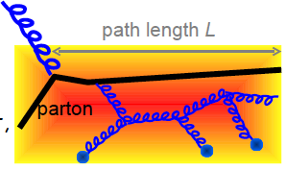
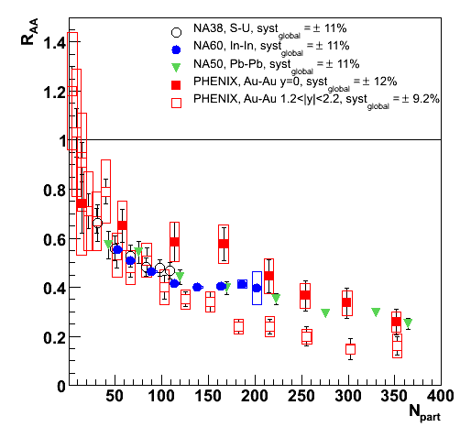
Physics motivations
Heavy flavours:
  formed at the early stage of the collision in the highest density phase
  travel and interact in the medium → full collision history
Characterisation of the medium crossed by heavy quarks:
  energy loss depends on mass: c & b heavier than u, d, s + dead cone effect
Quarkonia:
  Quarkonia family as a thermometer of the QGP: sequential suppression
  RHIC measure similar suppression than SPS!
  What is expected at LHC?
T_{c}
ψ(2S)
T<T_{c}
T~1.1T_{c}
T~T_{c}
χ_{c}
J/ψ
T>>T_{c}
Binding En.
Mass
23rd rencontres de Blois
Tuesday 31 May 2011
2
Bruno Espagnon
IPN Orsay – Univ. Paris Sud

Slide 4
Physics motivations
Data also interesting for itself:
Measurement of Charm & beauty production cross section → comparison with pQCD
Probe of the gluon distribution at very low Björken x (down to 4.10⁻⁶) → saturation effect.
pp collisions used as a reference for the study of heavy ion collisions.
pA will be also needed.
Presented results: p-p collisions at √s = 2.76 and 7 TeV
and
Pb-Pb at √s_{NN} = 2.76 TeV
23rd rencontres de Blois
Tuesday 31 May 2011
3
Bruno Espagnon
IPN Orsay – Univ. Paris Sud

Slide 5
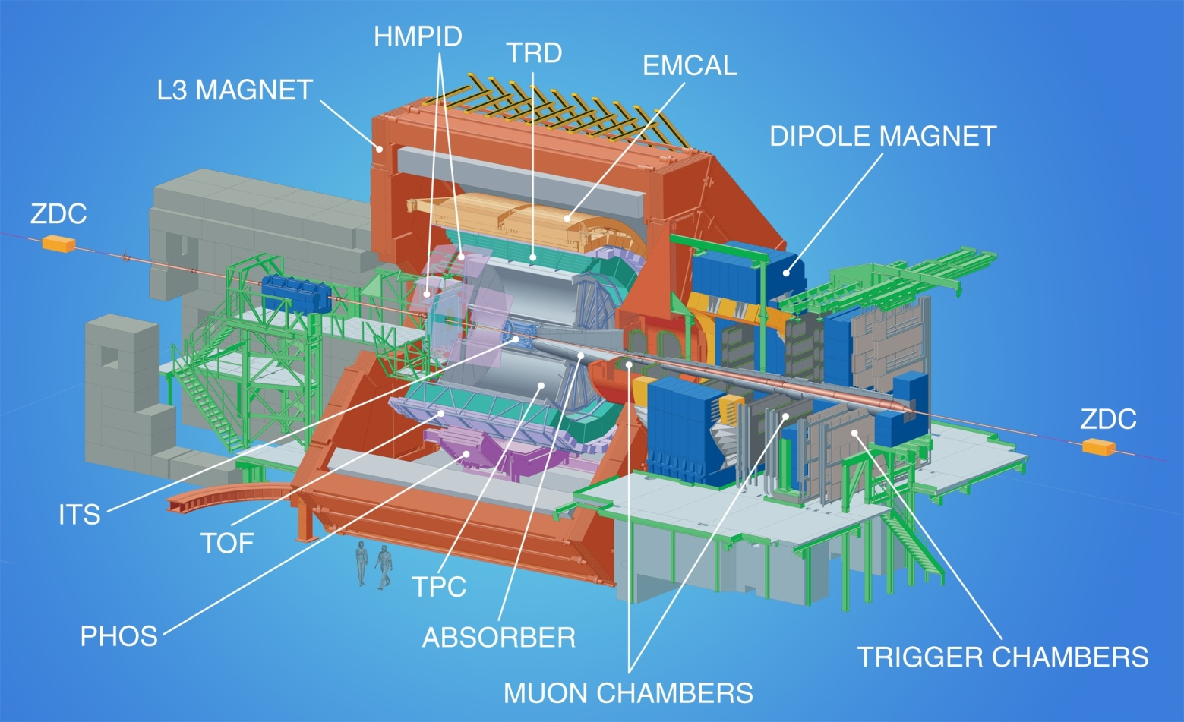
The ALICE experiment
Central Barrel: |η| < 0.9
Open heavy flavour in hadronic & semi-leptonic decays (e)
Quarkonia in the e⁺e⁻ channel
Tracking: ITS+TPC
PID: TPC+TOF+TRD
Muon spectrometer: -4 < η < -2.5
Open heavy flavour &
Quarkonia in muonic channels
Muon filters: front absorber + Iron wall
Tracking + Trigger
ALICE coll., J. Instrum. 3, S08002 (2008)
23rd rencontres de Blois
Tuesday 31 May 2011
4
Bruno Espagnon
IPN Orsay – Univ. Paris Sud

Slide 6
The p-p reference
√s = 2.76 and 7 TeV
23rd rencontres de Blois
Tuesday 31 May 2011
5
Bruno Espagnon
IPN Orsay – Univ. Paris Sud

Slide 7
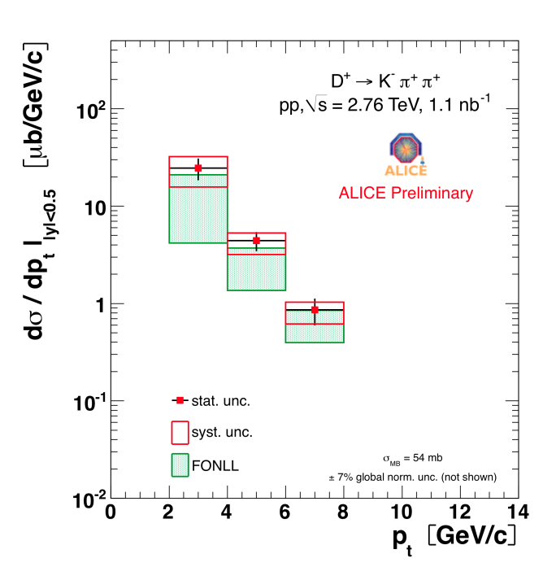
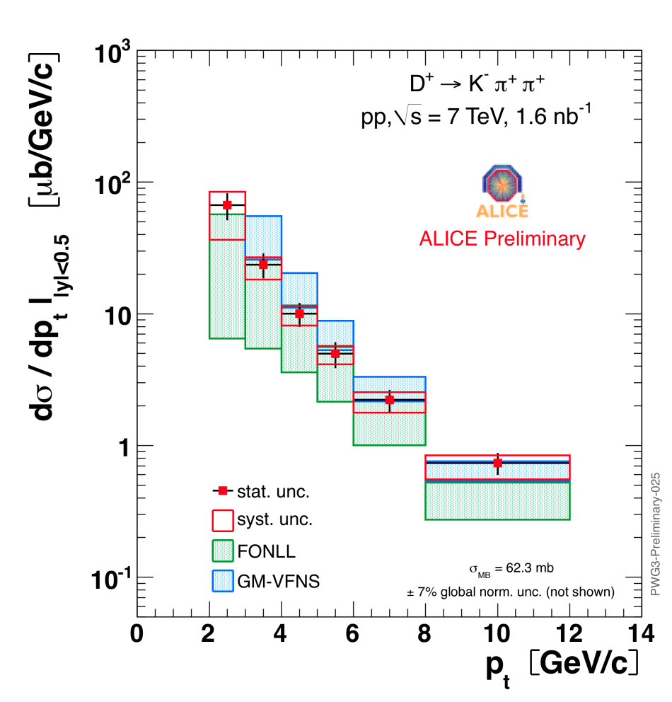
Heavy flavours in pp collisions
- Open charm -
Measurement of D mesons in hadronic channel
2 < p_{t} < 12 GeV/c, with 1.6 nb⁻¹ (~20% of 2010 statistics) for 7 TeV data
2 < p_{t} < 8 GeV/c, with 1.1 nb⁻¹ (3 days of data 3 months ago!) for 2.76 TeV data
y acceptance is p_{t}-dep (Δy~0.5 - 0.8): data scaled to |y|<0.5
pQCD predictions (FONLL and GM-VFNS) compatible with our data
Same behaviour for D⁰ not shown here
p+p 7 TeV
FONLL: Cacciari et al., in preparation
GM-VFNS: Kniehl et al., in preparation
p+p 2.76 TeV
23rd rencontres de Blois
Tuesday 31 May 2011
6
Bruno Espagnon
IPN Orsay – Univ. Paris Sud

Slide 8
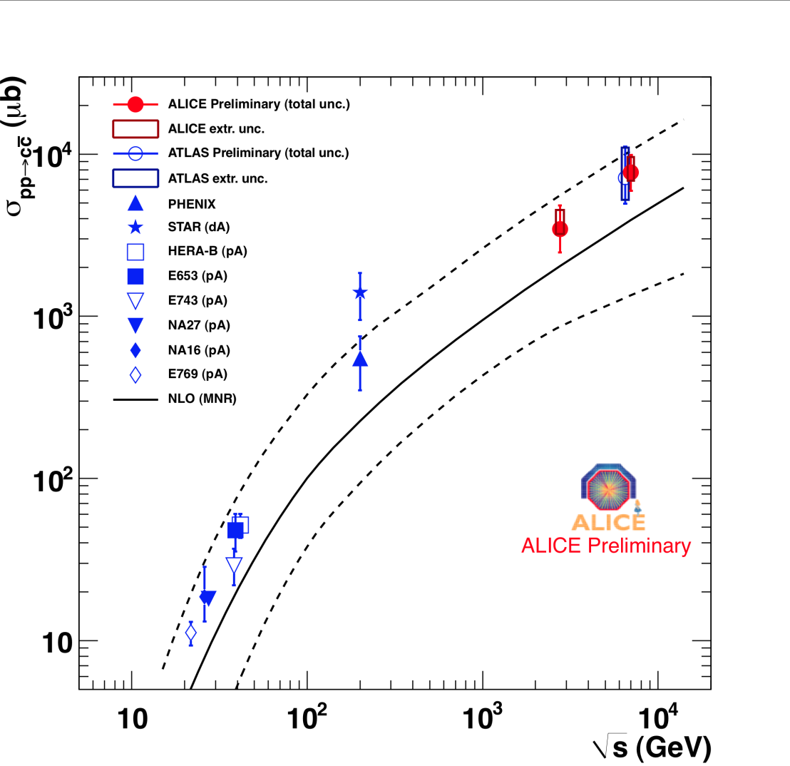

Heavy flavours in pp collisions
Extrapolation from p_{t} = 2 GeV/c to 0 (about ×2) and fully using FONLL
Consistent comparison with NLO over 3 orders of magnitude
Charm cross section
23rd rencontres de Blois
Tuesday 31 May 2011
7
Bruno Espagnon
IPN Orsay – Univ. Paris Sud

Slide 9
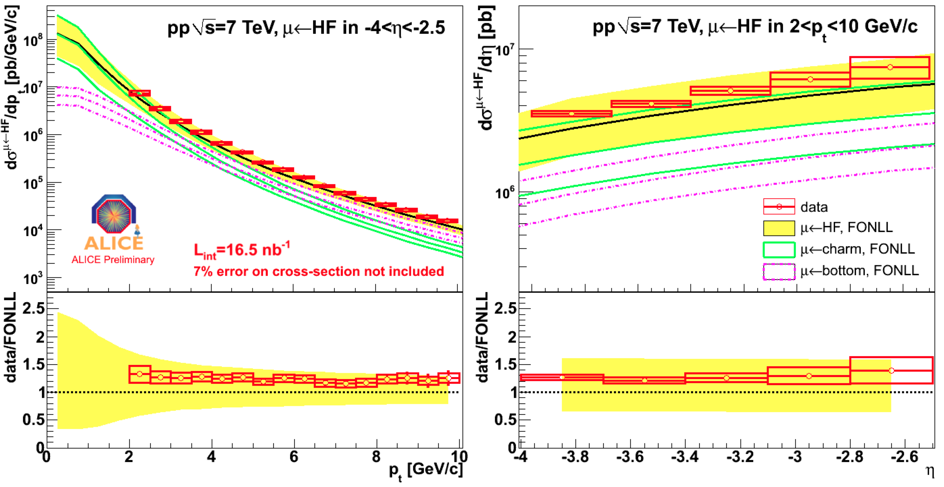
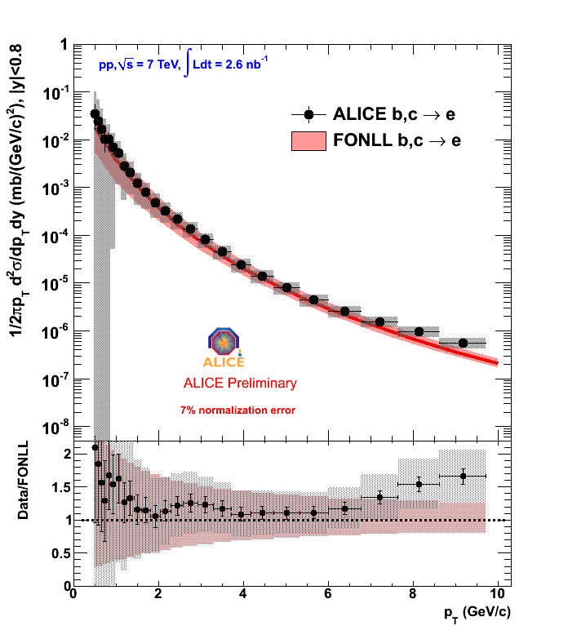
Heavy flavours in pp collisions
Beauty and charm measurement in muon and electron channel
Measured dσ/dp_{t} in 2-10 GeV/c and dσ/dη in -4 to -2.5
subtration of muons from primary K/π decay based on detector MC simulations
Well described by FONLL predictions
FONLL indicates beauty dominance above 6 GeV/c
p+p 7 TeV
p+p 7 TeV
Inclusive electron spectrum – cocktail of background electrons
23rd rencontres de Blois
Tuesday 31 May 2011
8
Bruno Espagnon
IPN Orsay – Univ. Paris Sud

Slide 10
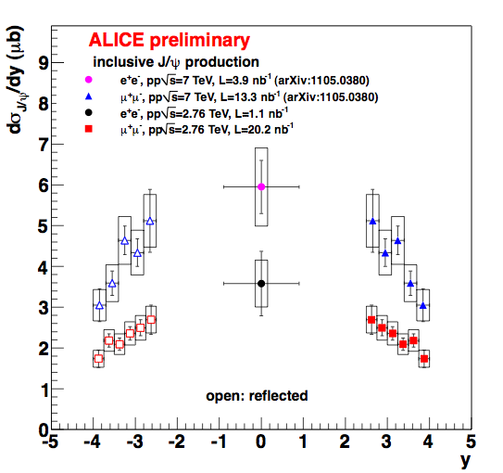
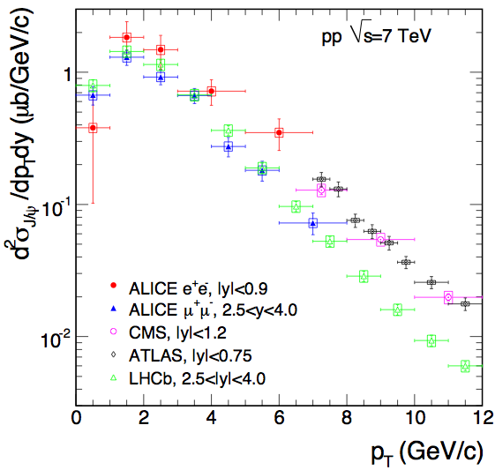
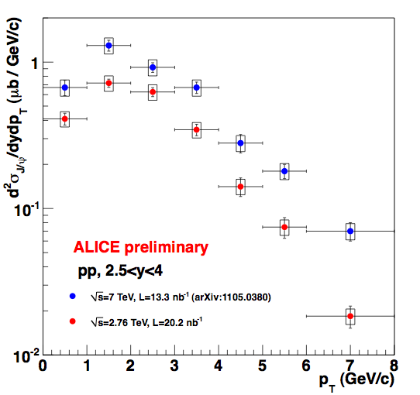
Quarkonia in pp collisions
Integrated J/ψ production cross sections for 2.76 and 7 TeV (down to p_{t} = 0)
pp@2.76 TeV:
σ_{J/ψ}(|y|<0.9) = 6.4±1.7 μb (e channel); σ_{J/ψ}(2.5<y<4) = 3.46±0.35 μb; (μ channel)
pp@7TeV:
σ_{J/ψ}(|y|<0.9) = 10.7±2.1 μb (e channel); σ_{J/ψ}(2.5<y<4) =6.31±0.84 μb. (μ channel)
ALICE coll., arXiv:1105.0380v1 (2011)
Good agreement with the other LHC experiments
23rd rencontres de Blois
Tuesday 31 May 2011
9
Bruno Espagnon
IPN Orsay – Univ. Paris Sud

Slide 11
Pb-Pb collisions
√s = 2.76 TeV
23rd rencontres de Blois
Tuesday 31 May 2011
10
Bruno Espagnon
IPN Orsay – Univ. Paris Sud

Slide 12
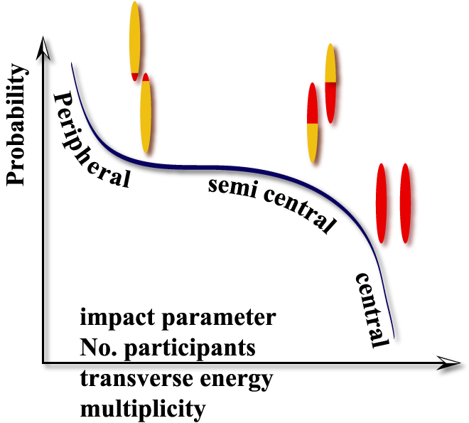
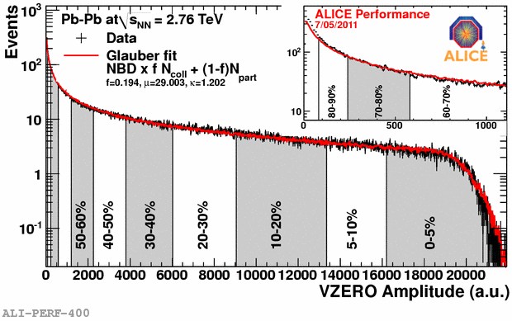
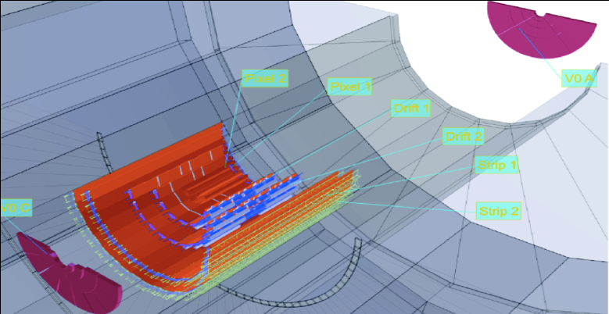
Geometry of heavy ion collision
b impact parameter
Spectators
Participants
small impact parameter (b~0)
high energy density
large volume
Large number of produced particles
Geometry of the collision measured as:
fraction of cross section “centrality”
number of participants
number of nucleon-nucleon collisions
From a Glauber
Monte Carlo
calculation
SPD
Centrality selection based on a Glauber model fit of the V0 amplitude
V0C/V0A
23rd rencontres de Blois
Tuesday 31 May 2011
11
Bruno Espagnon
IPN Orsay – Univ. Paris Sud

Slide 13
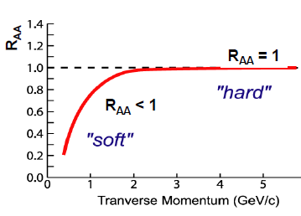
How to compare pp and AA data?
R_{AA} the nuclear modification factor for a given collision centrality
If the process yield scales with the binary collisions:
R_{AA} = 1 at high p_{T} where the hard scattering dominate
If the binary scaling is broken:
R_{AA} ≠ 1
For open heavy flavours, the pp reference is scaled from 7 to 2.76 TeV using pQCD (FONLL)
R_{cp} comparison of the process between central and peripheral collisions
If there is binary scaling: R_{CP} = 1
If there are effects affecting in a different way central or peripheral collisions: R_{CP} ≠ 1
Doesn’t need a pp reference
23rd rencontres de Blois
Tuesday 31 May 2011
12
Bruno Espagnon
IPN Orsay – Univ. Paris Sud

Slide 14
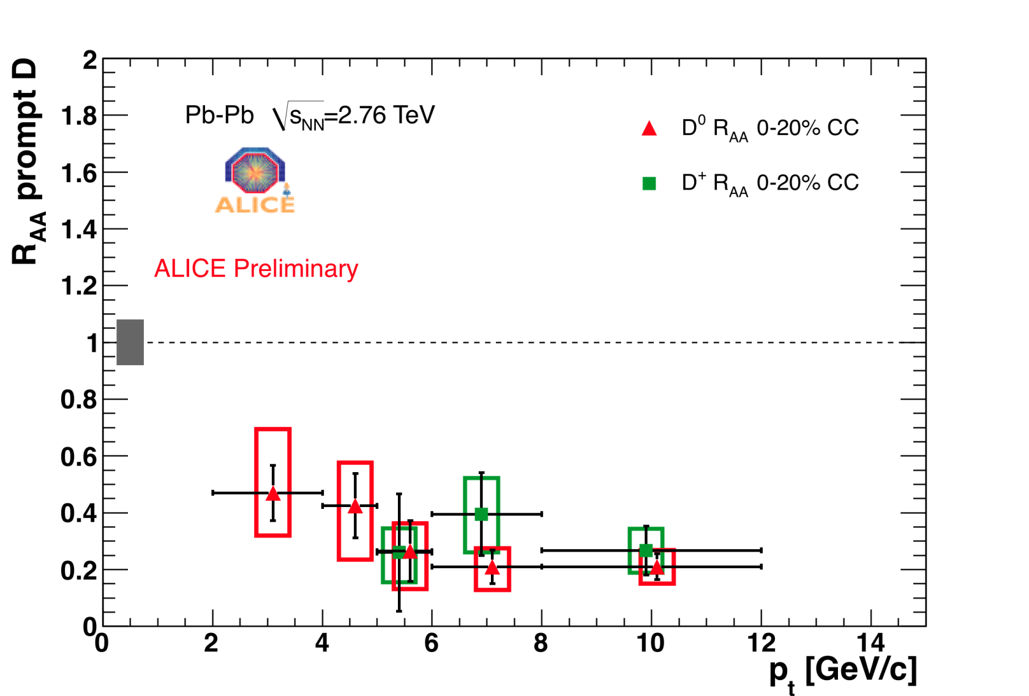
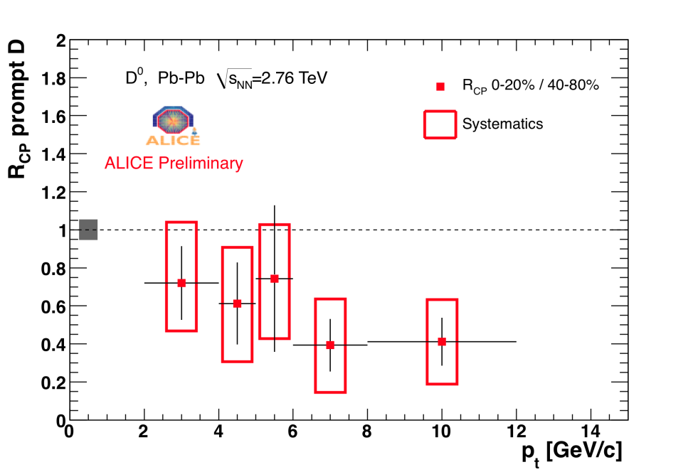
Heavy flavours in heavy ions collisions
- Open charm -
Measurement of D mesons in hadronic channel
Suppression for charm is a factor 4-5 above 5 GeV/c
Suppression clearly seen also in R_{CP} (no pp reference)
Factor 2-3 above 5 GeV/c
23rd rencontres de Blois
Tuesday 31 May 2011
13
Bruno Espagnon
IPN Orsay – Univ. Paris Sud

Slide 15
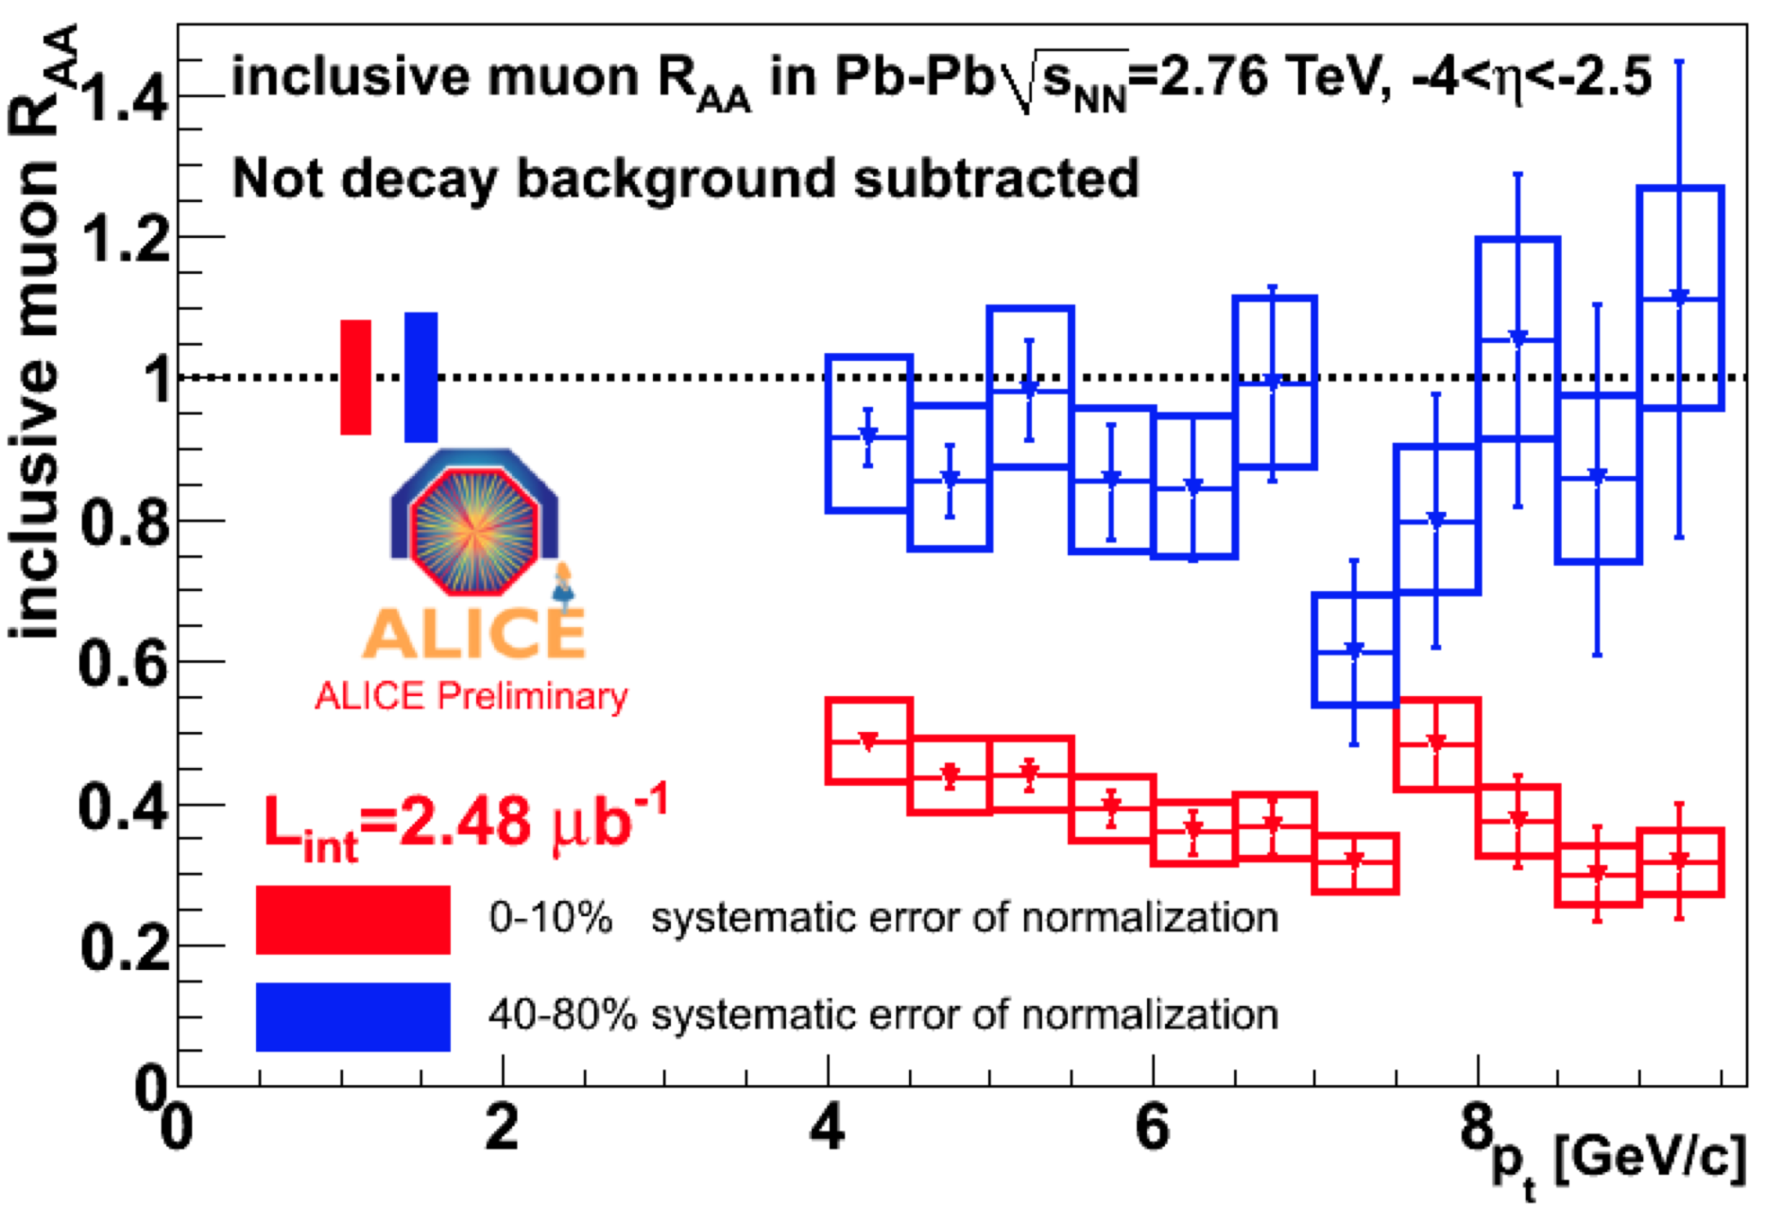
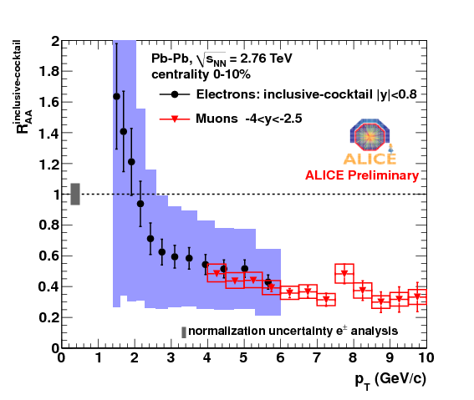
Heavy flavours in heavy ions collisions
Beauty and charm measurement in muon and electron channel
Electrons: Mid-rapidity |η| < 0.8
Muons: Forward rapidity -4 < η < -2.5
Same suppression within large sys. uncertainties
For electrons, only above 4 GeV can be considered as electrons from HF
Suppression is of about a factor 3 above 6 GeV/c
According to FONLL, beauty dominant in this region
23rd rencontres de Blois
Tuesday 31 May 2011
14
Bruno Espagnon
IPN Orsay – Univ. Paris Sud

Slide 16
Quarkonia in heavy ions collisions
J/ψ➔ μμ, p_{T}>0
J/Ψ R_{AA} larger at LHC (2.5<y<4) than at RHIC (1.2<|y|<2.2);
Similar as RHIC (|y|<0.35), except for the most central collisions.
23rd rencontres de Blois
Tuesday 31 May 2011
15
Bruno Espagnon
IPN Orsay – Univ. Paris Sud

Slide 17
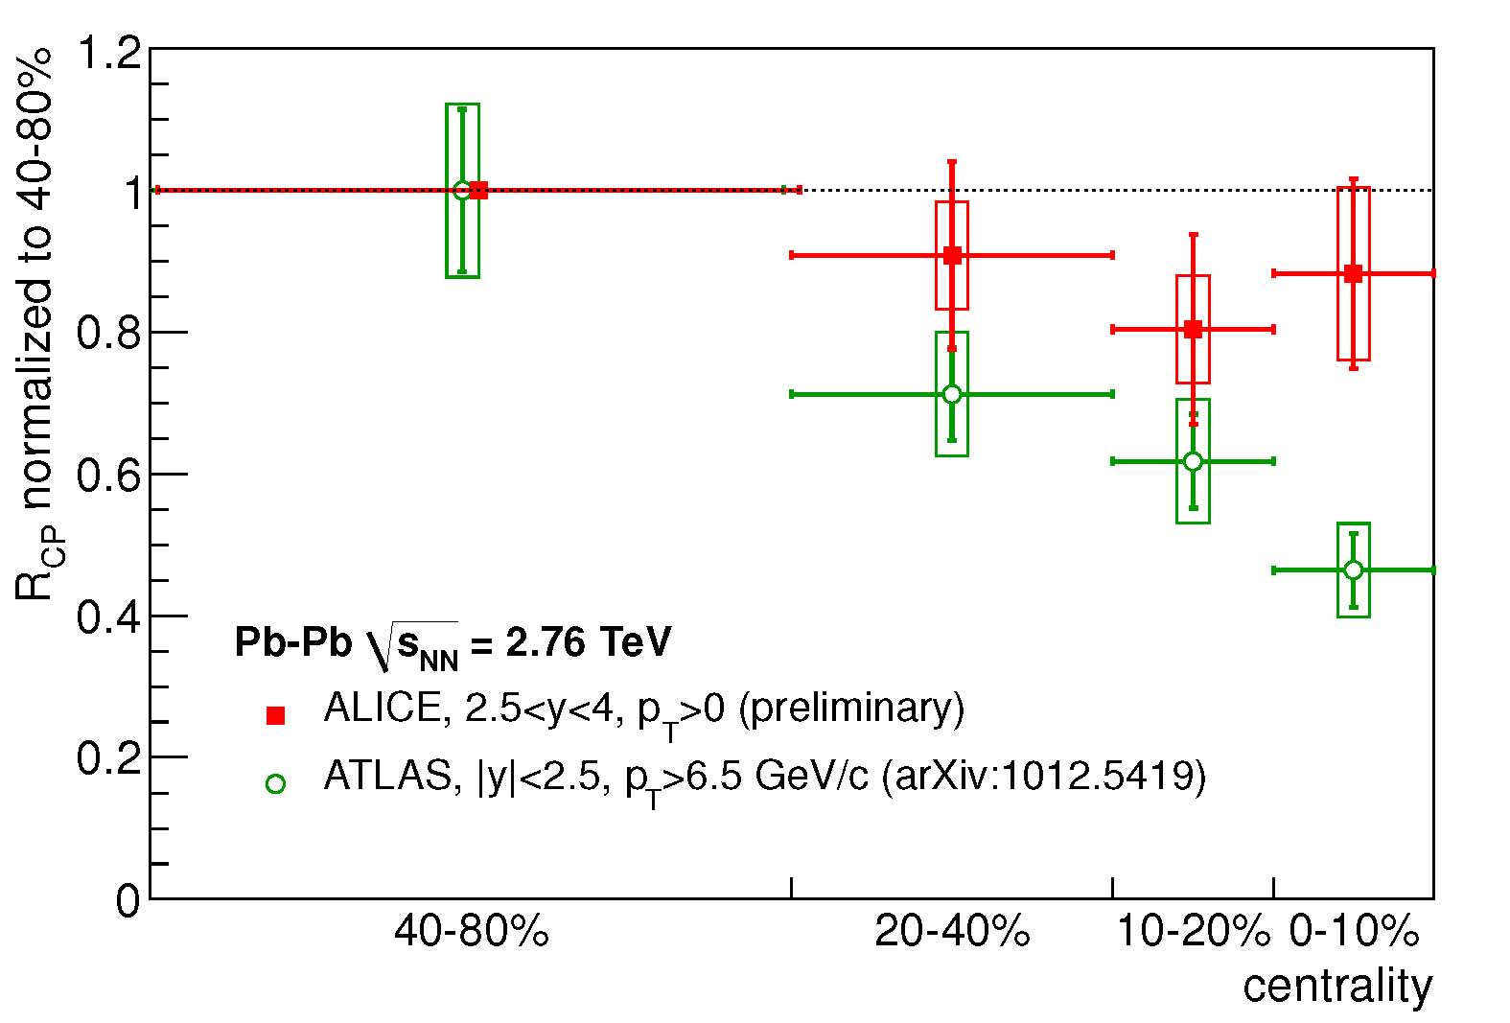
Quarkonia in heavy ions collisions
« Peripheral » reference 40%-80% centrality bin
ALICE:
2.5<y<4.0;
p_{T}>0 GeV/c;
ATLAS:
|Y|<2.4
80% J/y, p_{t} ≥ 6.5 GeV/c;
Error in 40-80% centrality bin not propagated.
ALICE 2.5<y<4.0 exhibits less suppression than ATLAS data (high p_{T}, |y|<2.4)
23rd rencontres de Blois
Tuesday 31 May 2011
16
Bruno Espagnon
IPN Orsay – Univ. Paris Sud

Slide 18
Conclusions
Heavy flavours and J/Ψ have been measured in p-p and Pb-Pb collisions at LHC
The nuclear modification factors in Pb-Pb for heavy flavours have been measured by ALICE
The D meson and high-p_{t} lepton R_{AA} exhibit a strong suppression in central collisions (down to ~0.2 for D’s)
The suppression tends to vanish towards peripheral collisions.
Charm cross section calculated.
Inclusive J/Ψ pp cross section at 2.76 and 7 TeV.
J/Ψ (p_{T}>0) R_{AA} measurement:
Larger than RHIC & than ATLAS (not the same kinematical domain).
Unknown CNM, namely shadowing.
pA is now needed at LHC!
Only a little part of ALICE results presented here (40 talks and more than 70 posters at QM 2011 last week! For HF and Quarkonium : 24 posters, 5 parallel talks and 2 plenary talks)
A lot of (very good ;) ) publications in the next few months → stay tuned http://aliweb.cern.ch/Documents/generalpublications
23rd rencontres de Blois
Tuesday 31 May 2011
17
Bruno Espagnon
IPN Orsay – Univ. Paris Sud

Slide 19
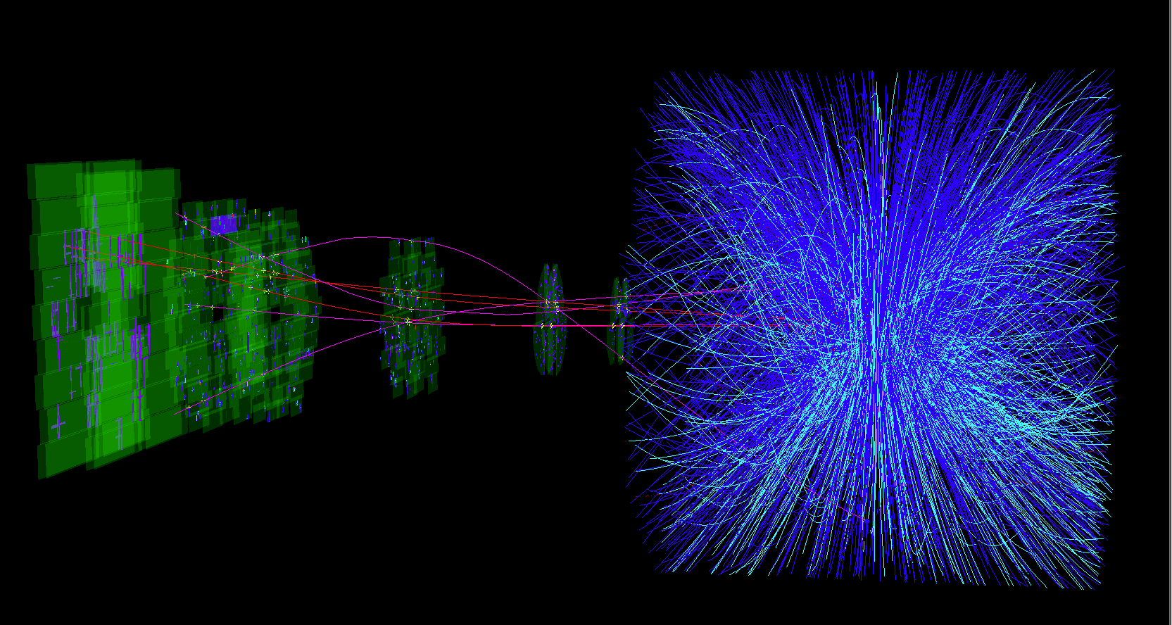
Central Pb-Pb collision at √s_{NN} = 2.76 TeV.
Thank you for your attention
23rd rencontres de Blois
Tuesday 31 May 2011
18
Bruno Espagnon
IPN Orsay – Univ. Paris Sud

Slide 20
Backup
23rd rencontres de Blois
Tuesday 31 May 2011
19
Bruno Espagnon
IPN Orsay – Univ. Paris Sud

Slide 21
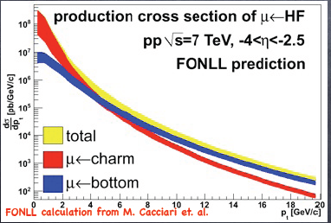
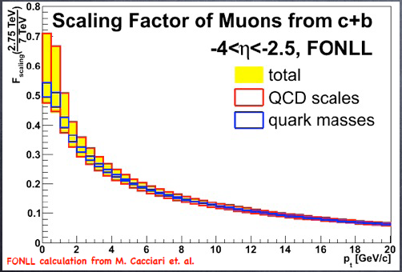
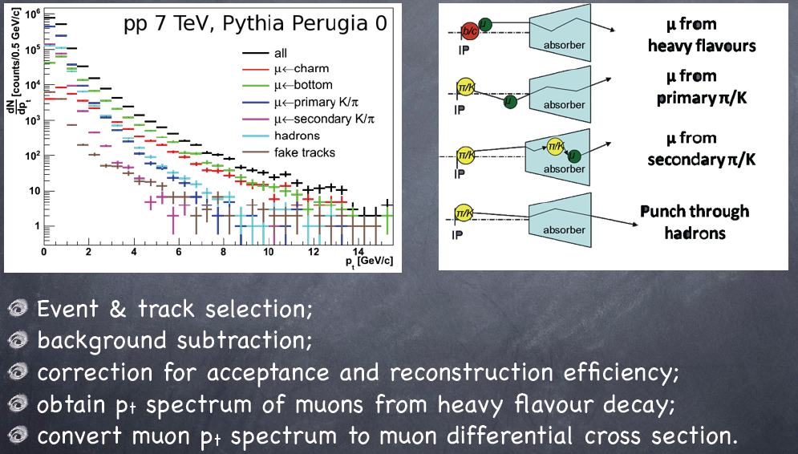
Heavy flavours study in μ channel
23rd rencontres de Blois
Tuesday 31 May 2011
20
Bruno Espagnon
IPN Orsay – Univ. Paris Sud

Slide 22
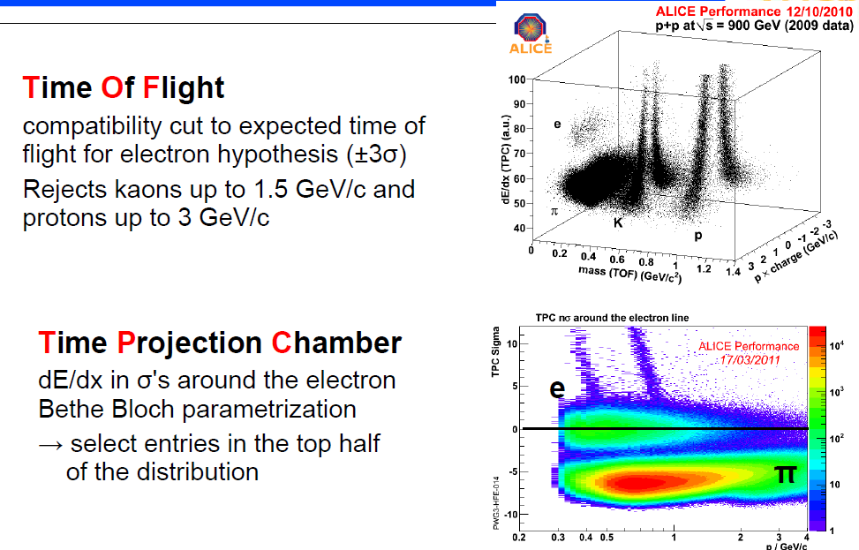
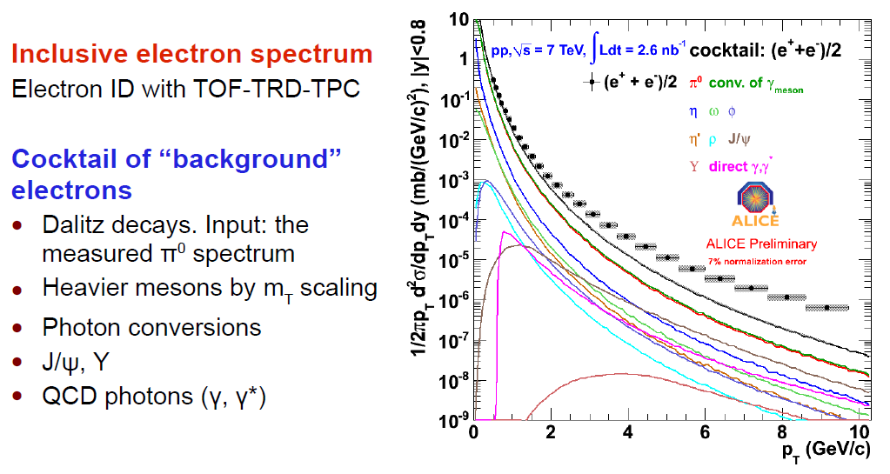
Heavy flavours study in e⁻ channel
23rd rencontres de Blois
Tuesday 31 May 2011
21
Bruno Espagnon
IPN Orsay – Univ. Paris Sud

Slide 23
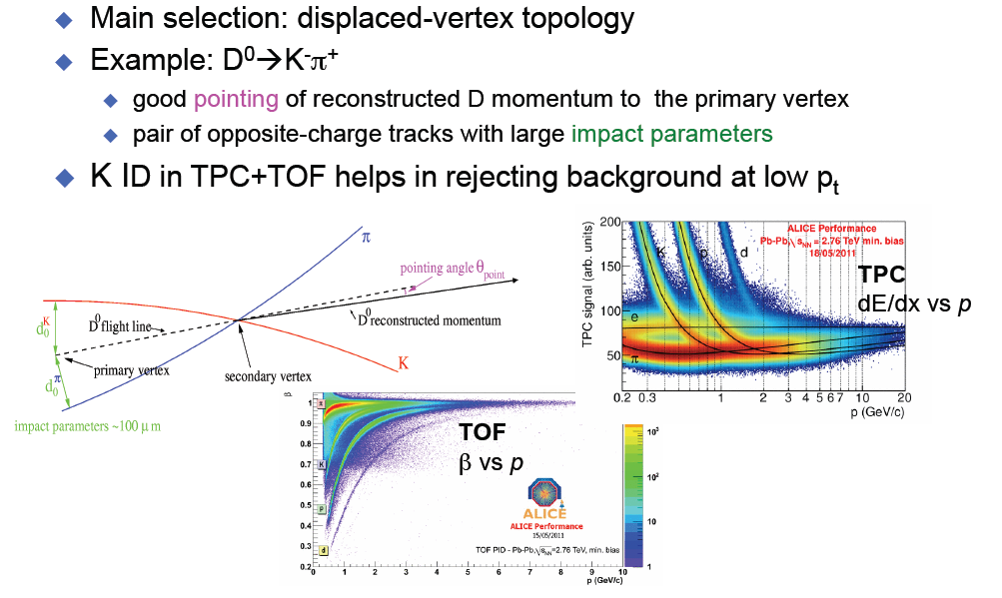
D meson reconstruction in ALICE
23rd rencontres de Blois
Tuesday 31 May 2011
22
Bruno Espagnon
IPN Orsay – Univ. Paris Sud

Slide 24
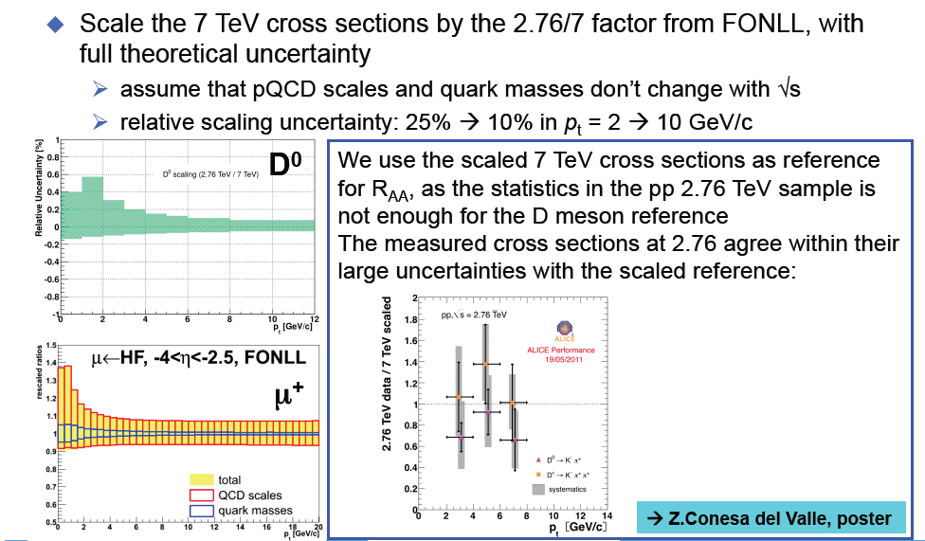
pp reference at 2.76 TeV via pQCD-driven √s-scaling
23rd rencontres de Blois
Tuesday 31 May 2011
23
Bruno Espagnon
IPN Orsay – Univ. Paris Sud

Slide 25
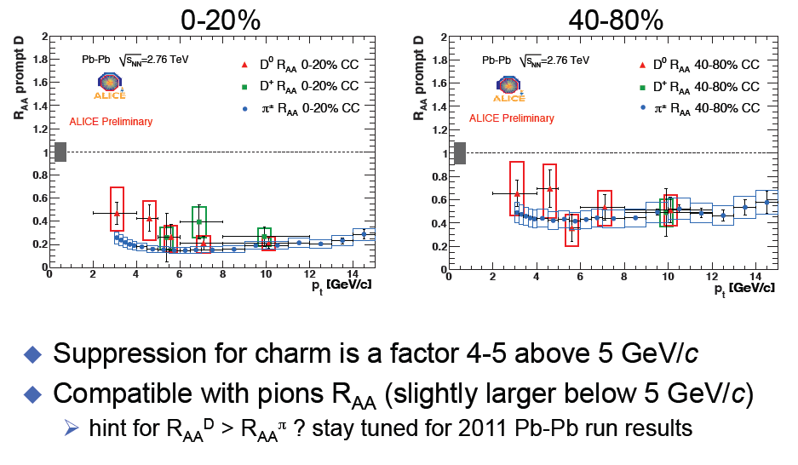
Data Comparisons: D and π±
23rd rencontres de Blois
Tuesday 31 May 2011
24
Bruno Espagnon
IPN Orsay – Univ. Paris Sud

Slide 26
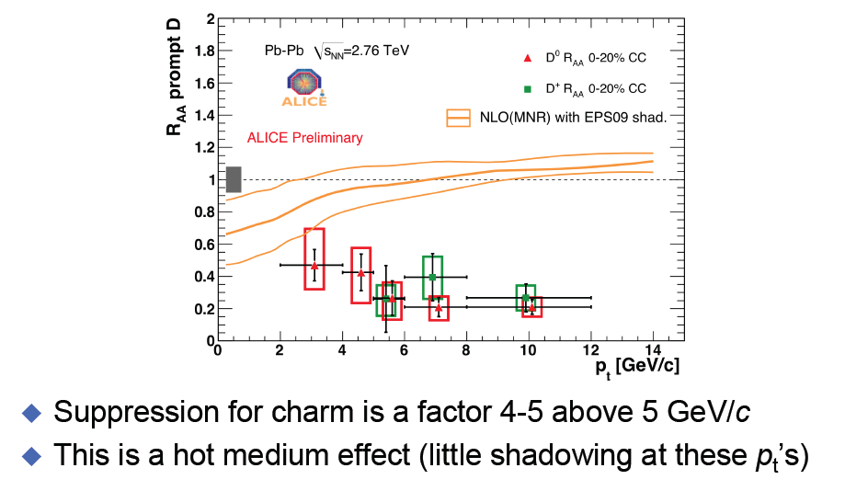
Model Comparisons: Shadowing
23rd rencontres de Blois
Tuesday 31 May 2011
25
Bruno Espagnon
IPN Orsay – Univ. Paris Sud

Slide 27
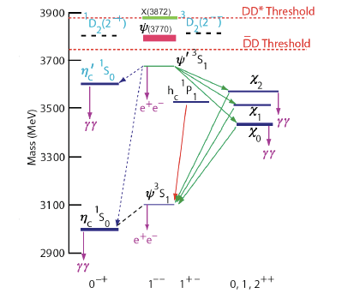
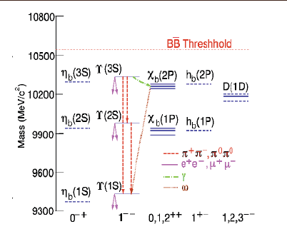
Quarkonia family
Charmonium family
Bottomonium family
23rd rencontres de Blois
Tuesday 31 May 2011
26
Bruno Espagnon
IPN Orsay – Univ. Paris Sud

Slide 28
The screening radius λ_{D}(T) (i.e. the maximum distance which allows the formation of a bound qq pair) decreases with the temperature T
vacuum
Temperature T<Td
Temperature T>Td
J/ψ
λ_{D}
λ_{D}
c
c
c
J/ψ
c
c
c
r
r
r
if resonance radius < λ_{D}(T) → resonance can be formed
if resonance radius > λ_{D}(T)
→ no resonance can be formed
At a given T:
23rd rencontres de Blois
Tuesday 31 May 2011
27
Bruno Espagnon
IPN Orsay – Univ. Paris Sud

