Slide 1
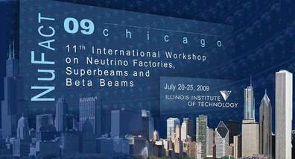
The International Design Study for the
Neutrino Factory
▬ motivation, status, and plans

Slide 2
Acknowledgements:
Many thanks to those who provided information or material:
  And in particular the IDS-NF collaboration …
ABl

Slide 3
Mission statement:
Neutrino oscillations, an established phenomenon
Standard Neutrino Model:
Zukanovitch-Funchal, Neutrino08

Slide 4
Mission statement:
Neutrino oscillations, an established phenomenon
Standard Neutrino Model:
an acceptable parameterisation
  Empirical observations: coincidences or smoking guns?
Theory presently unable to offer explanations
  Many ideas, many predictive, none established
We have been in this situation before:
  E.g., Balmer series: f₂—f₁ ∝ n⁻² [… and not ∝ n^{-2.1} ]
    Precise measurements led to: Bohr atom, quantum mechanics …
Precision measurements likely to be decisive in development of theory ‘beyond the Standard Model’
  Imperative: devise best experimental programme:
    Best sensitivity for discovery, best precision on parameters

Slide 5
Contents:
The IDS-NF baseline
Timescales, planning, and organisation
Status of the study:
  Physics performance and evaluation group
  The Neutrino Factory accelerator complex
  The Neutrino Factory detector systems
Challenging the baseline
Opportunity and conclusion!

Slide 6
Timescales, planning, and organisation

Slide 7
Now published:
  Physics report : Rep. Prog. Phys. (next month)
  Accelerator report: JINST 4:P07001,2009
  Detector: JINST 4:T05001,2009

Slide 10
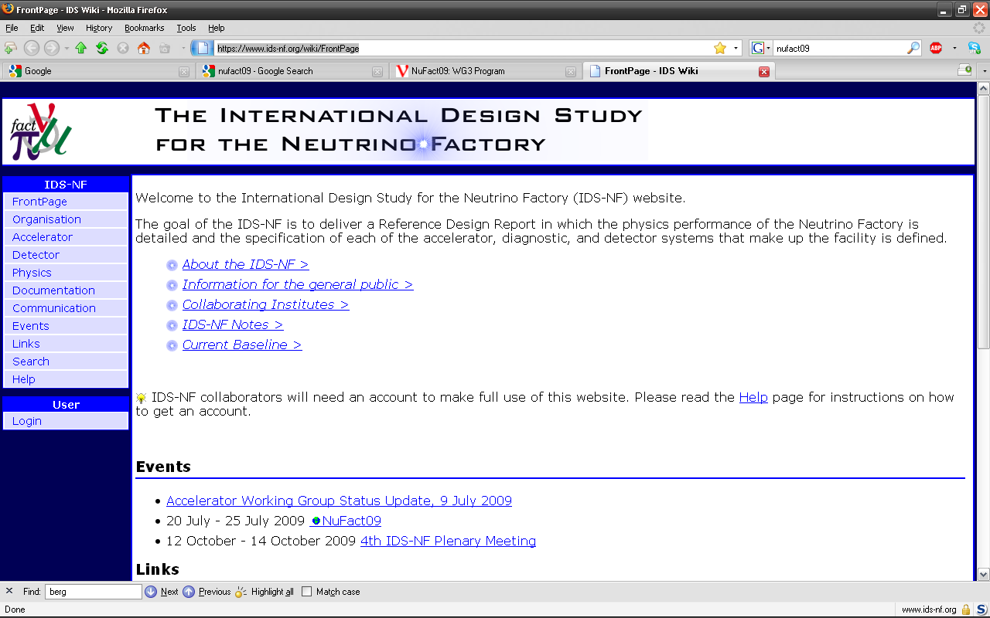
Organisation:
https://www.ids-nf.org/wiki/FrontPage

Slide 11
The IDS-NF baseline

Slide 12
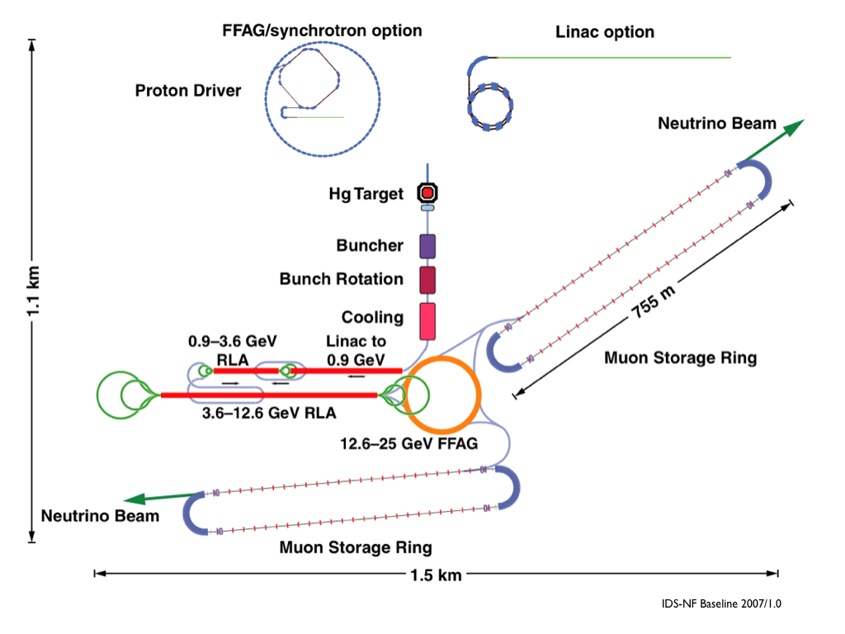
Neutrino Factory: accelerator facility:
IDS-NF-002: https://www.ids-nf.org/wiki/FrontPage/Documentation?action=AttachFile&do=view&target=IDS-NF-002-v1.1.pdf

Slide 13

Accelerator facility: parameters:
IDS-NF-002: https://www.ids-nf.org/wiki/FrontPage/Documentation?action=AttachFile&do=view&target=IDS-NF-002-v1.1.pdf

Slide 14
Neutrino Factory: detectors:
Two baselines (source→detector):
  3000 – 5000 km
  7000 – 8000 km
Magnetised Iron Neutrino Detector (MIND) at each location
Magnetised Emulsion Cloud Chamber at intermediate baseline for tau detection
IDS-NF-002: https://www.ids-nf.org/wiki/FrontPage/Documentation?action=AttachFile&do=view&target=IDS-NF-002-v1.1.pdf

Slide 15
Neutrino detectors: parameters:
IDS-NF-002: https://www.ids-nf.org/wiki/FrontPage/Documentation?action=AttachFile&do=view&target=IDS-NF-002-v1.1.pdf

Slide 16
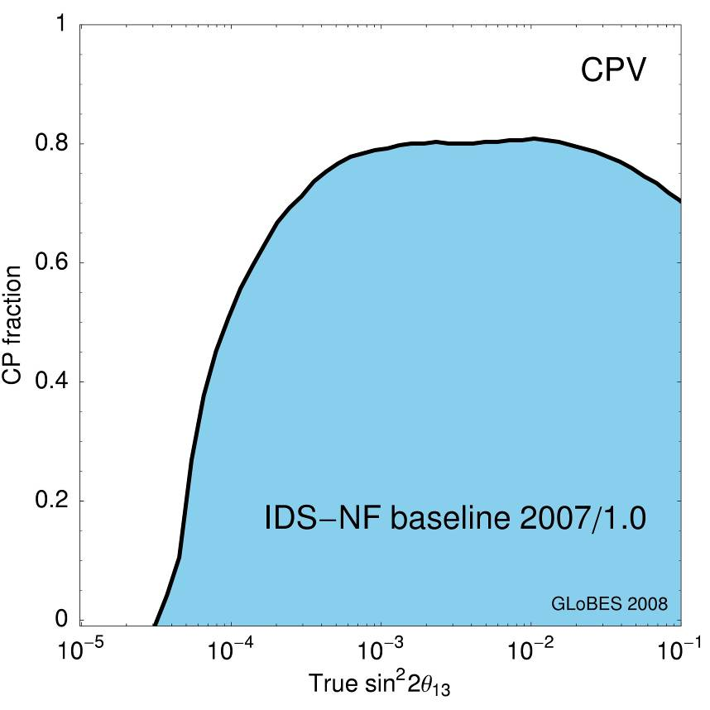
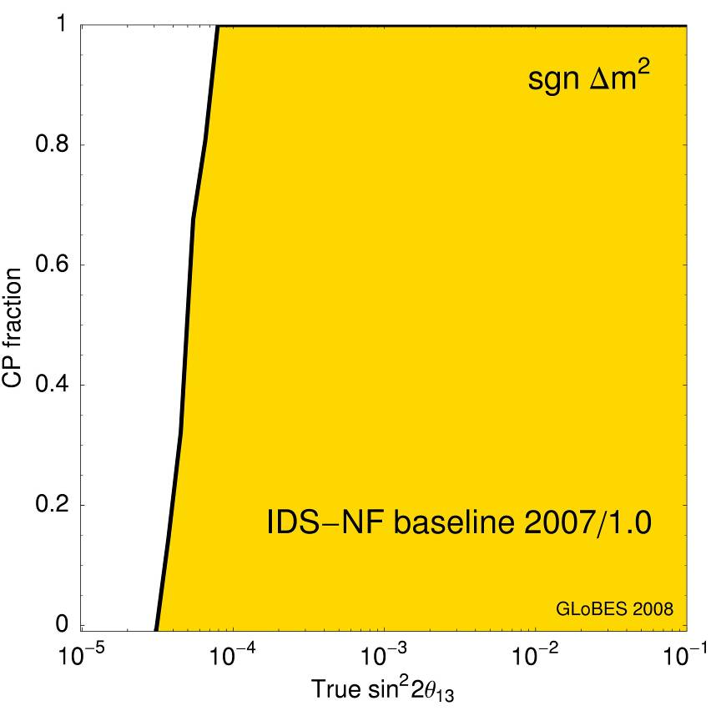
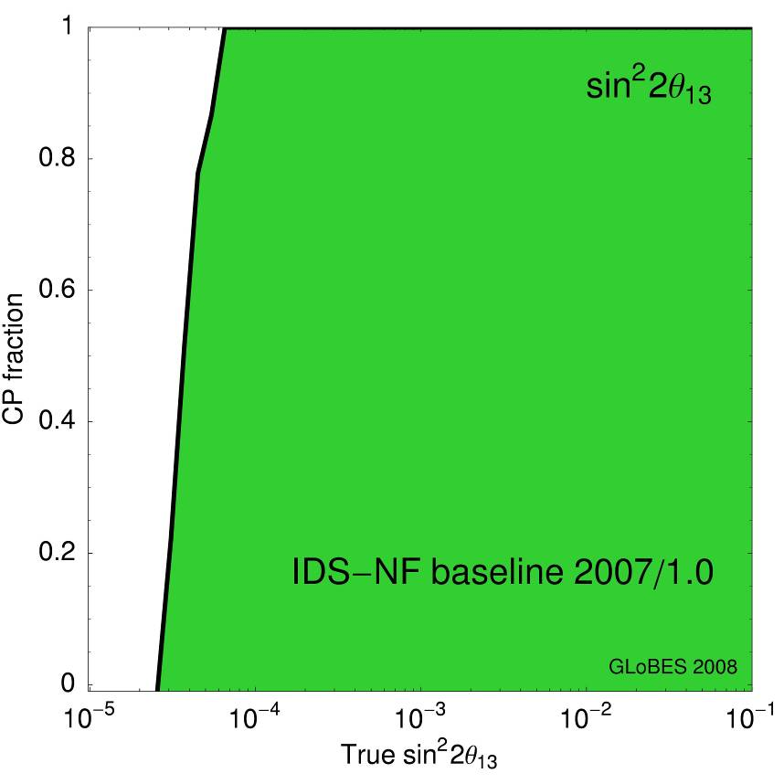
IDS-NF: baseline, performance:
IDS-NF-002: https://www.ids-nf.org/wiki/FrontPage/Documentation?action=AttachFile&do=view&target=IDS-NF-002-v1.1.pdf

Slide 17
IDS-NF: status and progress:
Physics and Performance Evaluation

Slide 18
Physics and performance evaluation group
Two roles:
  Reponsive:
    Evaluate changes to baseline
      See ‘Challenging the baseline’
  Neutrino physics:
    Goal is to do best physics!
    Define and articulate physics
    case
    Evaluate context and progress
    in the neutrino oscillations and related fields
  Example, recent w/s ‘NuFlavour’:
    http://www.ippp.dur.ac.uk/Workshops/09/Coseners/
    Clear outcome: articulate muon programme:
      Charged lepton flavour violation programme — COMET/Mu2e/PRISM
      Neutrino Factory [Muon Collider]
Winter

Slide 19
IDS-NF: status and progress:
Accelerator facility
See S.Berg, WG3 and WG3 talks for details

Slide 20
Proton driver:
Proton driver is the accelerator system most likely to be constrained by requirements of host-site
IDS-NF approach:
  Consider two ‘generic’ options:
    LINAC:
      Possible development option for SPL (CERN) or Project-X (FNAL)
      Requires accumulator/compressor rings
    Rings:
      Development option for J-PARC or RAL or possible ‘green-field’ option
      Requires bunch compression
For Interim Design Report:
  Envisaged as considering ‘example sites’ to be studied further in preparation of the Reference Design Report
    Will require some effort from example sites

Slide 21
CERN SPL as proton driver:
Accumulator and compressor ring scheme:
  Two options: 6 bunches or 3 bunches
SPL:
  Staged scenario under consideration (Myers):
    Low power SPL to serve LHC
    High power SPL to serve applications such as Neutrino Factory
  We seek to ensure upgrade path to high power stays open

Slide 22
SPL accumulator/compressor ring design:
E.Benedetto, M.Aiba
Accumulator ring:
  Isochronous:
    Reduce bunch length for given [dp/p]_{rms}
    No RF
  Instabilities considered (see E.Benedetto’s talk)
    Instabilities are small or can
    be managed
Compressor ring:
  Two options studied:
    Superconducting or normal
  Phase rotation studied
    Including space charge

Slide 23

FNAL Project-X as proton driver:
See V.Lebedev WP3
Conceived as serving:
  Long-baseline neutrino oscillation experiment:
    Wide-band beam; FNAL – DUSEL
  Kaon- and muon-based programme using 8 GeV protons from FNAL recycler
    E.g. mu2e charged lepton-flavour violation search
  An upgrade path for Neutrino Factory and Muon Collider
Design criteria:
  2 MW proton power at 60–120 GeV
  150 kW proton power at 8 GeV
  Upgradable to 2–4 MW at 8 GeV

Slide 24
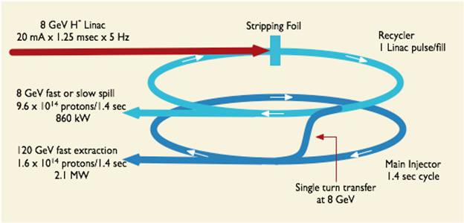
Project-X as proton driver:
Initial configuration document (ICD):
  Linac:
    325 MHz to 420 MeV
    1.3 GHz to 8 GeV
  Accumulate in Recycler
  Accelerate in Main ring
  0.5 MW at 8 GeV sufficient for WBB K/μ programmes
  Issue: recycler not suited for accumulation
    Permanent magnets (fixed energy), small acceptance, high impedance, …

Slide 25
Project-X as proton driver:
Alternative configuration document (now ICD II):
  Still evolving!
    See …
  Linac:
    H⁻ linac to 2 GeV,
    charge-exchange
    injection into
  Rapid-cycling synchrotron for:
    Accumulation
    Acceleration to 8 GeV
Upgrade path to 4 MW at 8 GeV
  We seek to ensure this upgrade path stays open

Slide 26
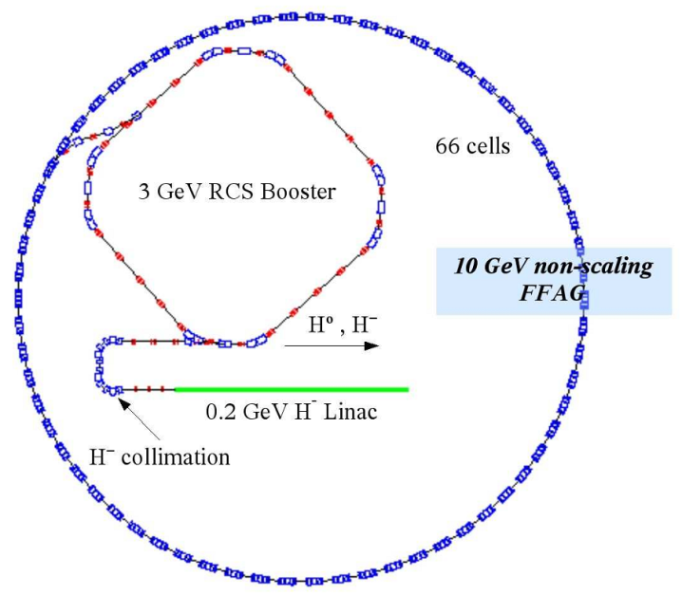
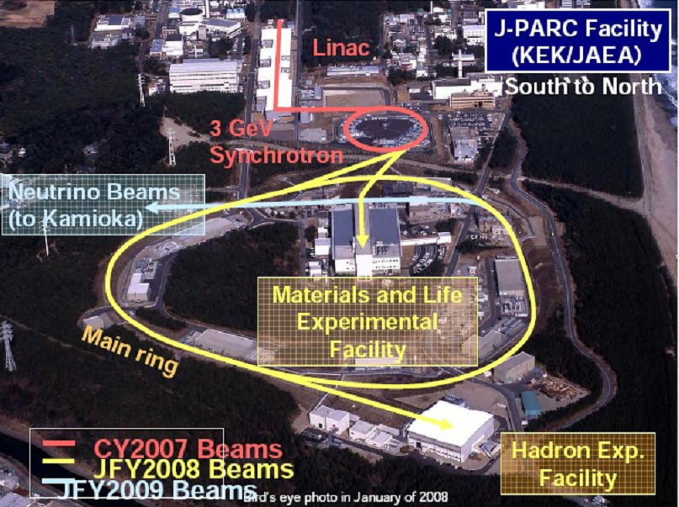
Ring-based proton driver:
Greenfield options:
  H⁻ linac to 180 MeV;
  Achromat for phase rotation
  RCS and/or FFAG to reach final energy and for bunch compression
ISIS upgrade options:
  ISIS upgrade:
    MW class, short pulse neutron spallation source
  J-PARC upgrade:
    Upgrade to 1.66 MW planned
      Ultimate power?

Slide 27
Example: ISIS upgrade as proton driver:
3.2 GeV RCS feeds booster/compressor ring:
  Two options considered: 6.4 & 10.3 GeV
    3.2 GeV RCS circulates 4 [5] bunches at 50 Hz
    delivering 4–5 MW
    Extract to neutron target and Neutrino Factory target
J.Pasternak

Slide 28
Target/capture:
Baseline: mercury jet, tapered solenoid for pion capture:
  Study 2: 20 T tapering to 1.25 T in ~13 m
  Study 2a: 20 T tapering to 1.75 T in ~13 m
    Adopted as baseline

Slide 29
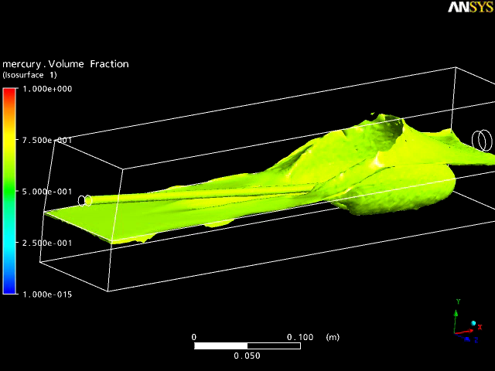
Target engineering:
Baseline (S2a) current densities in superconducting coils evaluated:
  Differences found with the Study 2a calculations:
    Revisit Study 2 configuration, require to re-evaluate baseline
Studying handling of
mercury in target:
  Mitigation of possible
  effects of high velocity
  splash caused by
  beam-target interaction
  ‘Tsunami’ mitigation
  Circulation of mercury
Need for a prototype!
T.Navenne

Slide 30
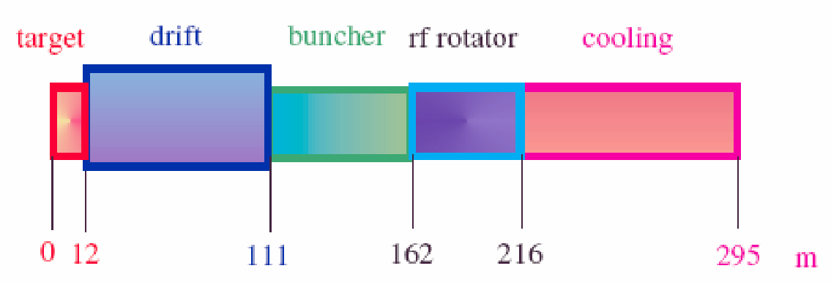
Muon front-end:
Principal issues:
  Cooling channel ‘systems test’:
    MICE: (A.Bross, P.Soler WG3)
  17 MV/m, 201 MHz RF in magnetic field:
    MuCool: (A.Bross and WG3 talks)
F/e team considering options to mitigate risk that RF gradient can’t be achieved

Slide 31
Mitigation of RF gradient risk:
C.Rogers
Various options being considered:
  Modified lattices, magnetic return, bucking coils, gas filled cavities…
  Studies emphasise:
    Priority: expedite MICE and MuCool programmes!
Will need to define configuration (and alternative?) to be included in Interim Design Report early in 2010
  Risk mitigation
  Process by which baseline can evolve established

Slide 32
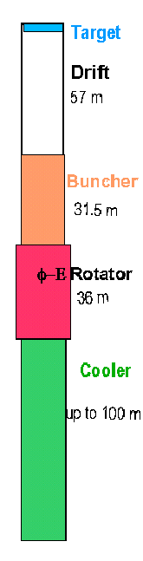
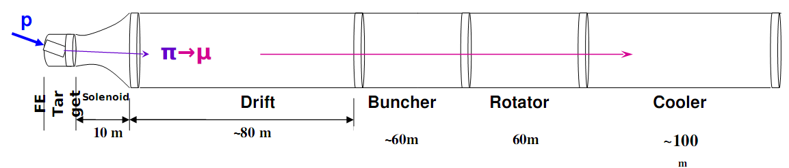
Alternative front-end schemes:
Shorter phase rotation and bunching sections:
  Improved yield, but higher gradients required
Re-visit 44/88 MHz scheme:
  Outline:
    Bunching , phase rotation, intial cooling, and acceleration to 280 MeV at 44 MHz, ~ 2 MV/m
    Cooling and acceleration to 1 GeV at 88 MHz, ~10 MV/m
  Issues:
    Longer channel, larger cavities
    Gradients high for low frequency cavities
      Effect of magnetic fields?
    May require reconsideration of other parts of complex
G.Prior

Slide 33
Muon acceleration:
Linac/RLAs:
  Development of optics
    Graded focussing
  Tracking with OPTIM and MAD-X
  Error-tolerance analysis for droplet arcs
  Ready for end-to-end tracking
FFAG:
  Lattice specification update
  Analysis of distortions & chromaticity
  Evaluation of injection and extraction systems

Slide 34
Pre-accelerator, RLA I & II:
A.Bogacz
Solenoid focusing lattice for 0.9 GeV linac
  Optics and first tracking complete
Transfer section for injection into RLA I:
  Optics and first tracking complete
Lattice for linacs I and II complete:
  Quadrupole focusing
Droplet return arcs
  Optics, first tracking, and match linacs performed
Arcs RLA I
Arcs RLA II

Slide 35
Muon FFAG:
S.Berg, J.Pasternak, D.Kelliher
Lattice revision required to:
  Provide drift spaces for installation of kickers
Various options:
  Doublet, triplet, FODO, single and
  ‘doublet’ of cavities
  Some indicative estimate of cost
    How to converge on a single,
    optimised design?
Kicker schemes under development:
Orbit distortions related to magnet apertures in injection and extraction sections under study
Chromaticity (sextupole) corrections required to mitigate time-of-flight differences

Slide 36
Storage rings:
C.Prior
Three muon bunches per pulse:
  Either (both?) μ⁺ and μ⁻ in each storage ring
  If counter-rotating, opposite sign bunch trains are interleaved:
    80 201-MHz bunches per bunch train (total length 397.5 ns)
    At injection ‘gap’ between μ⁺ and μ⁻ bunch trains is 497 ns
    Issues:
      Require RF to maintain inter-bunch-train separation during store
      Shielding against decay electrons
      Chromaticity corrections and dynamic aperture

Slide 37
Storage rings:
M.Apollonio
Chromaticity correction in arcs using sextupoles considered:
  Reduced dynamic aperture remains well above the nominal acceptance
Storage ring modelled in G4BeamLine:
  Consideration of decay losses
  Detailed simulation of transport in realistic fields

Slide 38
IDS-NF: status and progress:
Long baseline neutrino detectors, near detector
Details in WG1

Slide 39
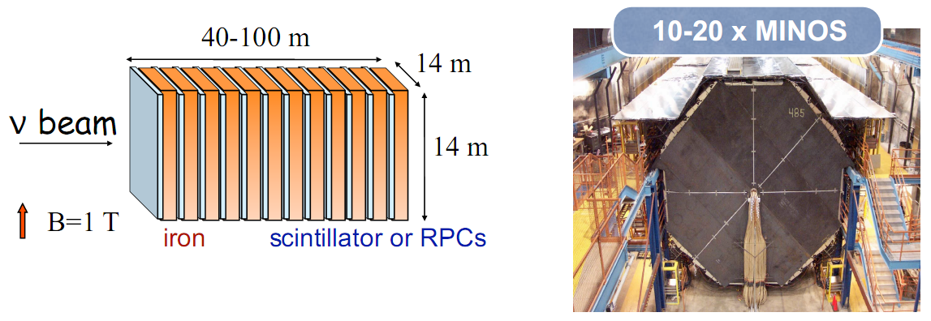
Measurement of oscillation parameters:
Essential, golden channel:
  ν_{μ} appearance
    Wrong sign muon
      Magnetic detector
Baseline:
  Magnetised Iron Neutrino Detector (MIND)
    Known technology, straightforward to magnetise

Slide 40
Measurement of oscillation parameters:
Access to silver and platinum
  Full study of oscillation pattern
  Requires τ± (silver) and e± (platinum) reconstruction
Alternatives:
  Totally Active Scintilator
  Detector
  Liquid argon detector
  Requires magnetisation of large volume
Presently focussing on simulation:
  Need to develop targeted
  R&D programme

Slide 41
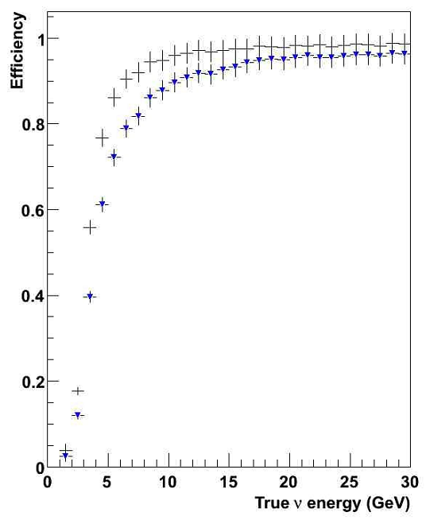
Common software framework:
A.Cervera, A.Laing, J.Martinez
Required to allow:
  Detailed evaluation (and optimisation) of performance
  Quantitative comparison of options
MIND

Slide 42
TASD: performance update:
M.Ellis
Assume:
  35 kT total mass
  0.5 T field
  Simulation using ‘NOvA’ concept
Muon

Slide 43
Near detector: mission:
Near detector programme:
  Neutrino oscillation programme:
    Direct measurement of neutrino flux
    Detailed study of charm cross sections
    Detailed study of neutrino-nucleon scattering
      Including deep inelastic, quasi-elastic, and resonance scattering
  Search for non-standard interactions
    In particular, require sensitivity to τ± (see below)
  Neutrino physics:
    Polarised (and un-polarised) structure functions
      Determination of α_{S}
    Electroweak physics: Weinberg angle
    CP violation from D⁰, D⁰ mixing, polarised Λ production, …

Slide 44
ISS near detector concept:
Not yet part of IDS-NF baseline

Slide 45
Challenging the baseline:
Large θ₁₃, non-standard interactions:

Slide 46
Large θ₁₃:
IDS-NF baseline optimised for sensitivity at low θ₁₃
Need to reconsider optimisation if θ₁₃ > 10⁻² or so
Attractive option:
  ‘Low Energy Neutrino Factory’

Slide 47
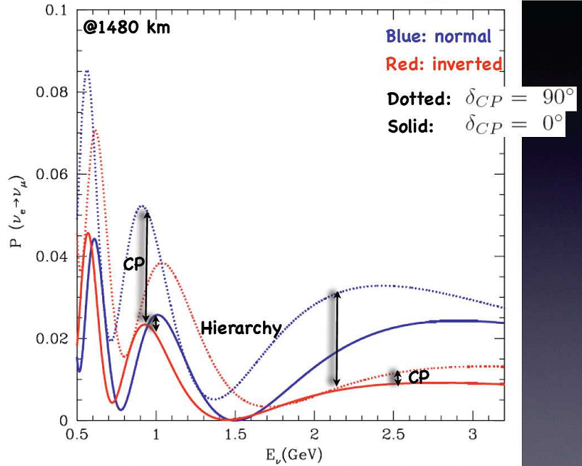
Low energy Neutrino Factory:
Consider E_{μ} = 4.5 GeV
  Matched to baseline
  ~1500 km
Crucial issue:
  Low energy threshold:
    E_{ν} > 0.5 – 0.8 GeV
  Good energy
  resolution
Facility:
  Accelerator facility:
    ‘Remove’ second RLA and muon FFAG
  Detector:
    TASD (or liquid argon)

Slide 48
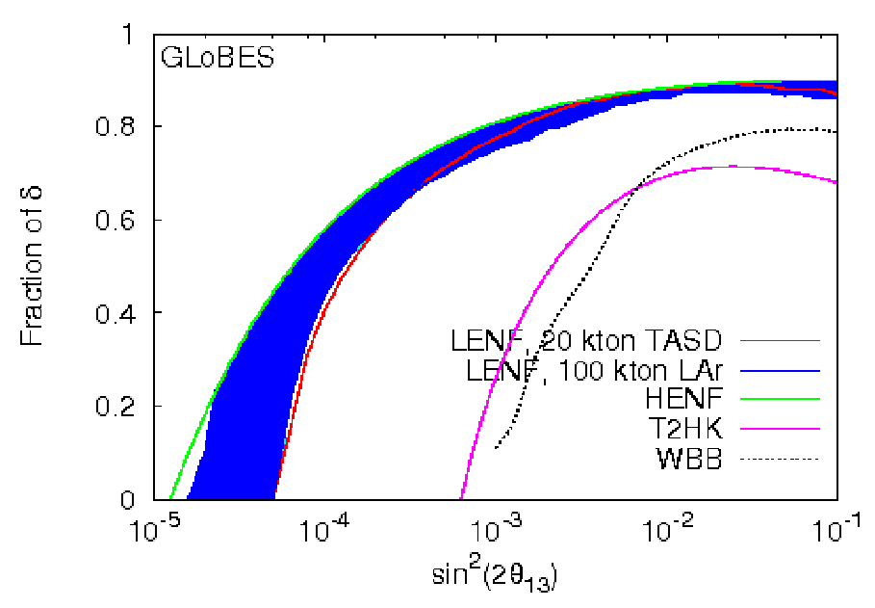
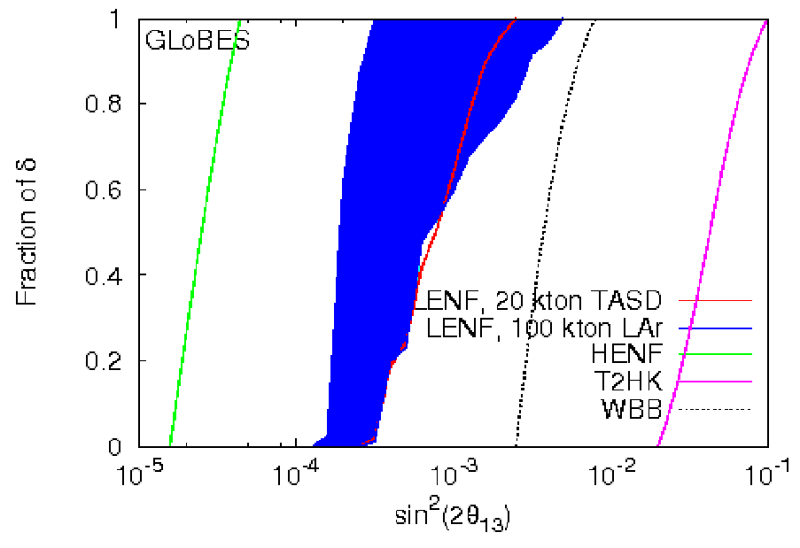
Low energy Neutrino Factory: performance:
T.Li
Excellent performance at θ₁₃ > 10⁻²
TASD and LAr competitive
  Need to assess optimistic LAr scenario

Slide 49
Non-standard interactions:
Beyond the ‘Standard Neutrino Model’:
  3 × 3 matrix may not be unitary
  May have non-standard interactions:
    At production
    In propagation
    At detection
Issue was raised:
  Is MECC at intermediate baseline required to investigate NSI?

Slide 50
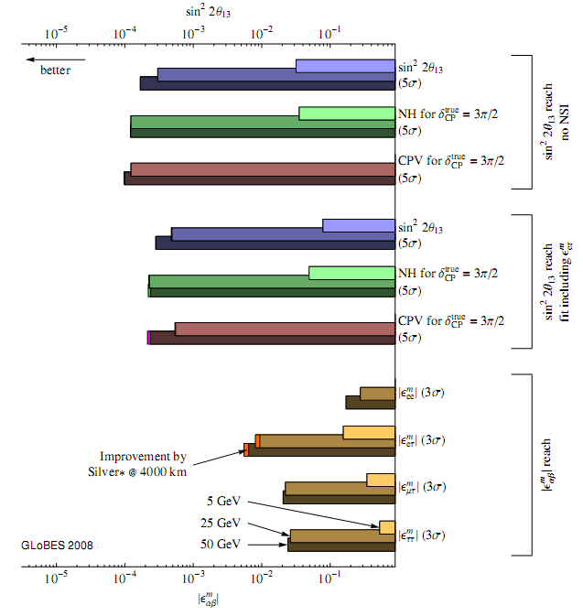
IDS-NF note is in preparation:
  Will be discussed and evaluated at IDS-NF meeting in Mumbai
  Crucial issue:
    Be sure that we can ‘nail a discovery’ with the facility we propose
A.Donnini, P.Huber, J.Kopp,

Slide 51
Opportunity and conclusions:

Slide 52
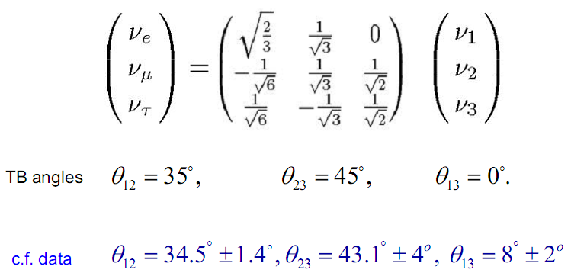
Physics, not ‘stamp collecting’:
Neutrino oscillations established
  Sign post for Physics at
  highest energy scale:
    New symmetries?
      E.g. family symmetry?
    New particles?
      E.g. heavy, Majorana
      neutrinos?
    New forces?
      E.g. SUSY?

Slide 53
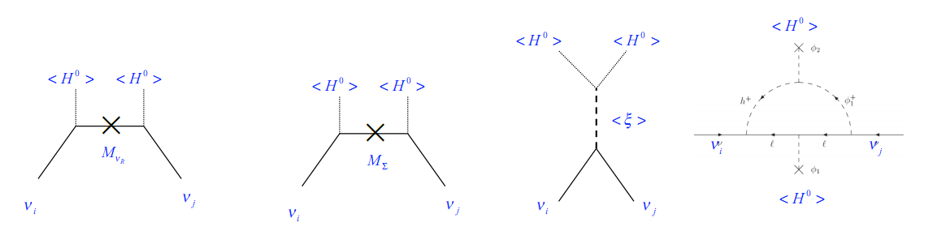
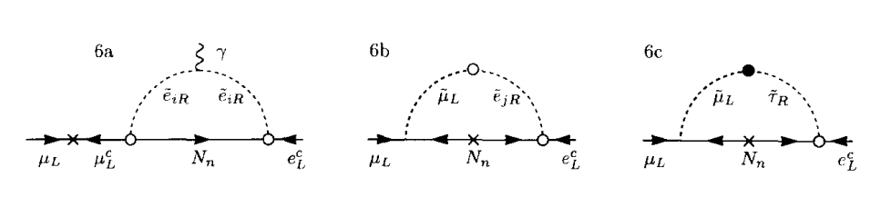
Opportunity:
Neutrino oscillations:
Charged lepton flavour violation:
Related processes!
  Greatest benefit:
    Neutrino oscillations, CLFV searches, LFV at colliders
Can we articulate a ‘muon programme’?
  Definitive CLFV programme
  Definitive neutrino oscillations programme
  The route to the energy frontier in lepton-antilepton collisions

Slide 54
Conclusions:
The Neutrino Factory, the ‘facility of choice’:
  Best discovery reach
  Best precision:
    But define agreed figure of merit
  Best sensitivity to non-standard interactions:
The IDS-NF baseline established and, so far, robust
  Alternatives to the baseline, addressing particular issues (e.g., Low Energy Neutrino Factory), are under discussion
The IDS-NF collaboration:
  Energetic and ambitious, working towards IDR 2010/11 and RDR 2012/13
Scientific imperative remains to make the Neutrino Factory an option for the field
  Join us in Mumbai! Together we’ll make the weather!

Slide 55
Backup:

Slide 56


EUROnu and the IDS-NF
EUROnu is the European contribution to the IDS-NF
EUROnu
IDS-NF
SB
BB
NF

