Slide 1
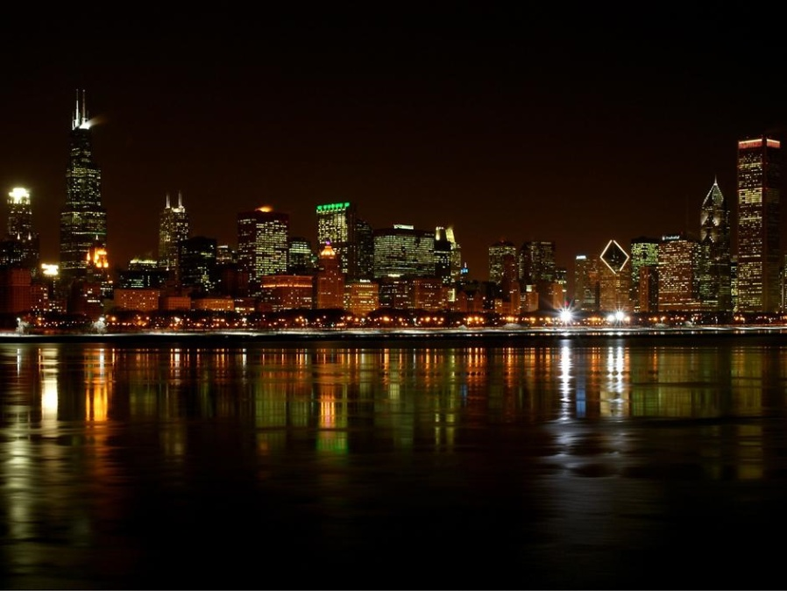
From SuperBeams to Neutrino Factories
The Program in Neutrino Factory R&D
Alan Bross
N u F a c t 0 9

Slide 2
Pre-Ramble
Neutrino Factory means different things to different people
  Not so much for SuperBeams
I will be talking about a muon-based Neutrino Factory as opposed to a β-beam “Neutrino Factory” which has similar potential with respect to ν oscillation physics
  This is my personal prejudice
    I believe that the power of a facility that produces ultra-intense muon beams is unmatched and can lead us to the Energy Frontier via a Muon Collider
    And this program can be staged, doing physics at each stage as Alain described on Monday
      And (maybe) a proton source can be built that can drive all the programs simultaneously as Raja mentioned on Monday.
    A β-beam facility cannot offer this

Slide 3
Pre-Ramble II – SuperBeams → Neutrino Factory?
When I talk with my colleagues who are currently running ν experiments, building experiments or planning the next experiment, I often get a blank stare or …
Neutrino Factory, huh, yeah
What is it good for?
Absolutely nothing
Uh-huh*
* With Apologies to Edwin Starr

Slide 4
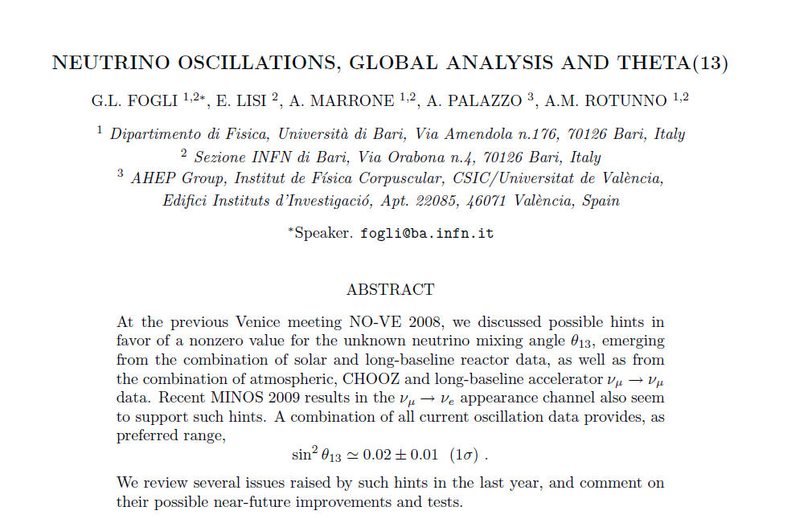
Pre-Ramble III – Why is this?
Phenomenological prejudice?
arXiv:0905.3549v2

Slide 5
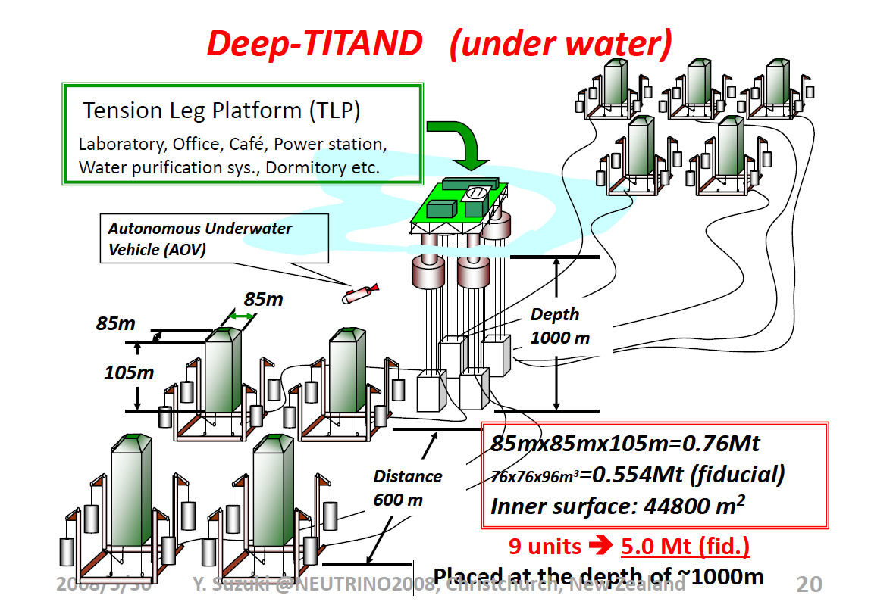
Experimental Prejudice?

Slide 6
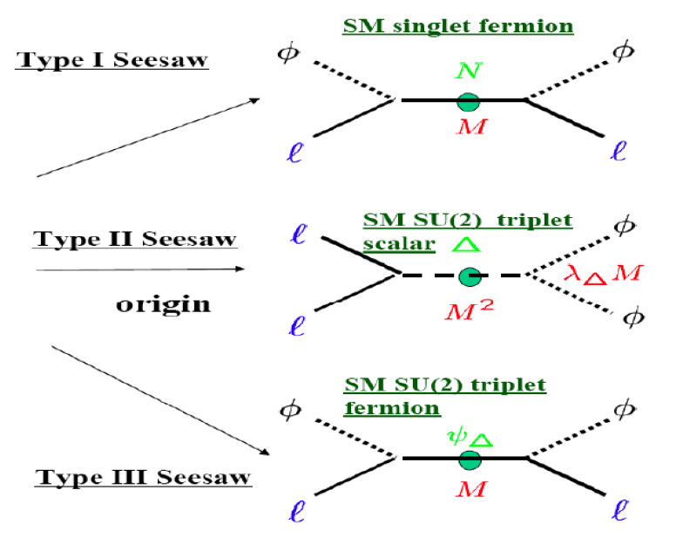
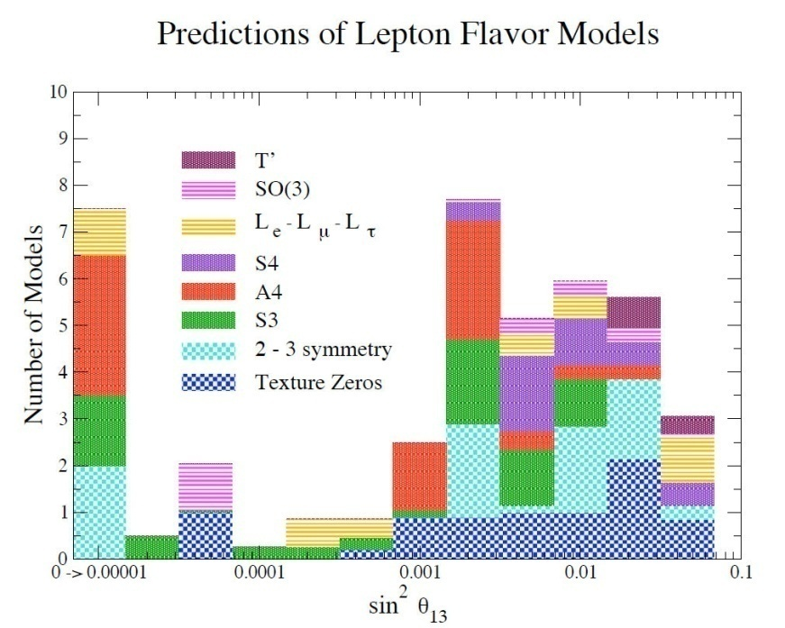
No, Because it’s the Physics Stupid
But all agree that the goal is not just to measure some numbers
  Gain knowledge/understanding of the underlying physics
Want to do the most precise experiments possible

Slide 7
NF: Superb Reach in 3ν mixing model parameters &
Maybe gives best chance to see something Unexpected (NSI)
3σ contours shown
ISS Physics Group Report: arXiv:0710.4947v2
Sin²2θ₁₃
Hierarchy
δ CP
SPL: 4MW, 1MT H₂OC, 130 km BL
T2HK: 4 MW, 1MT H₂OC, 295 km BL
WBB: 2MW, 1MT H₂OC, 1300 km BL
NF: 4MW, 100KT MIND, 4000 & 7500 BL
BB350: γ=350, 1MT H₂OC, 730 km BL

Slide 8
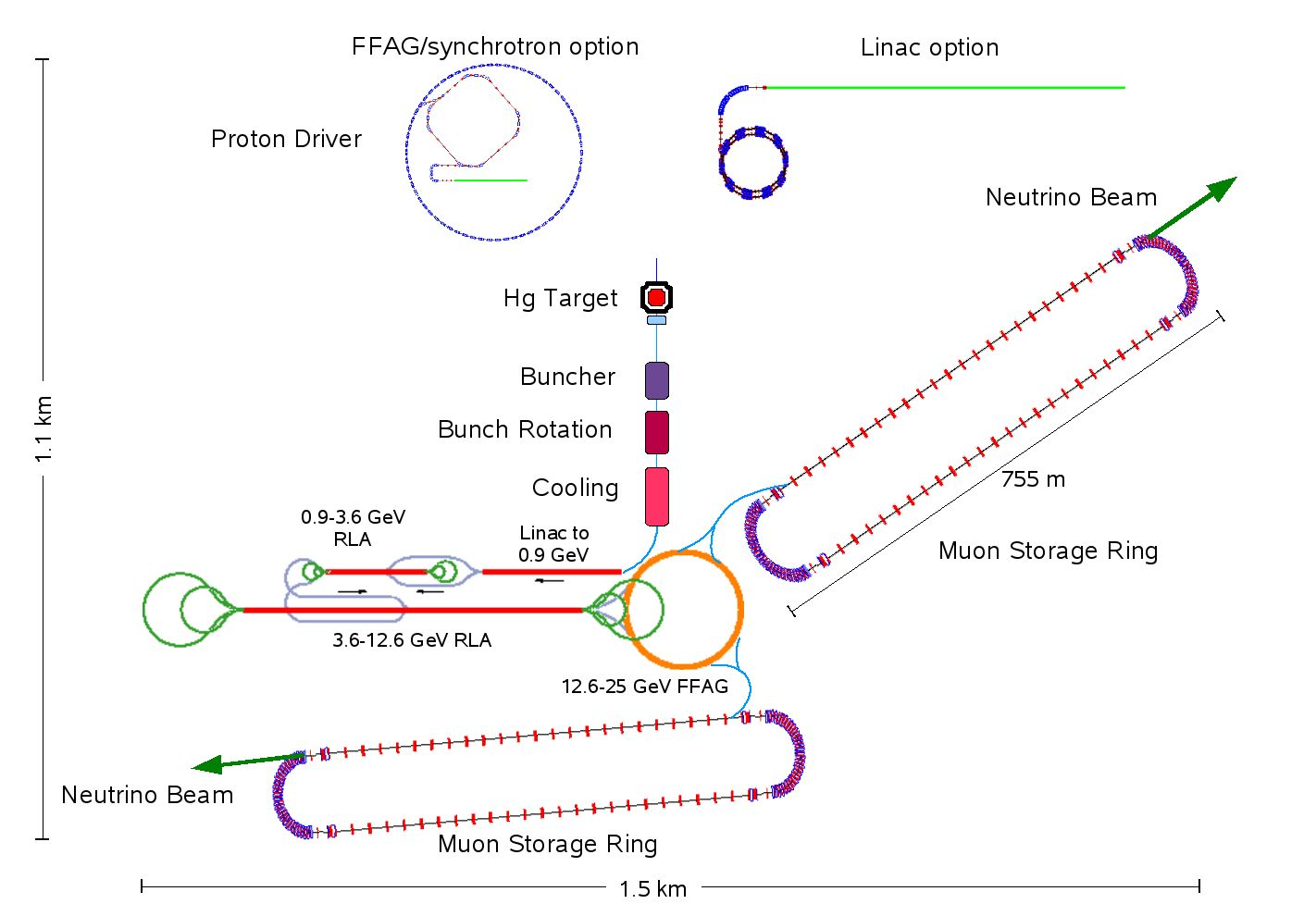
Neutrino Factory
4000 km baseline
25 GeV
7500 km baseline

Slide 9
So, Why Isn’t there a consensus from the Community to JUST get on with It (NF)?
Time
Experimentalists worry about running out of it

Slide 10
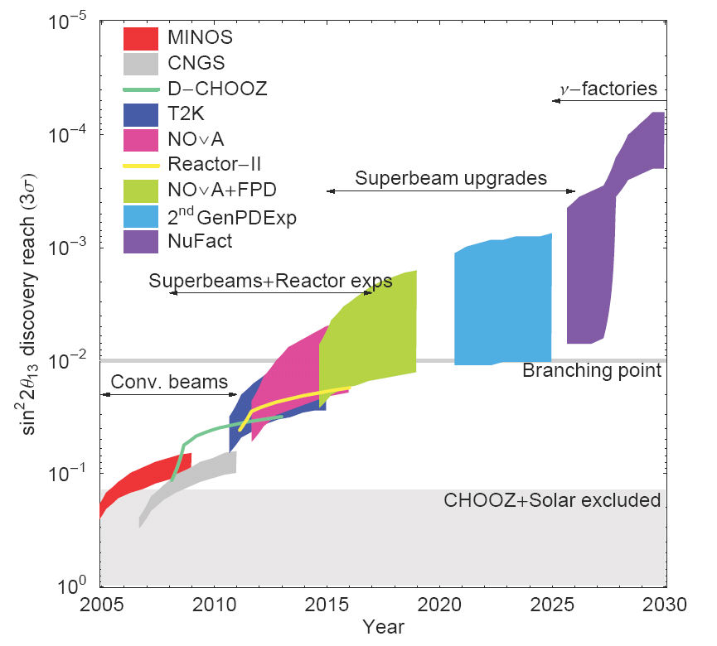
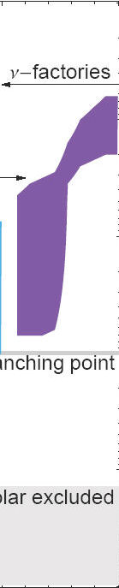
Neutrino Program Evolution
Adiabatic Approach
Technical Hurdles ⇒ More Time
$$$$ ⇔ TIME
TIME ⇔ $$$$
The R&D Program for the Neutrino Factory aims to
  Define and validate the required technologies
  Reduce risk
  Cost optimization.
  Deliver on specific time scale

Slide 11
Outline
R & D Program
  MERIT
  MuCool
  MICE
  Acceleration
    EMMA
  Detector
  International Design Study

Slide 12
Neutrino Factory Accelerator Facility
Baseline out of International Scoping Study
Proton Driver
  4 MW, 2 ns bunch
Target, Capture, Drift (π→μ) & Phase Rotation
  Hg Jet
  200 MHz train
Cooling
  30 πmm ( ⊥ )
  150 πmm ( L )
Acceleration
  103 MeV → 25 GeV
Decay rings
  7500 km L
  4000 km L
    Baseline is race-track design
    Triangle interesting possibility (C. Prior)
ISS Accelerator WG report: RAL-2007-023

Slide 13
ISS baseline: Detectors
Two baselines:
  3000 – 5000 km
  7000 – 8000 km
Magnetised Iron Neutrino Detector (MIND) at each location
Magnetised Emulsion Cloud Chamber at intermediate baseline for tau detection

Slide 14
R&D Program Overview
High Power Targetry (MERIT Experiment)
Ionization Cooling – (MICE (4D Cooling))
200 (& 805) MHz RF (MuCool and Muons Inc.)
  Investigate RF cavities in presence of high magnetic fields
    Obtain high accelerating gradients (~15MV/m)
    Investigate Gas-Filled RF cavities
Acceleration
  Linac for initial acceleration
  Multi-turn RLA’s
  FFAG’s – (EMMA)
Decay Ring(s)
Theoretical Studies
    Analytic Calculations
    Lattice Designs
    Numeric Simulations
Note: Almost all R&D Issues
for a NF are currently under
theoretically and experimentally study

Slide 15
MERIT
Mercury Intense Target
Liquid-Hg Jet

Slide 16
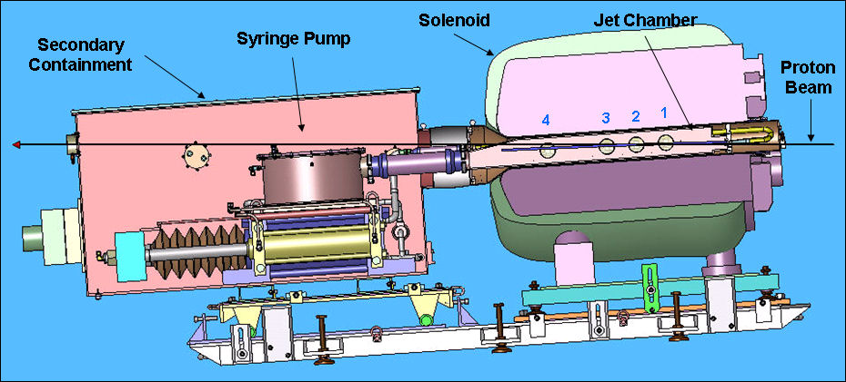

MERIT
The Experiment Reached 30TP @ 24 GeV
Experiment Completed (CERN)
  Beam pulse energy = 115kJ
  B-field = 15T
  Jet Velocity = 20 m/s
  Measured Disruption Length = 28 cm
  Required “Refill” time is then 28cm/20m/s = 14ms
    Rep rate of 70Hz
  Proton beam power at that rate is 115kJ *70 = 8MW

Slide 17
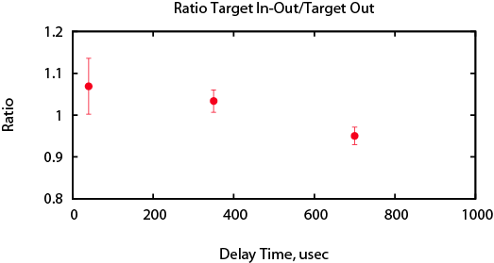
MERIT Conclusions
Jet surface instabilities reduced by high-magnetic fields
Proton beam induced Hg jet disruption confined to jet/beam overlap region
  20 m/s operations allows for 70Hz operations
  115kJ pulse containment demonstrated
  8 MW operations demonstrated
Hg jet disruption mitigated by magnetic field
Hg ejection velocities reduced by magnetic field
Pion production remains viable up to 350μs after previous beam impact

Slide 18
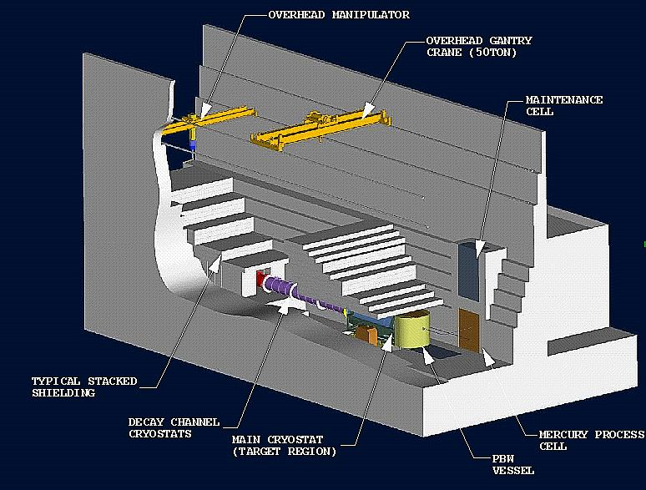
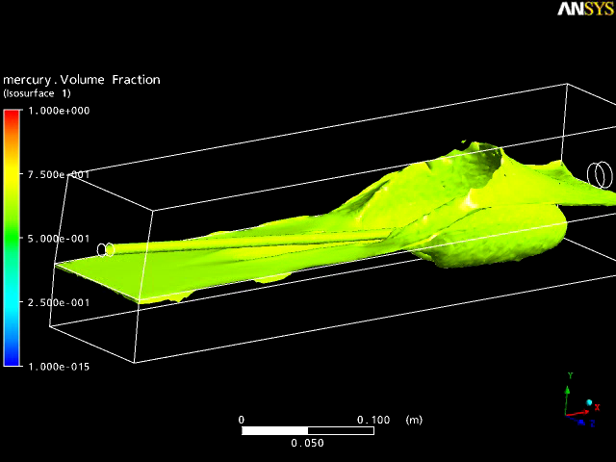
Target Station R&D
The Target Hall Infrastructure
Proton Hg Beam Dump
V. Graves, ORNL
T. Davenne, RAL

Slide 19
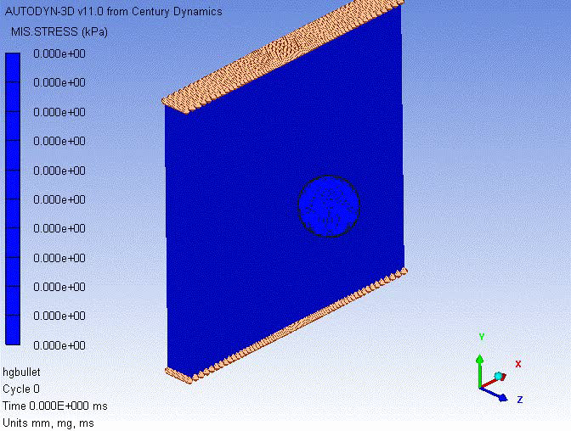

Slide 20
Muon Ionization Cooling
MuCool and MICE

Slide 21
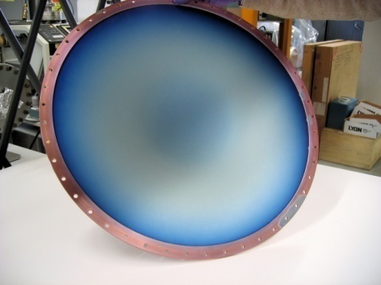
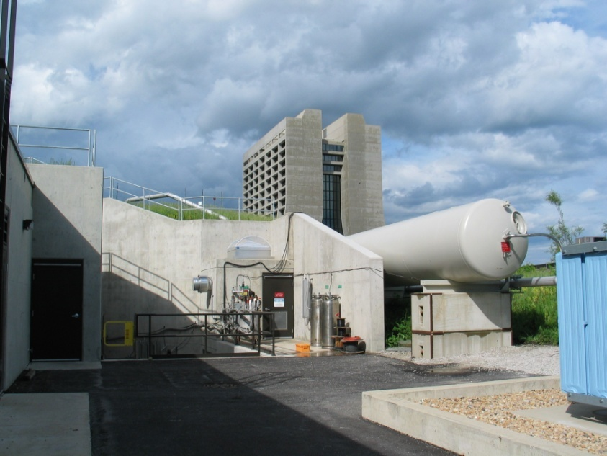
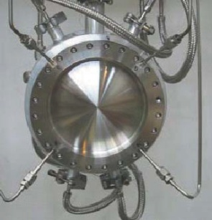
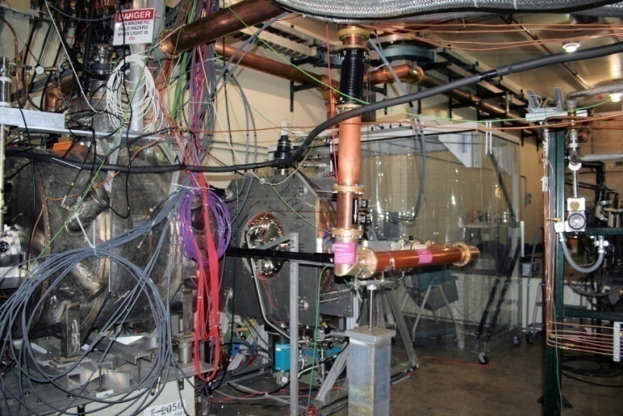
MuCool
Component R&D and Cooling Experiment
MuCool
  Component testing: RF, Absorbers, Solenoids
    With High-Intensity Proton Beam
  Uses Facility @Fermilab (MuCool Test Area –MTA)
  Supports Muon Ionization Cooling Experiment (MICE)
MuCool Test Area
42cm ∅ Be RF window
MuCool
201 MHz RF Testing
MuCool
LH₂ Absorber
Body

Slide 22
RF Test Program
MuCool has the primary responsibility to carry out the RF Test Program
Study the limits on Accelerating Gradient in NCRF cavities in magnetic field
Understand, in detail, the interaction of field emission currents with applied external magnetic field
Fundamental Importance to both NF and MC – RF needed in
  Muon capture, bunching, phase rotation
  Muon Cooling
  Acceleration
Arguably the single most critical
Technical challenge for the NF & MC

Slide 23
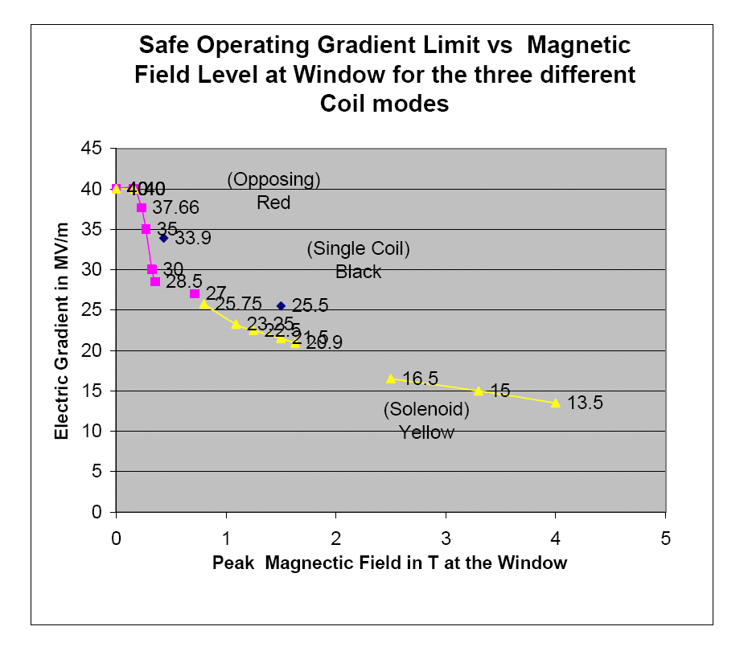
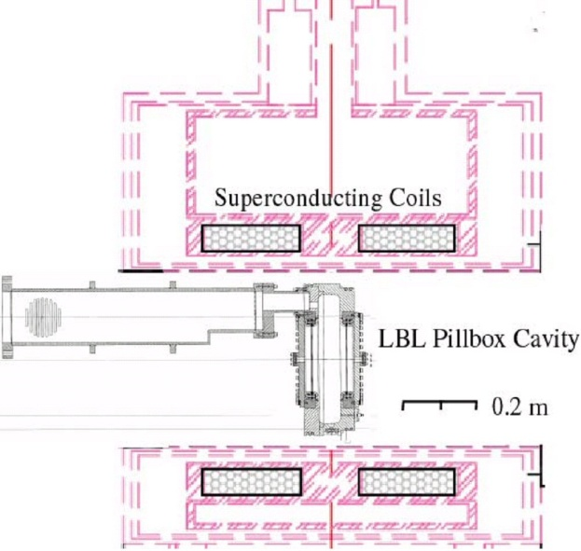
The Basic Problem – B Field Effect
805 MHz Studies
Max stable gradient degrades quickly with B field
Gradient in MV/m
>2X Reduction @ required field
Peak Magnetic Field in T at the Window

Slide 24
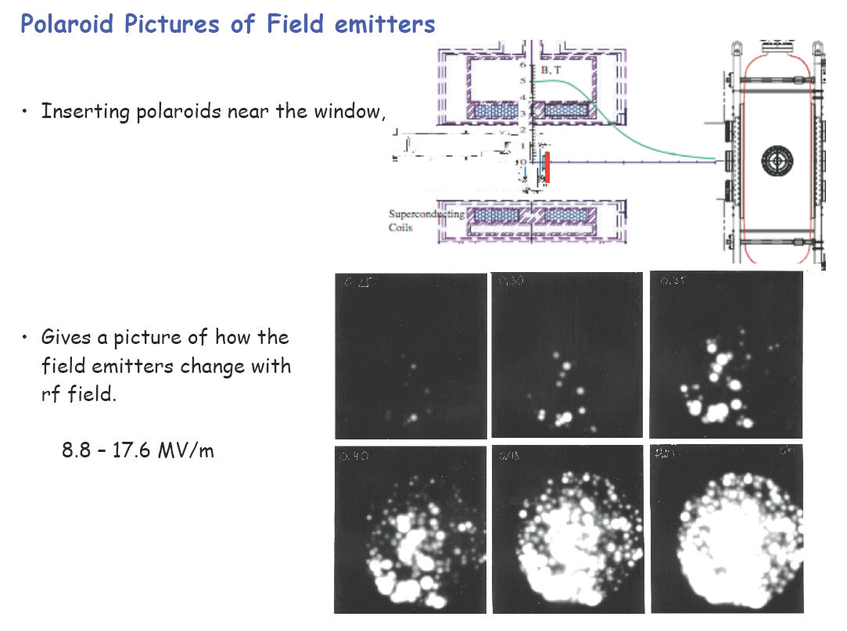
805 MHz Imaging

Slide 25
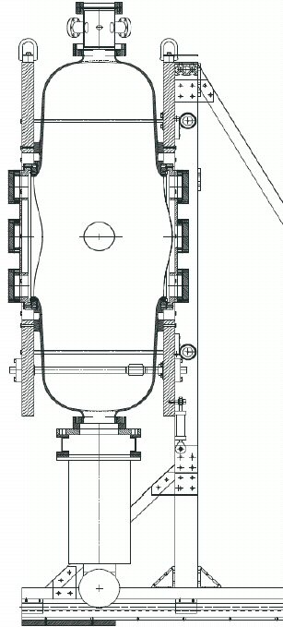
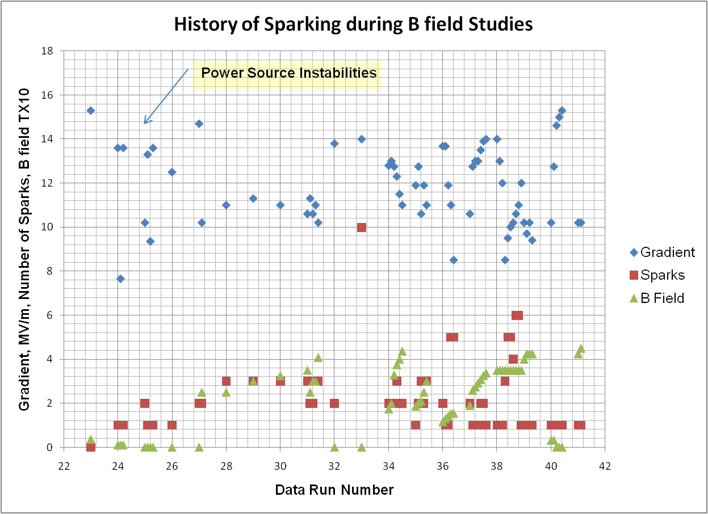
RF R&D – 201 MHz Cavity Test
Treating NCRF cavities with SCRF processes
The 201 MHz Cavity – 21 MV/m Gradient Achieved (Design – 16MV/m)
  Treated at TNJLAB with SCRF processes – Did Not Condition
But exhibited Gradient fall-off with applied B
Design Gradient
1.4m

Slide 26
Facing the RF B Field Challenge
Approaches to a Solution
  Reduce/eliminate field emission
    Process cavities utilizing SCRF techniques
    Surface coatings
      Atomic Layer Deposition
  Material Studies
      Non-Cu bodies (Al, Be?)
        Mitigate the effect of B field interaction on field emission currents ⇒ Breakdown
  RF cavities filled with High-Pressure gas (H₂)
    Utilize Paschen effect to stop breakdown
  Magnetic Insulation
    Eliminate magnetic focusing
      Not Yet Tested

Slide 27
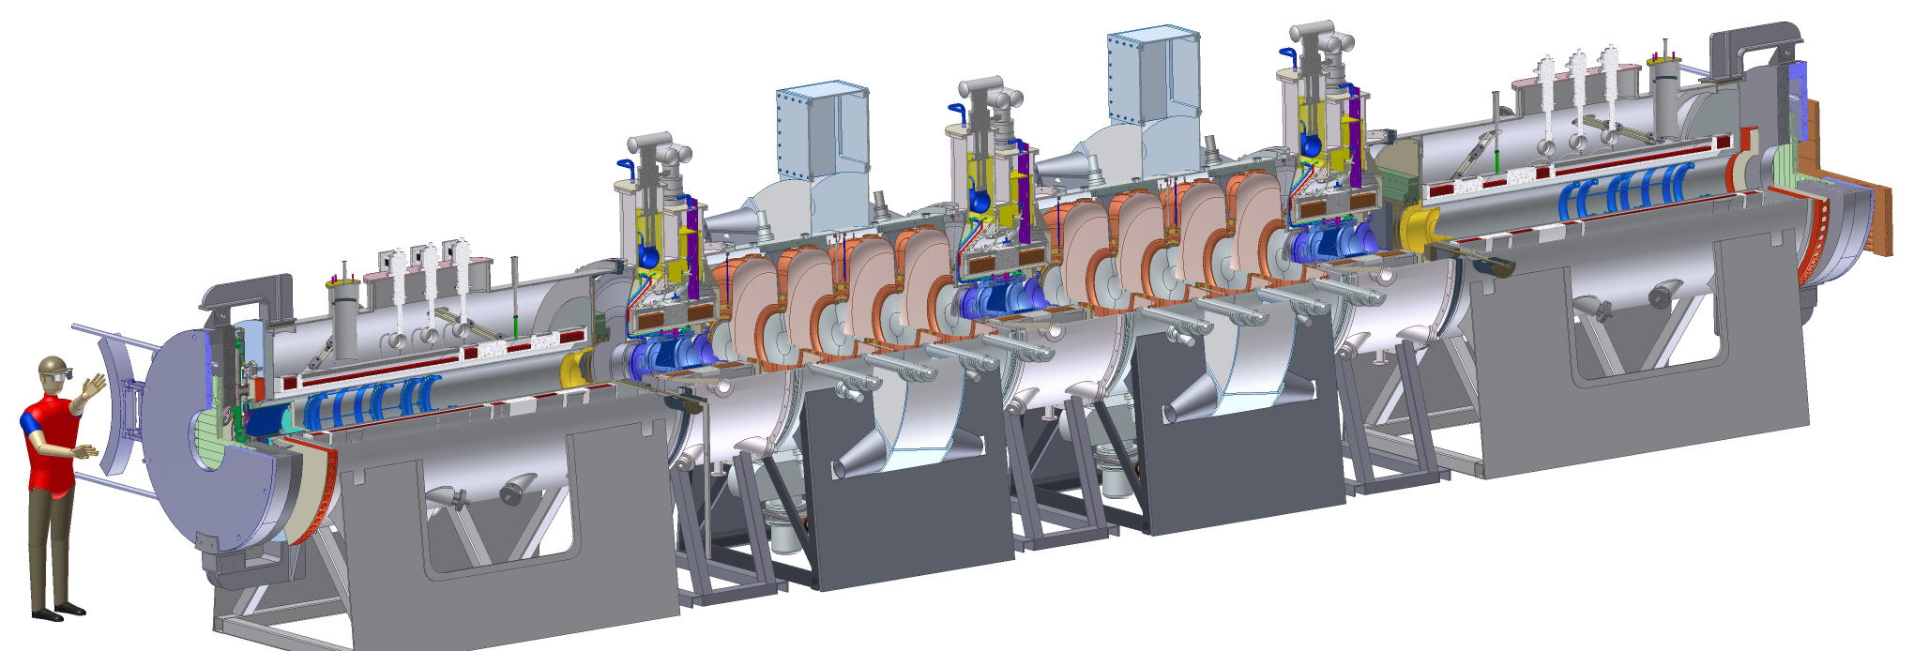
Muon Ionization Cooling Experiment (MICE)
http://mice.iit.edu/

Slide 28
Muon Ionization Cooling Experiment
Tracking Spectrometer
Focus
Coils
RF
Cavities
Liquid
Hydrogen
Absorbers
Magnetic
shield
Fiber Tracker
Measure transverse (4D) Muon Ionization Cooling
  10% cooling – measure to 1% (10⁻³)
Single-Particle Experiment
  Build input & output emmittance from μ ensemble

Slide 29
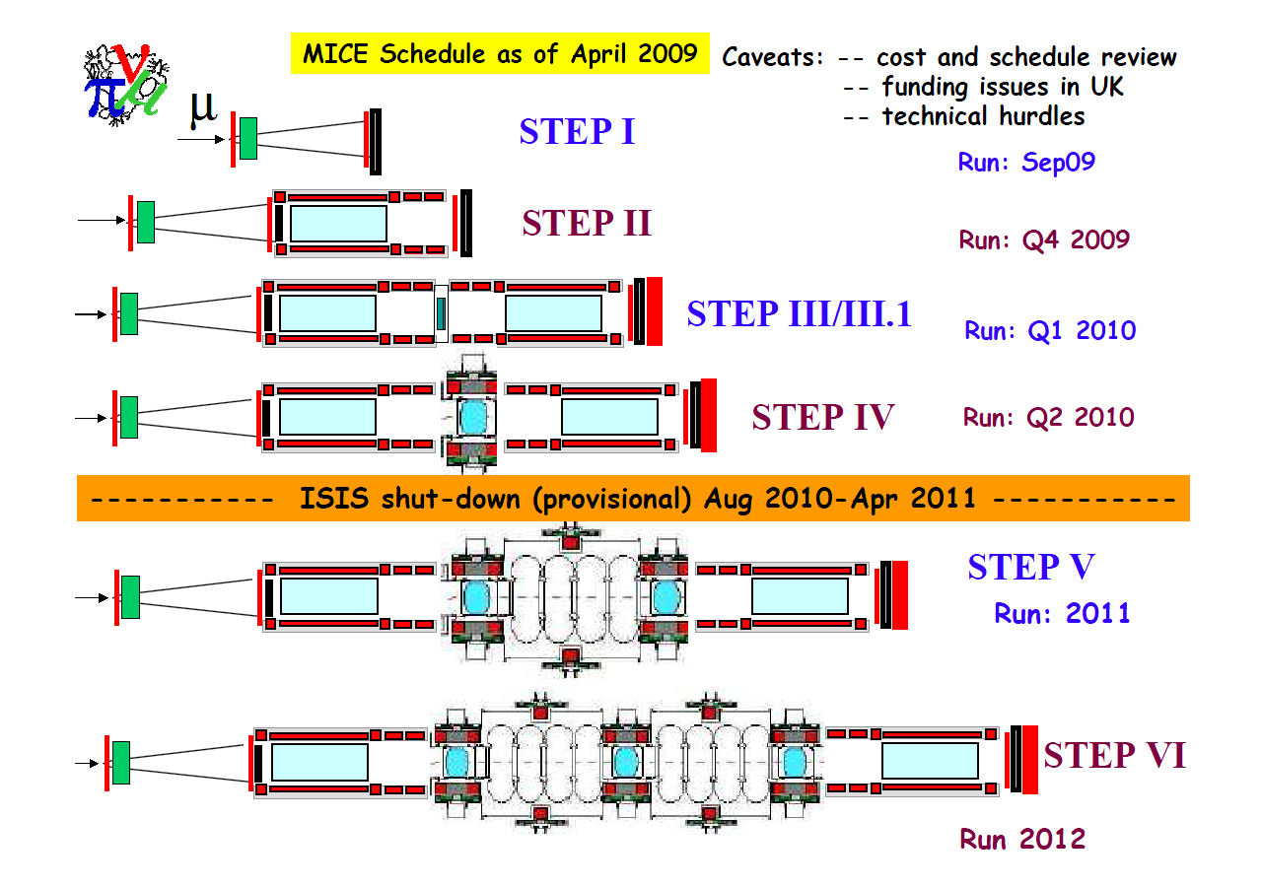
MICE Schedule
LiH

Slide 30
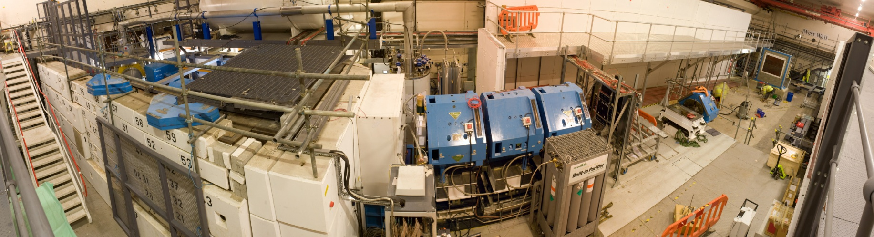
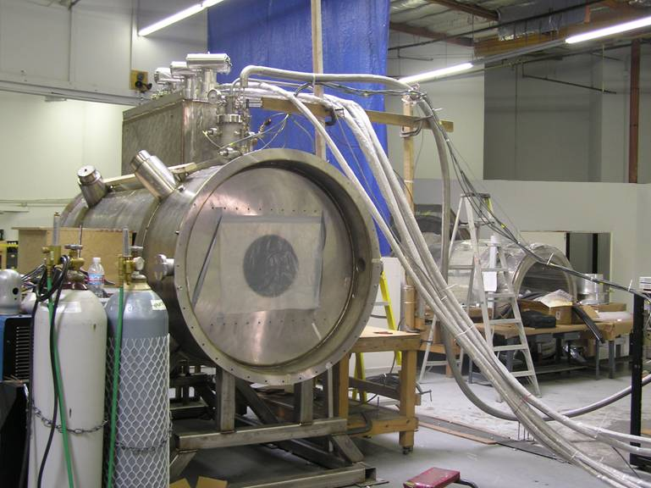
Progress on MICE
Beam Line Complete
  First Beam 3/08
    MICE target operated from Mar-Dec 2008.
PID Installed
  CKOV, TOF, EM Cal
  Beam registered in PID system
New target, decay solenoid and tracker
  Ready in Fall
First Spectrometer
  Winter 09
Spectrometer Solenoid being tested

Slide 31
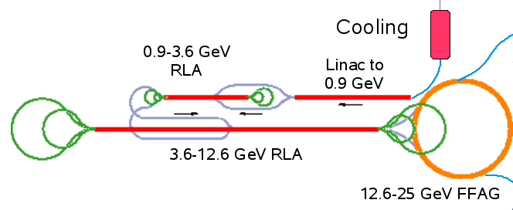
Neutrino Factory Front-End and Acceleration

Slide 32
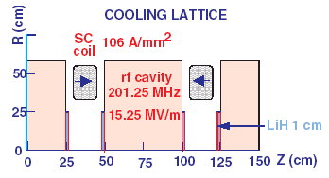
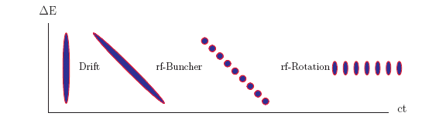
High-frequency Buncher and φ-E Rotator
Drift (π→μ)
“Adiabatically” bunch beam first (weak 320 to 240 MHz rf)
Φ-E rotate bunches – align bunches to ~equal energies
  240 to 202 MHz, 12MV/m
Cool beam 201.25MHz
p
π→μ
FE Target
Solenoid
Drift
Buncher
Rotator
Cooler
10 m
~60 m
~35m
35 m
~80 m
Obtains ~0.085 μ/ 8 GeV p
≈ 1.5 10²¹ μ/year

Slide 33
Acceleration - RLAs
Develop Engineering Design Foundation
244 MeV
0.9 GeV
Define beamlines/lattices for all components
146 m
79 m
0.6 GeV/pass
3.6 GeV
264 m
12.6 GeV
2 GeV/pass

Slide 34
Final Acceleration - FFAG
Fixed Field Alternating Gradient
  FF – Fast (no ramping)
  AG – aperture under control
Large 6D acceptance
Demonstration Experiment – EMMA
  Electron Model for Many Applications
    One of those is: Model of 10-20 GeV muon accelerator
  Hosted by Daresbury Lab
    International Collaboration Canada, France, UK, US
Goals
  Understand beam dynamics
  Map transverse and longitudinal acceptances
  Study injection and extraction
1st beams in to EMMA Nov 2009

Slide 35
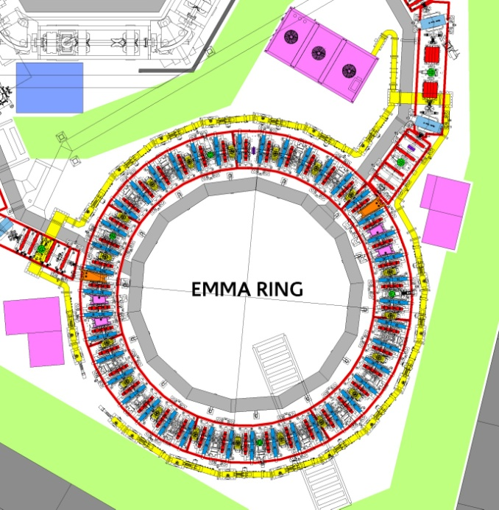
EMMA
Energy range | 10 – 20 MeV
Lattice | F/D Doublet
Circumference | 16.57 m
No of cells | 42
Normalised transverse acceptance | 3π mm-rad
Frequency (nominal) | 1.3 GHz
No of RF cavities | 19
Repetition rate | 1 - 20 Hz
Bunch charge | 16-32 pC single bunch

Slide 36
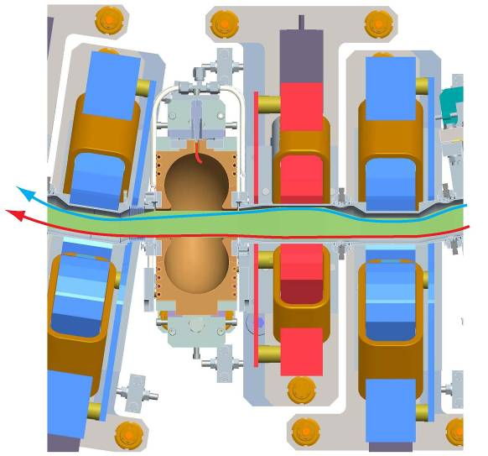
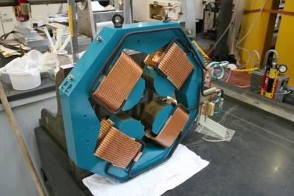
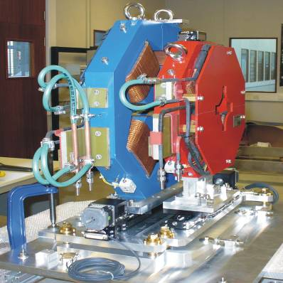
Production Status
Beam in November

Slide 37
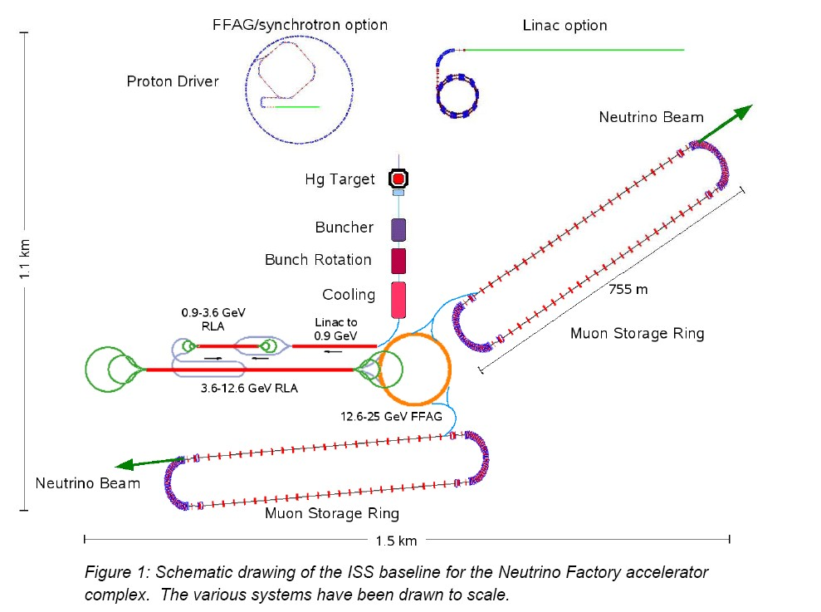
International Design Study for a Neutrino Factory (IDS-NF)

Slide 38
IDS-NF
Takes as starting point - International Scoping Study ν-Factory parameters
  ~4MW proton source producing muons, accelerate to 25 GeV, Two baselines: 2500km & 7500km
IDS Goals
  Specify/compute physics performance of neutrino factory
  Define accelerator and detector systems
  Compute cost and schedule
    Goal to understand the cost at the ≈ 50% level
  Identify necessary R&D items
IDS Deliverables
  Interim design report (c. 2010)
    Engineering designs for accelerator and detector systems
    Cost and schedule estimates
    Work plan to deliver Reference Design Report (RDR)
      Report production itself
      Outstanding R&D required
  Reference Design Report (c. 2012)
    Basis for a “request for resources” to get serious about building a neutrino factory

Slide 39
Timeline - NF
Aspirational
NF timeline
presented
in at NuFact07
Considerably
Sooner than
Adiabatic
Approach

Slide 40
Status of IDS-NF with Respect to θ₁₃
Must Consider the case for a Neutrino Factory for the scenario where θ₁₃ is large(ish)
  Possibly measured before report is delivered
Low-energy Neutrino Factory:
  Interesting option, especially in this scenario and as a step in a possible staging scenario, but:
    Physics reach for oscillation parameters ( 3ν mixing) for small θ₁₃ approaching that for baseline
      Not for Hierarchy

Slide 41
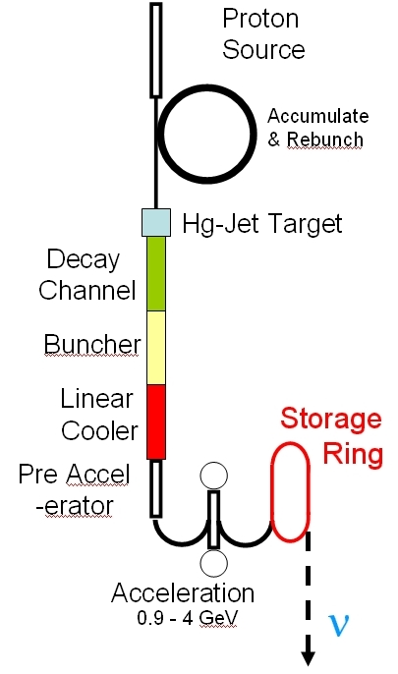
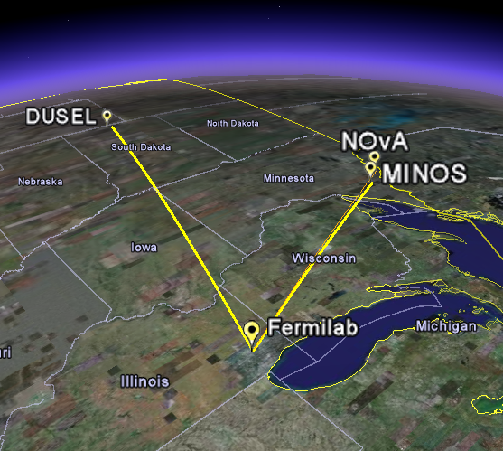
IDS Option: 4 GeV ν-Factory
Fermilab to DUSEL (South Dakota) baseline -1290km
4-5 GeV/c muons yield appropriate L/E_{ν}
Use a magnetized totally active scintillator detector
Ankenbrandt, Bogacz, Bross, Geer, Johnstone, Neuffer, Popovic
Fermilab-Pub-09-001-APC; Submitted to PRSTAB

Slide 42
Neutrino Detector R&D

Slide 43
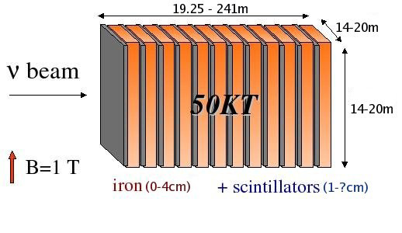
Magnetized Iron Detector, MIND
Baseline Neutrino Factory (25 GeV)
Simulation effort (see A. Laing’s talk) addresses optimization
  Cell geometry, plate thickness
Technology
  Photodetector (SiPM)
  Magnetization

Slide 44
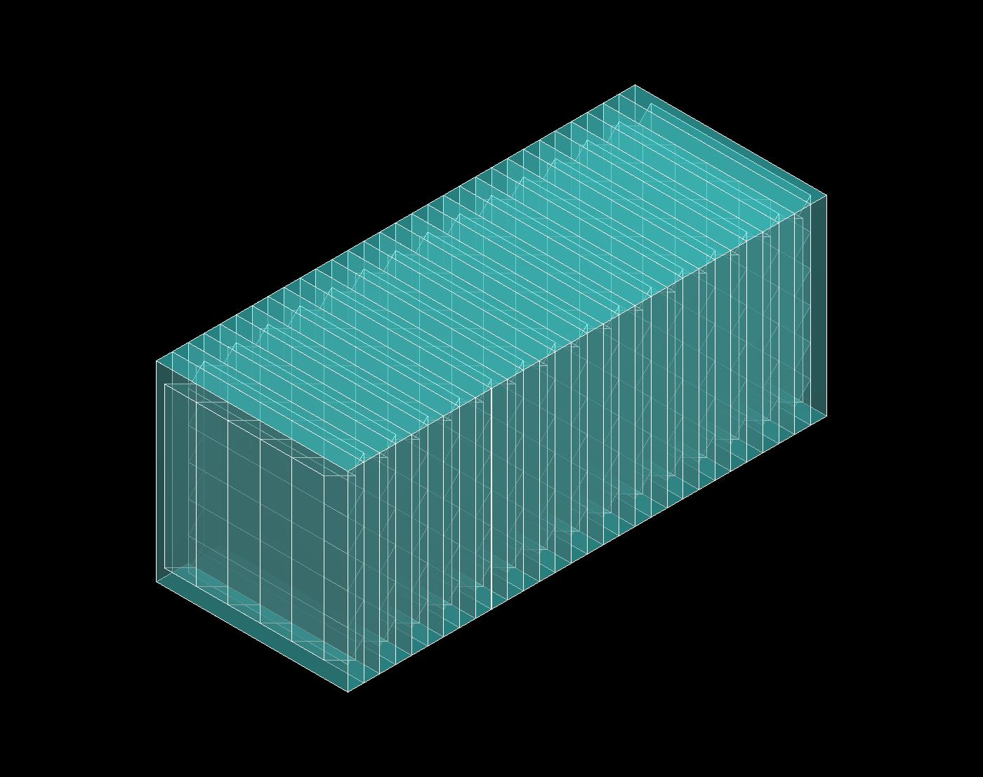
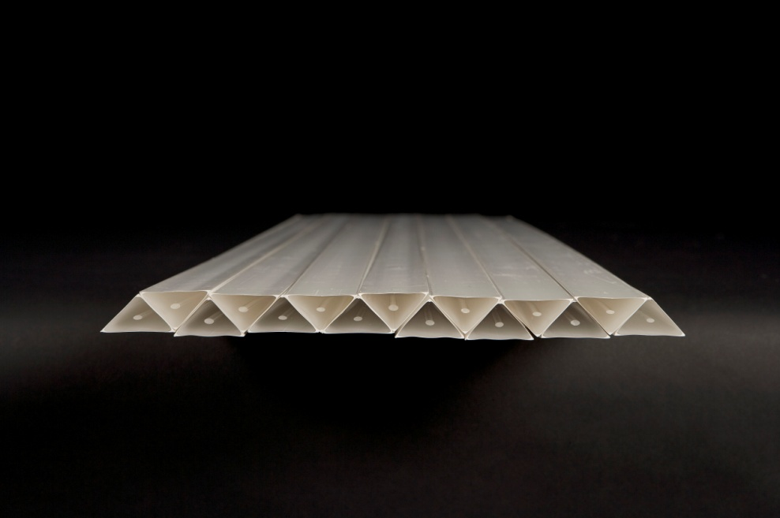
Fine-Resolution Totally Active Segmented Detector
Low-Energy Neutrino Factory
Simulation of a Totally Active Scintillating Detector (TASD) using Noνa and Minerνa concepts with Geant4
  35 kT (total mass)
  10,000 Modules (X and Y plane)
  Each plane contains 1000 cells
  Total: 10M channels
150 m
15 m
15 m
1.5 cm
15 m
3 cm
Momenta between 100 MeV/c to 15 GeV/c
Magnetic field considered: 0.5 T
Reconstructed position resolution ~ 4.5 mm
B = 0.5T

Slide 45
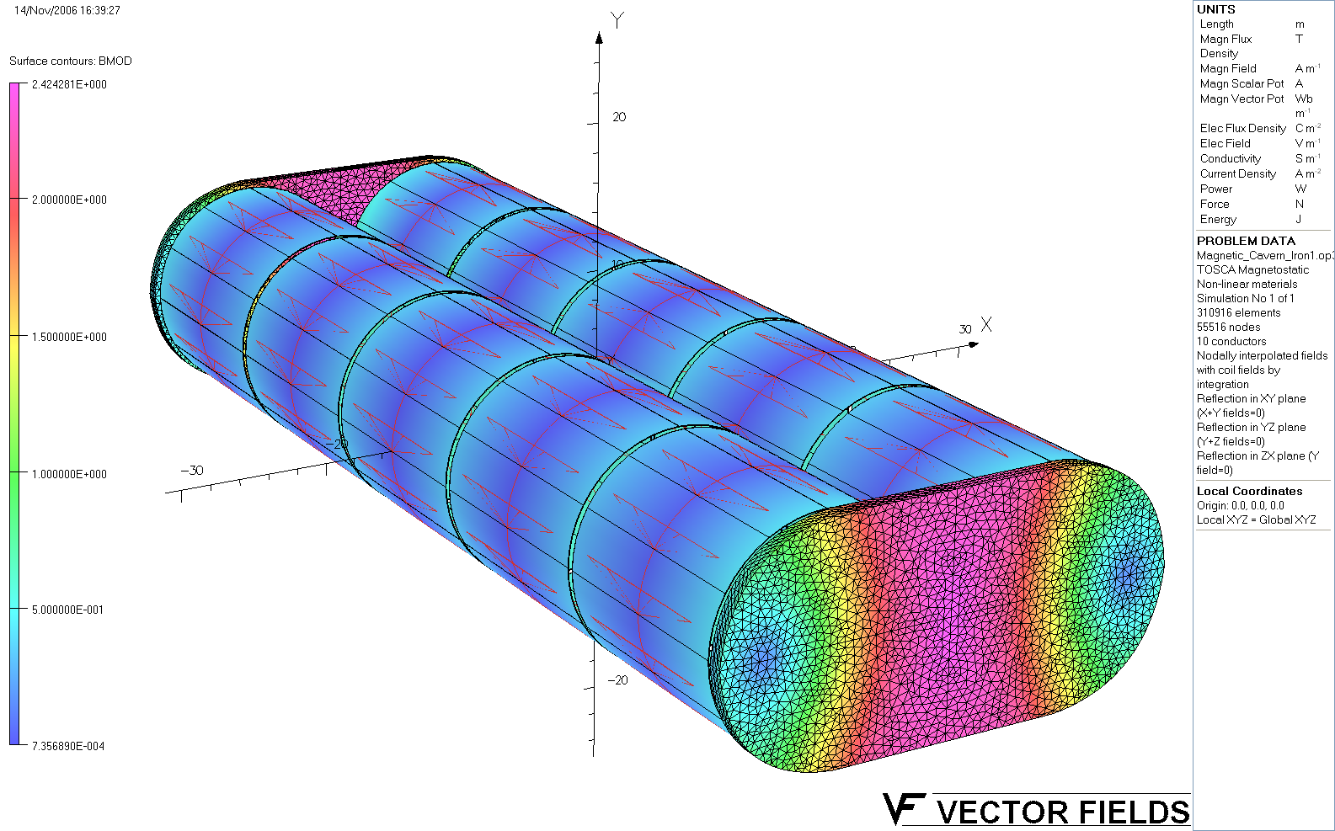
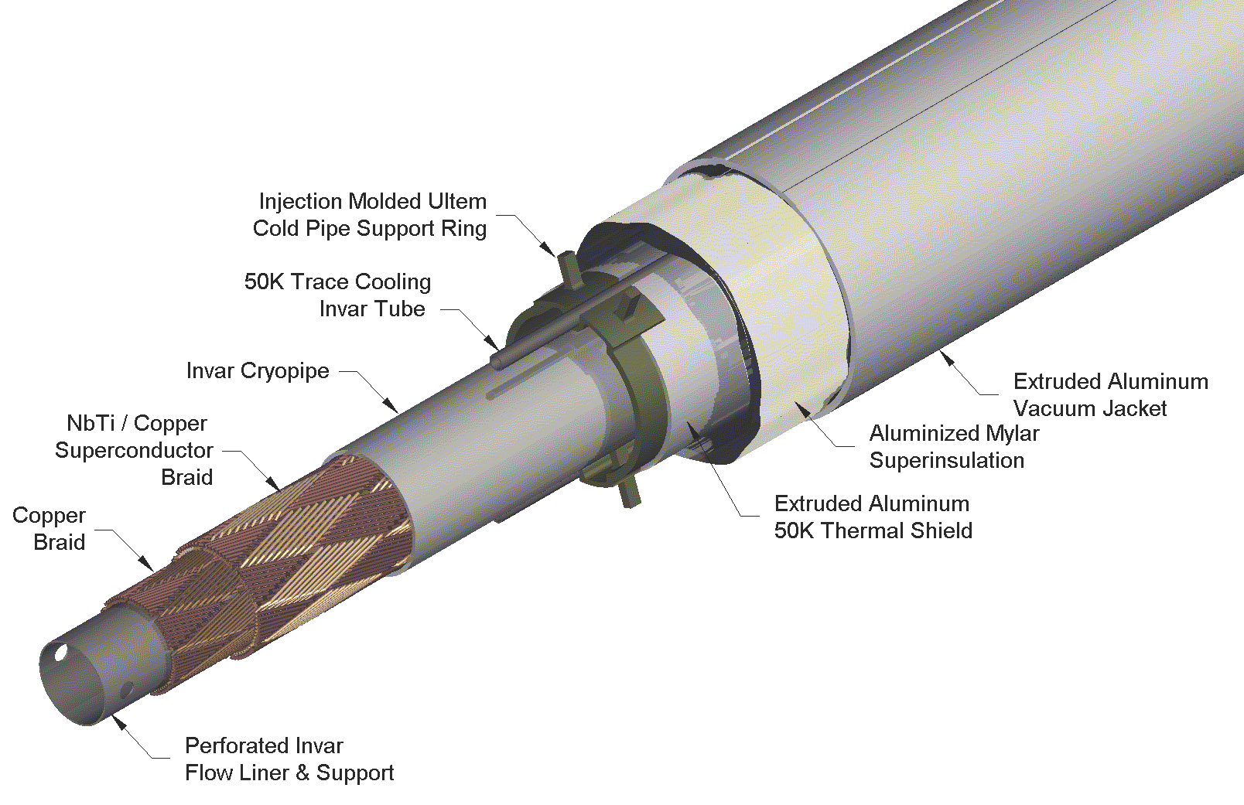
Very-Large-Magnetic Volume R&D
Production of very large magnetic volumes – expensive using conventional technology
  For SC magnets – cost driven by cryostat
  Use VLHC SC Transmission Line Concept
    Wind around mandrel
    Carries its own cryostat
    No large vacuum loads
Concept for 23 X 10³ m³
1 m iron wall thickness.
~2.4 T peak field in the iron.
Good field uniformity
Scaling Factor:
  Cost ∝ r ?

Slide 46
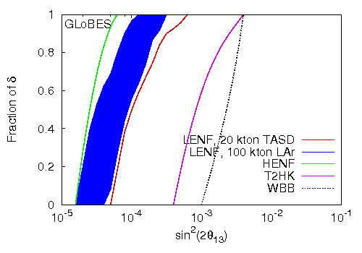
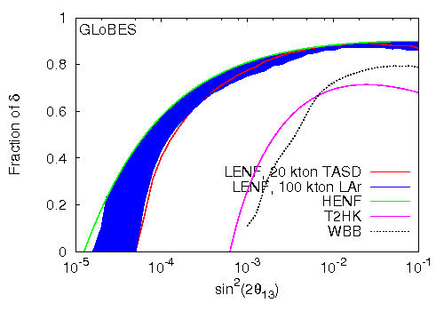
SuperBeam ⇒ Neutrino Factory
LAr concept is actively being considered for DUSEL
  Magnetization allows for natural SuperBeam ⇒ Neutrino Factory
θ₁₃
CP

Slide 47
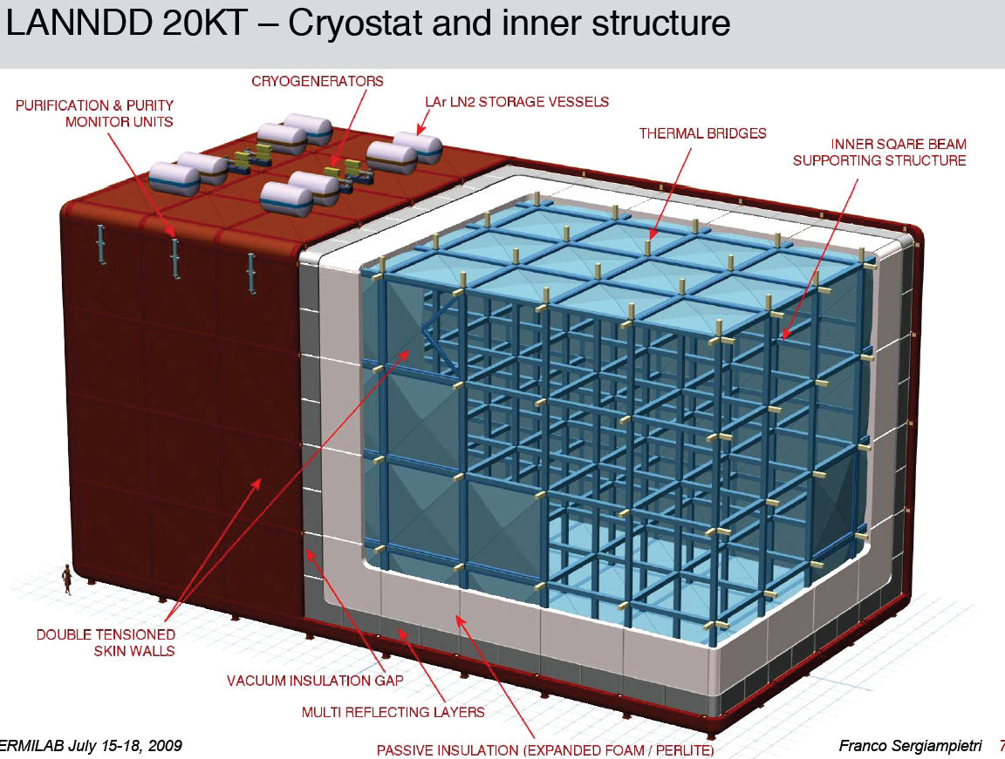
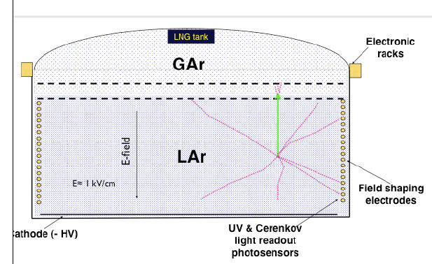
LAr
Active Programs in the Europe, Japan, Canada, UK and US
  Multiple implementation concepts being pursued
  Not part of the International R&D for a NF, per se.
Glacier
Magnetization more difficult due to
The long drift
And gaseous detectors

Slide 48
Conclusions

Slide 49
NF R&D Elevator Bullets
Proton Driver
  Someone build one
    Need proper “hooks” to allow for upgrades if necessary
Targetry
  Facility Engineering Design
Front-end
  Solve the RF “problem”
Acceleration
  Linac/RLA – lattices and transfer lines designed
    Complete tracking analysis
    Component engineering
  FFAG
    Injection and extraction – design and engineering
    Design optimization
    Cost analysis
Decay Ring
  Continue lattice and aperture studies
  Optimization – is shorter ring viable?
Please see all the talks
in WG 3 for the “Beef”

Slide 50
SuperBeams Neutrino Factory
The physics case for a Neutrino Factory is well established
How, When (if), Where we make the transition from superbeam experiments to experiments at a NF is not clear
The H,W, &W will depend on
  Physics
  Technical development
  Cost
  The landscape of the march to the Energy Frontier
    If it involves a Muon Collider, then the NF may become a natural first step
The R&D program must
  Successfully address the technical challenges (RF!)
  Cost
  And delivery a detailed plan (IDS Reference Design Report)
    On, what is now a now well-defined time scale
See You All at the First
NF Users Meeting @
NuFact13

Slide 51
Acknowledgements
  I would like to thank all my colleagues in the Neutrino Factory and Muon Collider Collaboration and in MICE, MuCool and the IDS
  Never a Dull Moment

Slide 52
BACKUP SLIDES

Slide 53
NF COST ESTIMATES
As presented to P5 in February 2008:
4 GeV NF Cost Estimate (excluding 2 MW proton source)
Unloaded estimate (M$)
Start from Study 2 cost estimate scaled to
account for post-study 2 improvements
(ranges reflect uncertainties in scaling) →
ILC analysis suggest loading coeff = 2.07
for accelerator systems and 1.32 for CFS.
Labor assumed 1.2 × M&S →
Loaded estimate = 2120 - 2670 (FY08 M$)
Target Systems | 110
Decay Channel | 6
Drift, Ph. Rot, Bunch | 112-186
Cooling Channel | 234
Pre-Acceleration | 114-180
Acceleration | 108-150
Storage Ring | 132
Site Utilities | 66-156
TOTAL (FY08 M$) | 881-1151
Front-end systems (including transverse cooling channel) which
might be common to a MC accounts for ~50% of this cost.

